Slide 1
T-Project
Physics education:
From SFB 1245 to high schools
Coordinator
Spatz, Verena
Physics Liaisons
Arcones, Almudena
Nörtershäuser, Wilfried

Slide 2
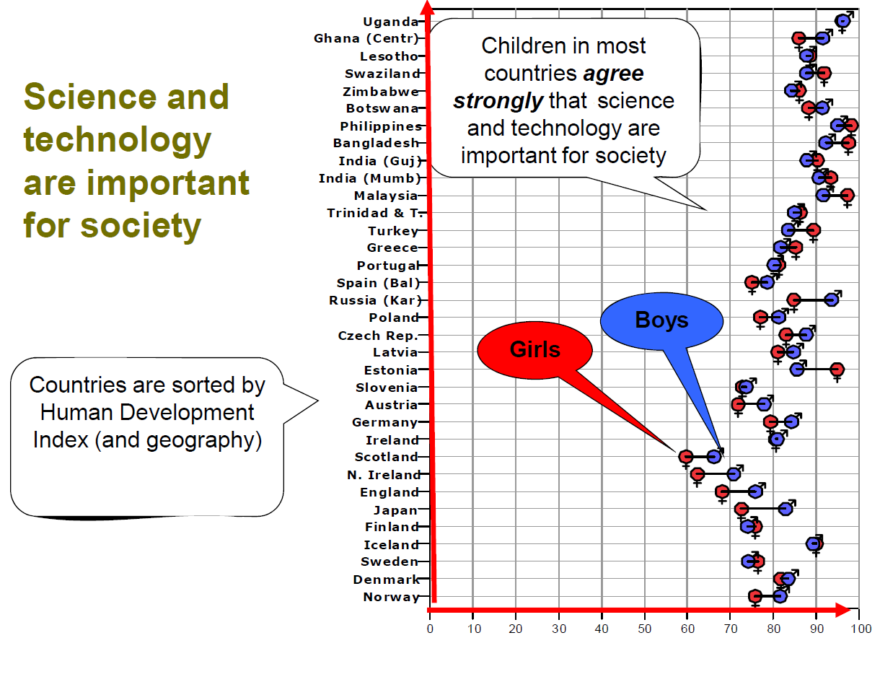
Sjøberg & Schreiner, 2010
Notes:
ROSE (The Relevance of Science Education) is an international study on factors that influence learning science and technology, with more than 40 nations involved. The ROSE study has several goals: it should, on the one hand, generate empirical findings that lead to a critical discussion of science education at national and international level. On the other hand, possible approaches should be suggested to improve the quality of science education in each country. In Germany, for example, more than 600 15-year-old students have answered the questionnaires.
…
However, the awareness of German high-school students on how science contributes to society and economy is significantly below the average of all OECD countries, as documented in the PISA surveys of 2006 and 2015.

Slide 3
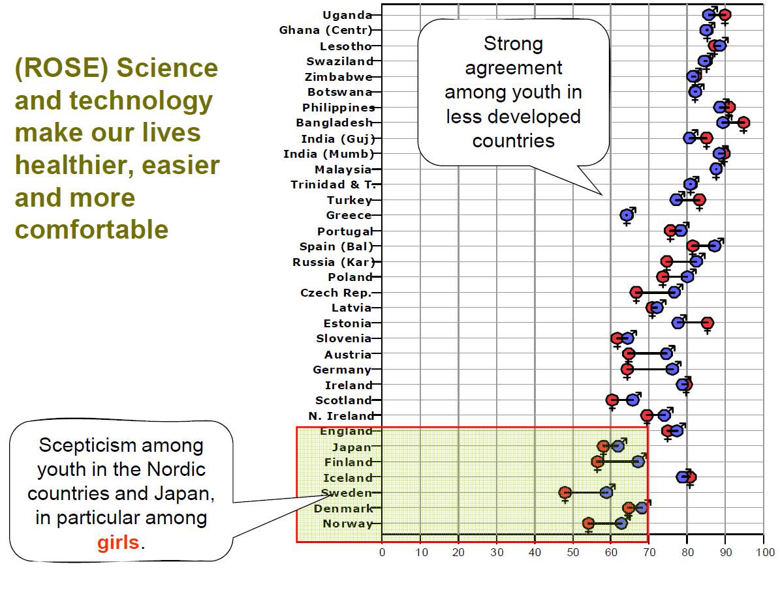
Sjøberg & Schreiner, 2010, Eurobarometer, EU 2005
Notes:
And if you ask a little further, a growing sceptisicm becomes obvious.
….
This is a question, which was also posed to adults in another survey, the Eurobarometer, so it is particularly interesting to compare the answers of students to those of adults in the individual countries.

Slide 4
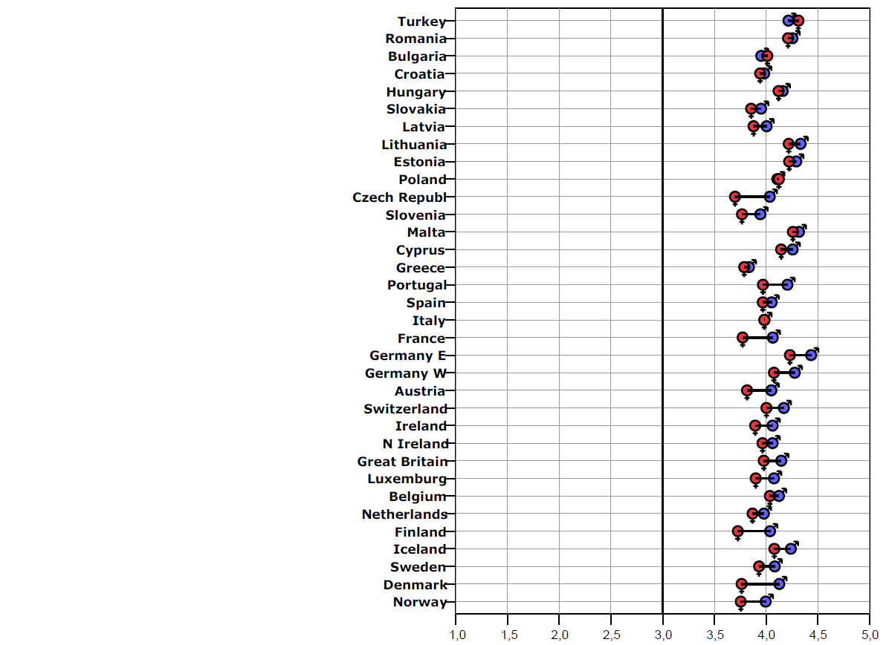
Eurobarometer
Sjøberg & Schreiner, 2010, Eurobarometer, EU 2005
Notes:
SO, we do see signs of a generation shift! While there is a wide argrement in all european countries among the adults, young people are more skeptical, with girls in particular in the richest countries, being more abivalent than boys.

Slide 5
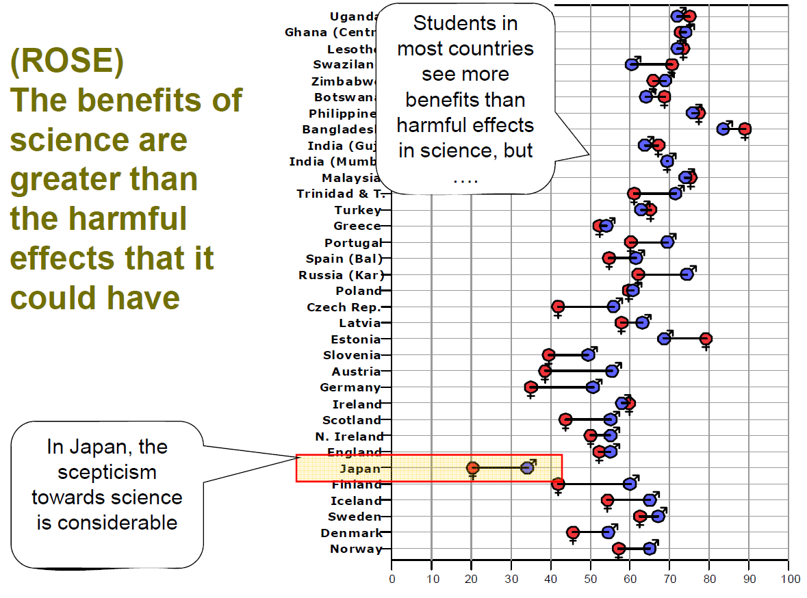
Sjøberg & Schreiner, 2010, Eurobarometer, EU 2005
Notes:
Similar pattern here
….

Slide 6
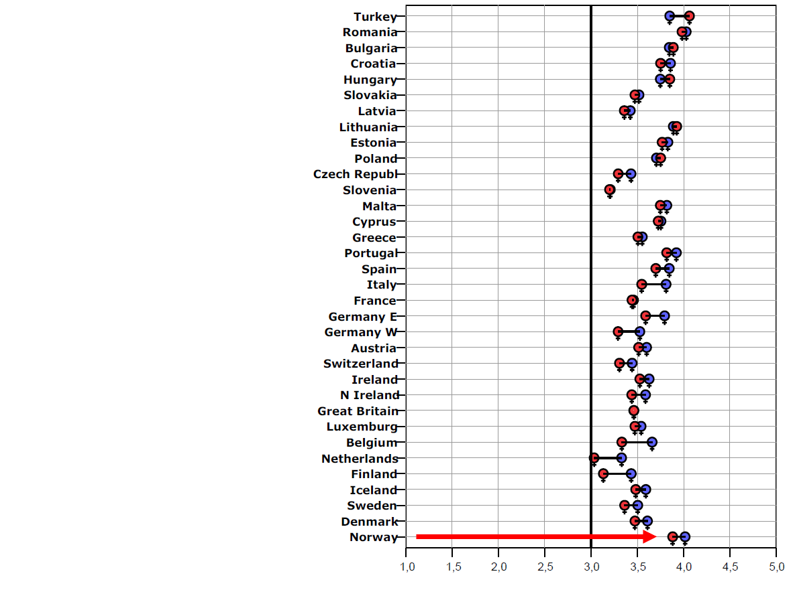
Eurobarometer
Sjøberg & Schreiner, 2010, Eurobarometer, EU 2005
Notes:
And again we see that young people, especially girls in Germany, are more pessimistic than adults.

Slide 7
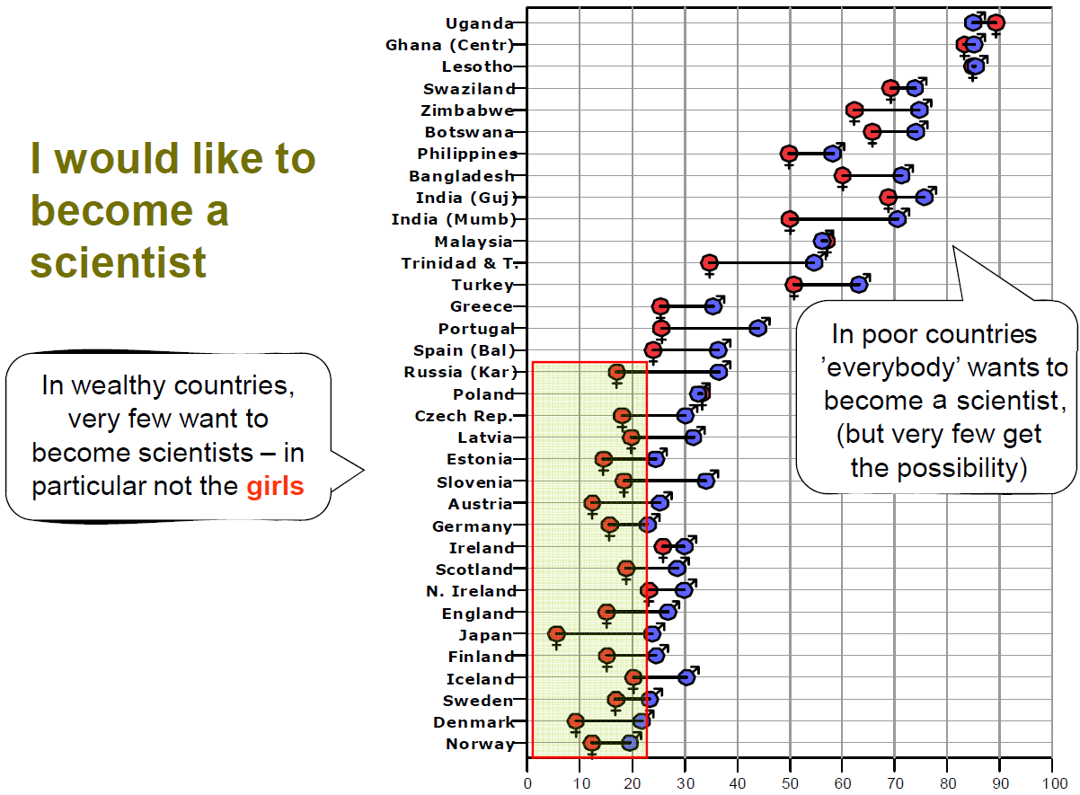
Sjøberg & Schreiner, 2010

Slide 8
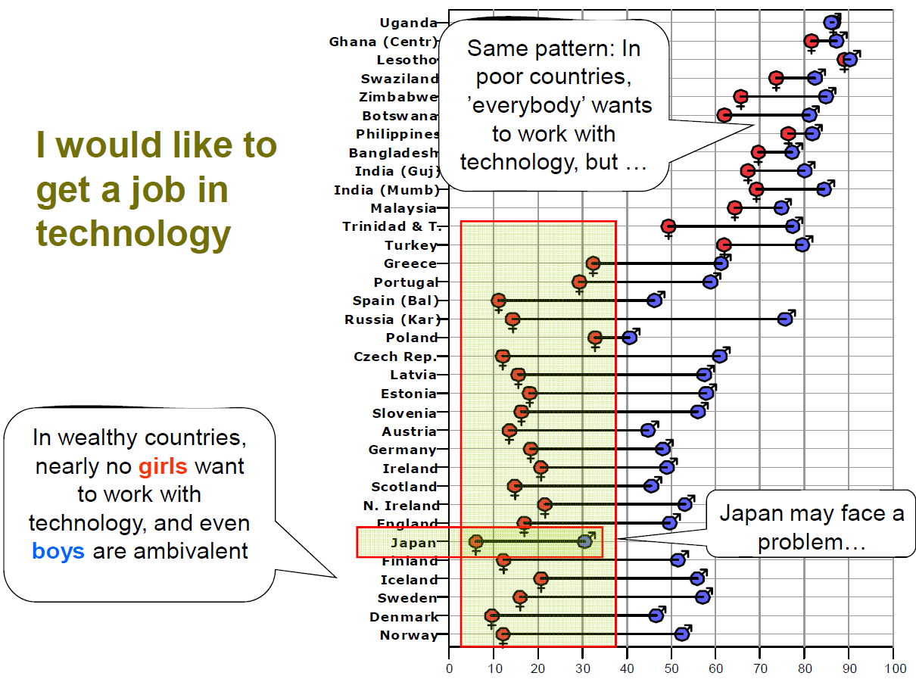
Sjøberg & Schreiner, 2010

Slide 9

Notes:
So, apparently, hurdles still exist for students, especially women, to opt for a career in science and technology, also in physics, that can be traced back to the age range of high-school students when career choices are made.

Slide 10
→ Lower the hurdles to opt for a career in science!
Notes:
And during that presentation, I would like to trace some and suggest measures to lower them.

Slide 11
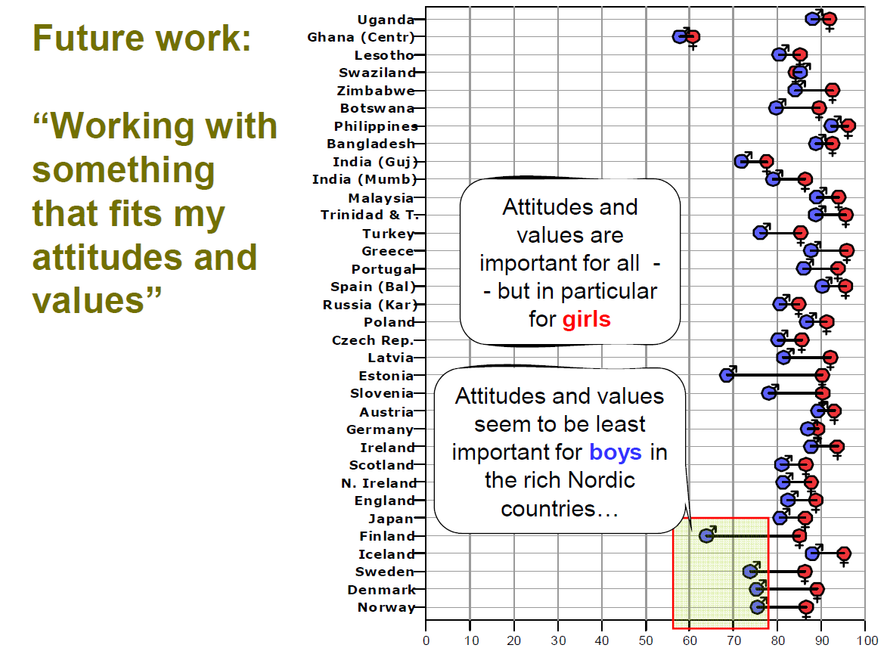
Sjøberg & Schreiner, 2010
Notes:
So, what is it that students imagine for their future work? What do they want to do?
…

Slide 12
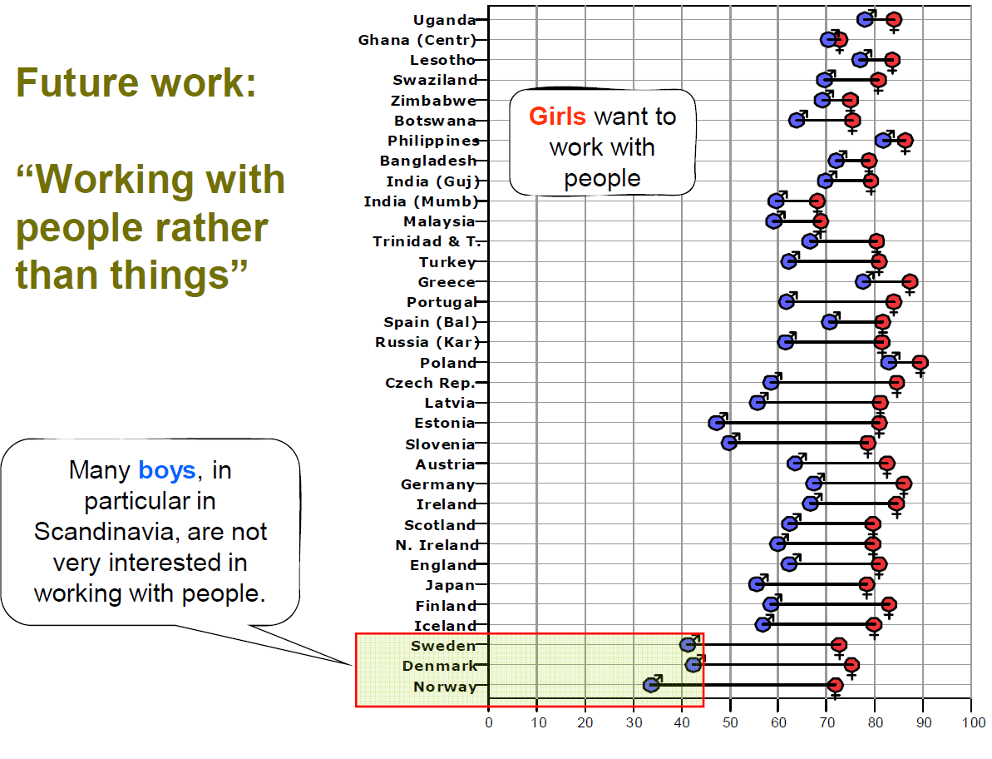
Sjøberg & Schreiner, 2010

Slide 13
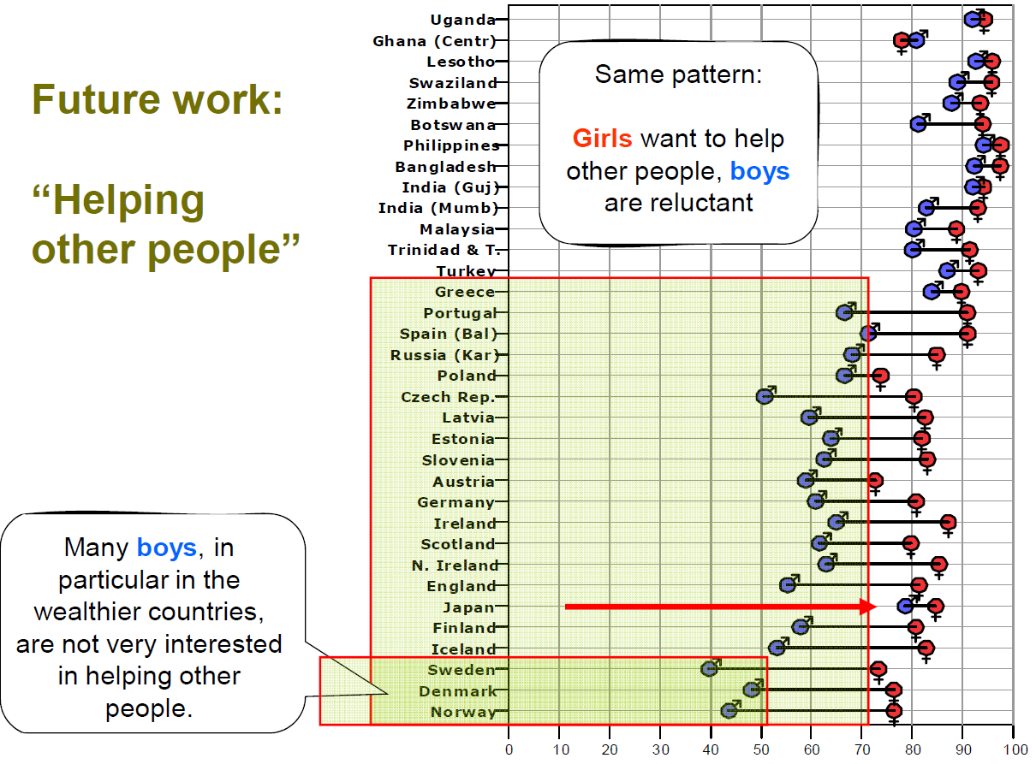
Sjøberg & Schreiner, 2010

Slide 14
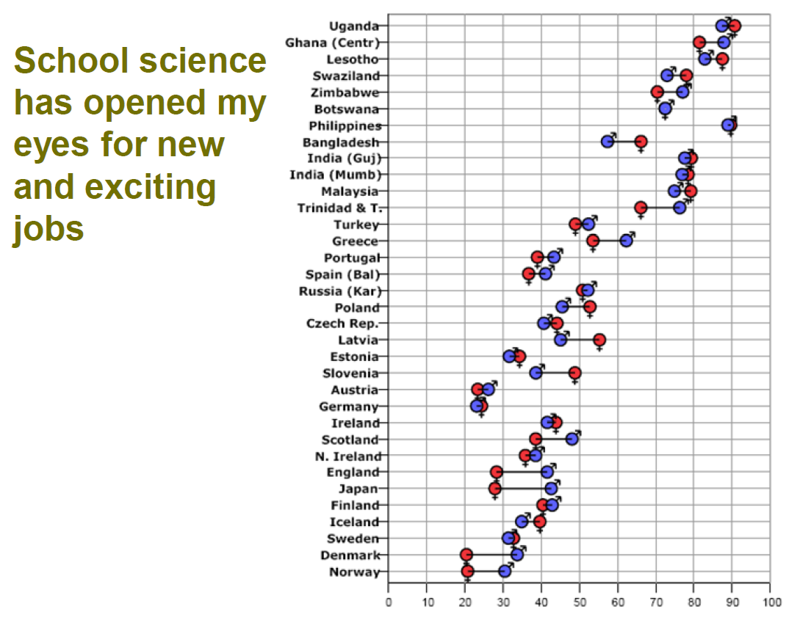
Sjøberg & Schreiner, 2010
Notes:
So have the science lessons, that students have experienced during many years at school opened their eyes for new and exciting jobs? – No!

Slide 15

Notes:
So students are not aware that there are such new and exciting jobs in physics, for example!

Slide 16
→ Open students’ eyes for new and exciting jobs in physics!
Notes:
And we really need to open their eyes in this regard.

Slide 17
Interest
ROSE survey / PISA survey:
students are interested in learning science
BUT: gender differences are greater than the OECD average
Sjøberg & Schreiner, 2010; Holstermann & Bögeholz, 2007; Elster, 2007; OECD, 2016
Notes:
SO lets stick a little longer to the question, how students experience their science lessons at school.
In the ROSE survey, a majority of the students agreed with the statement: “Science lessons are interesting.”
Also in the PISA survey of 2015 a majority of the students report a personal interest in learning science.
However, this proportion is higher among the boys than among the girls.
And in Germany these gender differences are greater than the OECD average. The difference between the proportion of boys and the proportion of girls who agreed with the statement "I like having new knowledge in science" is 17 percentage points (OECD average: 4 percentage points).

Slide 18
Interest
Boys are more interested in physics and chemistry,
girls prefer biology.
Duit, 1997; Krapp, 1998
Their interest is decreasing during their school history.
Hoffmann & Lehrke, 1986, Elster, 2005
Notes:
Also other empirical studies prove that the interest of girls and boys is age- and sex-dependent.
…
Even those learners who are interested justify their motivation mostly extrinsic e.g. to pass an exam.

Slide 19
Interest
The challenge for teaching is to catch "situational interest" and "hold" it for so long that “individual interest” in science (in class, as well as in further education and professions) can arises.
Krapp 2002; Alexander & Jetton 1996
Krapp, 2002
Interest of the student
Situational interest
Individual interest
Interestingness of the subject
(content, context)
Notes:
BUT interest is a crucial factor for the learning process:
If the learner is interested in the subject, he gets more involved with the content and this in turn allows a deeper understanding and transfer.
Interest in a specific situation is depend not only on … but also on …
…
Even if we can not influence the interests students come to class with, we certainly have an influence on the interests young people leave school with.

Slide 20
Interest
combination of content and context as a key factor :
Scientific contents can once again be brought into the focus of the learners, if they are embedded in contexts that are interesting and relevant for them.
Sjøberg, 2000; Hoffmann, Häußler, Lehrke,1998; Sjøberg & Schreiner, 2010
Notes:
Example: The content "light, colors, radiation" could be embedded
• in the context of health:
"How radiation affects the human body. “
• in the context of mysticism :
"Light around us, that we do not see.“
• in the context of zoology:
"How animals use colors to hide or to warn.“
• or in the context of technology:
"The use of the laser in engineering. "

Slide 21
Interest
Which are such interesting and relevant contexts?

Slide 22
IPN interest study
Physics and Technology
Humans and Nature
Society
Notes:
In the IPN interest study, three context areas could be deduced…
Physics and Technology: This area focuses on pure physics without applications or contexts.
Humans and Nature: This area on the other hand deals with applications of physics (e.g. in medicine), the explanations of (natural) phenomena, as well as the human body.
Society: This area deals with the social significance of physics and technology, as well as social developments initiated by physics and technology.

Slide 23
IPN interest study
Type A
20%, mostly males
Physics and Technology
Humans and Nature
Society
Notes:
Three types of students could be identified:
Type A: This type is interested in all areas. about 20%, mostly males: They usually have relatively good grades and a high self-confidence in their own abilities in physics.

Slide 24
IPN interest study
Type A
20%, mostly males
Type B
55%, males a. females
Physics and Technology
Humans and Nature
Society
Notes:
Type B: The main interest of this type lies in the area of humans and nature. about 55% males and females! This type includes most students. They have rather mediocre grades and a low self-confidence in their own abilities. These students are interested in natural phenomena, and also in how physics benefits society.

Slide 25
IPN interest study
Type A
20%, mostly males
Type B
55%, males a. females
Type C
25%, mostly females
Physics and Technology
Humans and Nature
Society
Notes:
Type C: The interest of this type is mainly in the area of societyand partly in the field of humans and nature. About 25%, mostly females. Students in this have rather poor grades and a low self-confidence.
SO, there seems to be a need to humanize school sience, to show that science is part of human history and culture, and that it is a corner stone in our present, modern world-view.

Slide 26
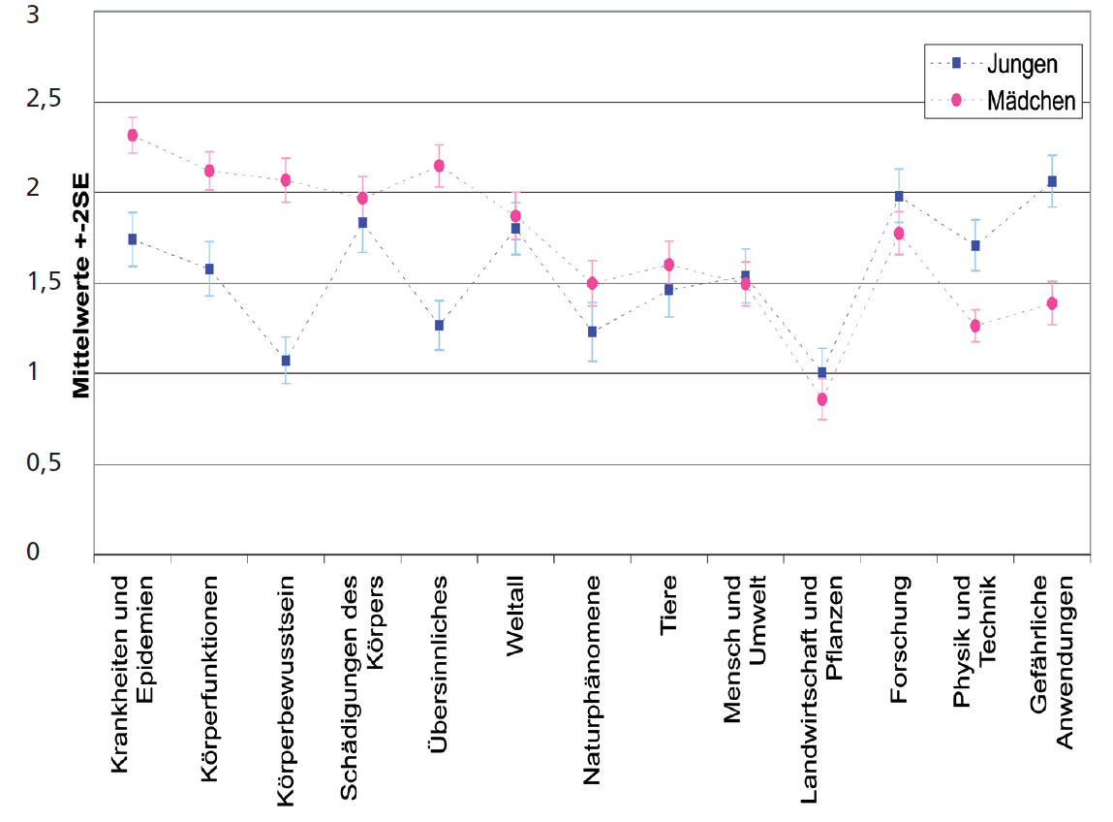
ROSE study
Mean +- 2SD
boys
girls
Ref. ZfdN ROSE paper
Ilnesses and Epidemics
Bodily functions
Body awareness
Damages of the body
Paranormal phenomena
Space
Natural phenomena
Animals
Humans and Environment
Agriculture and Plants
Research
Physics and Technology
Dangerous applications
Notes:
And also in the ROSE study one of the questions was: What I would like to learn about…
Resulst of German students‘ interest in various contexts are shown on this diagram.
The fact that boys are interested in technology as well as in dangerous applications is in line with the findings of the IPN study. Similarly, the low interest of girls for these topics. However, these data also show that girls, albeit a bit less than boys, are interested in aspects of research.
Research:
Inventions and discoveries that have changed the world.
Great failures and mistakes in research and inventions.
The latest inventions and discoveries in science and technology.
Phenomena that scientists still can not explain.

Slide 27
Conclusion
„In essence, the vision that (traditional) school science offers is a backward-looking view of the well-established scientific landscape, whereas, in contrast, what appeals to and excites students is the „white head“ of the technological future offered by science. In short, to capitalize on students‘ interests, school science needs to be less retrospective and more prospective.“
Osborne et al, 2003, p. 1062

Slide 28
Conclusion
→ to lower the hurdles to opt for a career in science, and
→ to open students’ eyes for new and exciting jobs in physics

Slide 29


Conclusion
→ to lower the hurdles to opt for a career in science, and
→ to open students’ eyes for new and exciting jobs in physics
We will transfer the excitement for physics developments in the area of our SFB 1245 to high school students, particularly also to female students and combine it with a physics education evaluation of its impact and further improvement.

Slide 30
Conclusion
We will design an afternoon course for high schools, which explains the physics at the heart of SFB 1245 research in age-appropriate terms.
We will emphasize the fundamental character of the scientific view of the world, and thus raise the awareness of the benefits of fundamental research for society and the economy.
Notes:
Thus, we will initiate more lasting result than just knowledge, such as an increased interest in physics and more positive attitudes towards physics.
This in turn will lead all students to engage in science related issues as reflective citizens. And it will lead some to decide for a career in physics.

Slide 31
“For future citizens in a democratic society, understanding the interrelationships of science, technology and society may be as important as understanding the concepts and processes of science.”
Gallagher, 1971, p. 337
Notes:
As early as 1971 in the journal Science Education, Jim Gallagher proposed a new goal for school science:
“For future citizens in a democratic society, understanding the interrelationships of science, technology and society may be as important as understanding the concepts and processes of science. (p. 337)”

