Slide 1



















Basics of phase-field brittle fracture model

Slide 2























Basics of phase-field brittle fracture model

Slide 3

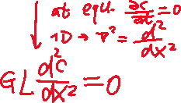

Basics of phase-field brittle fracture model

Slide 4
Basics of phase-field brittle fracture model

Slide 5
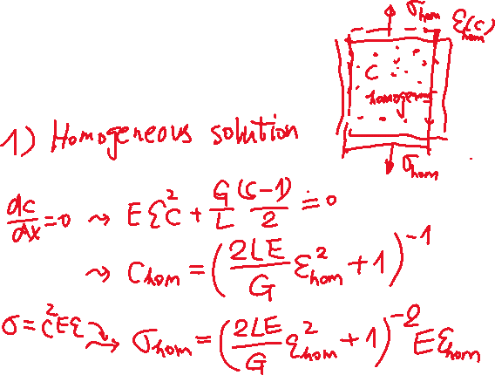
Basics of phase-field brittle fracture model

Slide 6





Basics of phase-field brittle fracture model

Slide 7



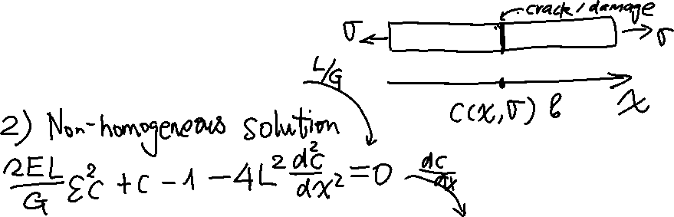
Basics of phase-field brittle fracture model

Slide 8

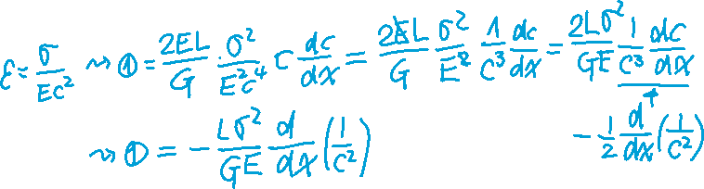


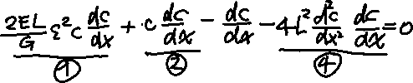
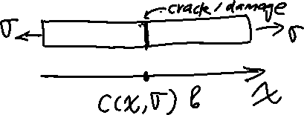





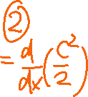




Basics of phase-field brittle fracture model

Slide 9
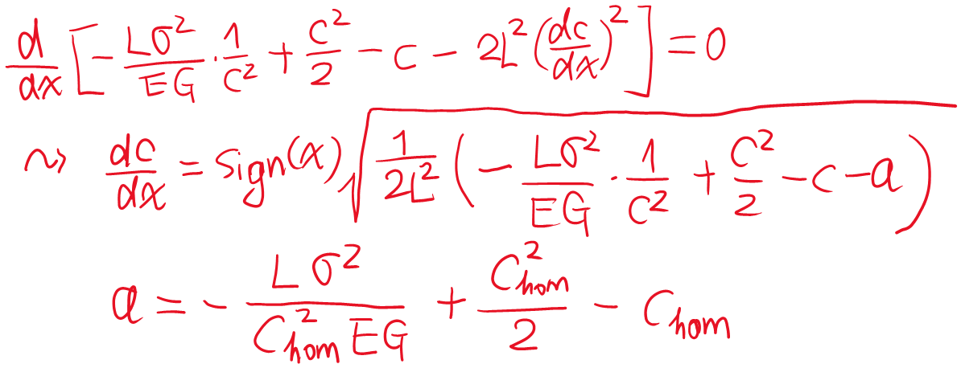
Basics of phase-field brittle fracture model

Slide 10
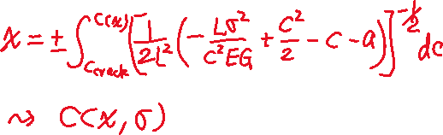
Basics of phase-field brittle fracture model

Slide 11
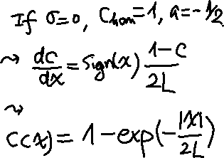
Basics of phase-field brittle fracture model

Slide 12








Basics of phase-field brittle fracture model

