Slide 1

II. Fundamentals of Continuum Mechancis
Supplimentary slides

Slide 2
2.1 Conventions and Theorem
Please refer to the mansucript for more details. Feel free to ask questions in Q & A session in Zoom.

Slide 3

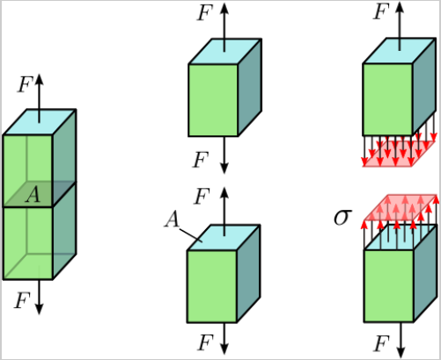
2.2 Stress
Stress vector
Normal stress

Slide 4

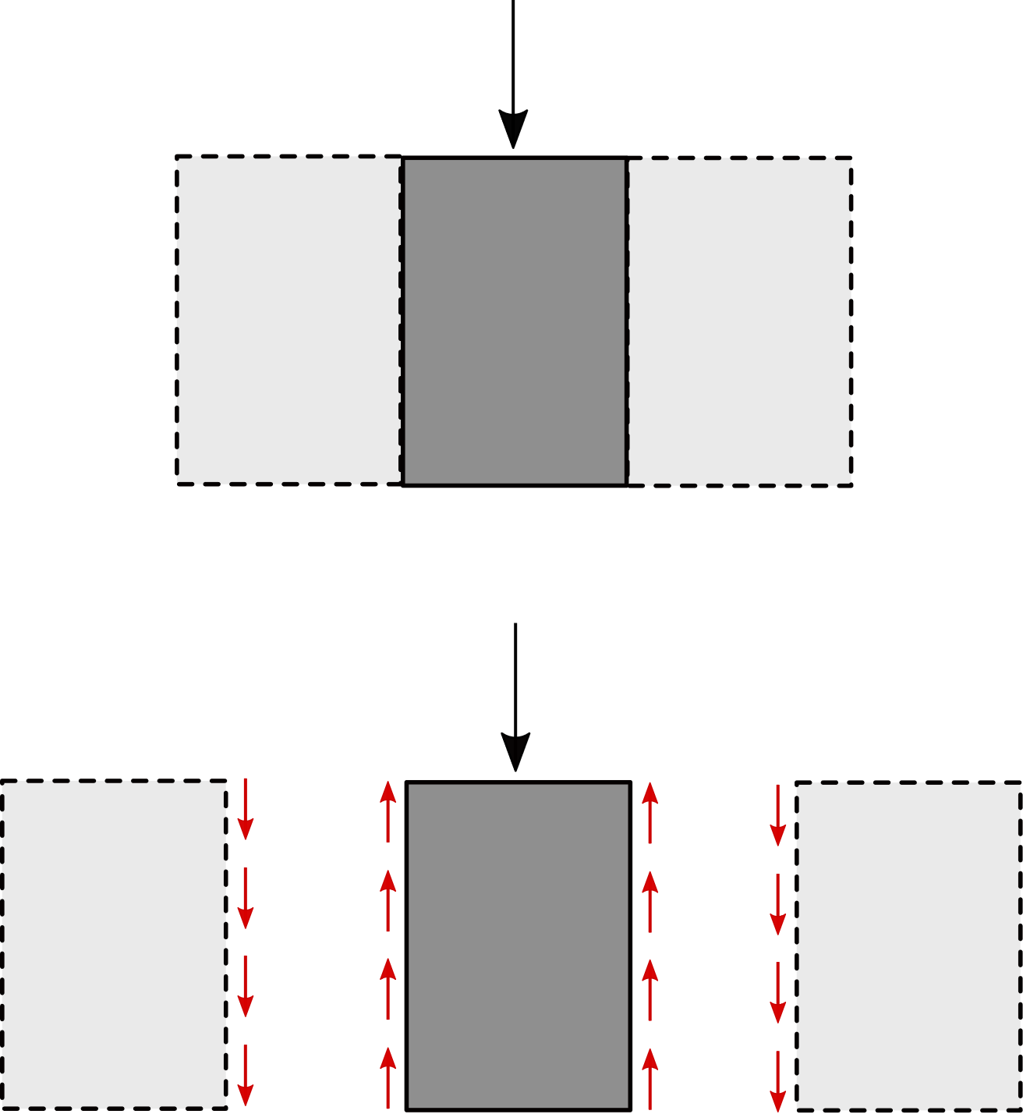


2.2 Stress
Stress vector
Shear stress
$$F$$
$$F$$

Slide 5
2.2 Stress
Stress vector
Stress vector at a material point:
Decomposition of the stress vector:

Slide 6
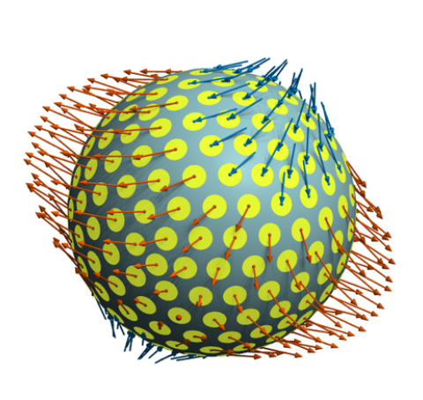
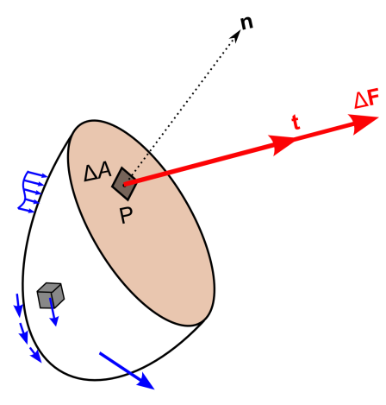
2.2 Stress
Stress vector
Stress vectors on different cross sections at one point

Slide 7
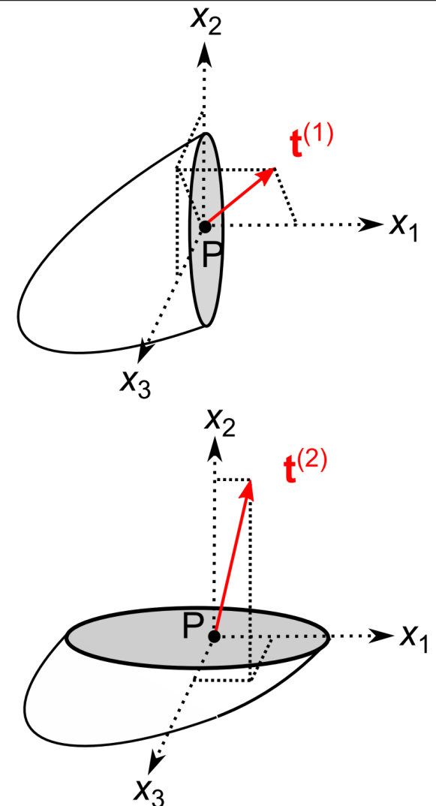
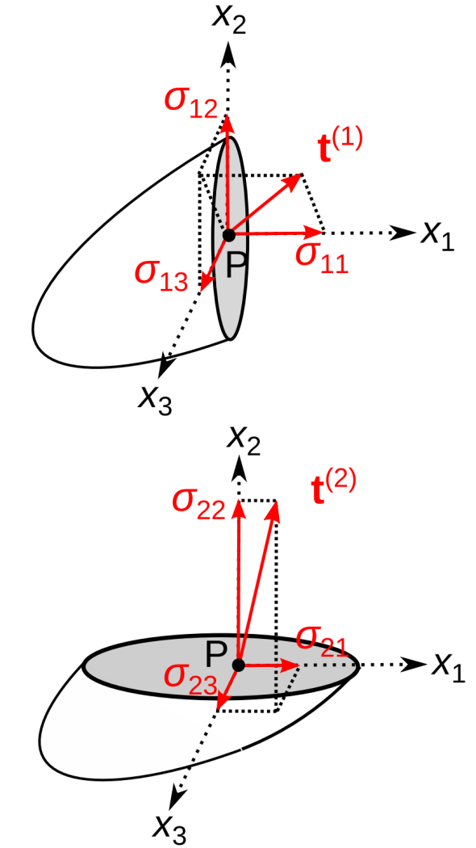
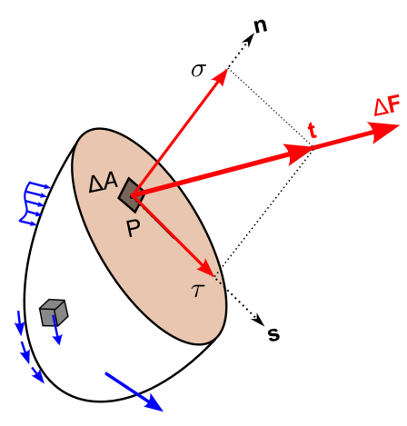
2.2 Stress
Stress tensor
Stress vectors

Slide 8
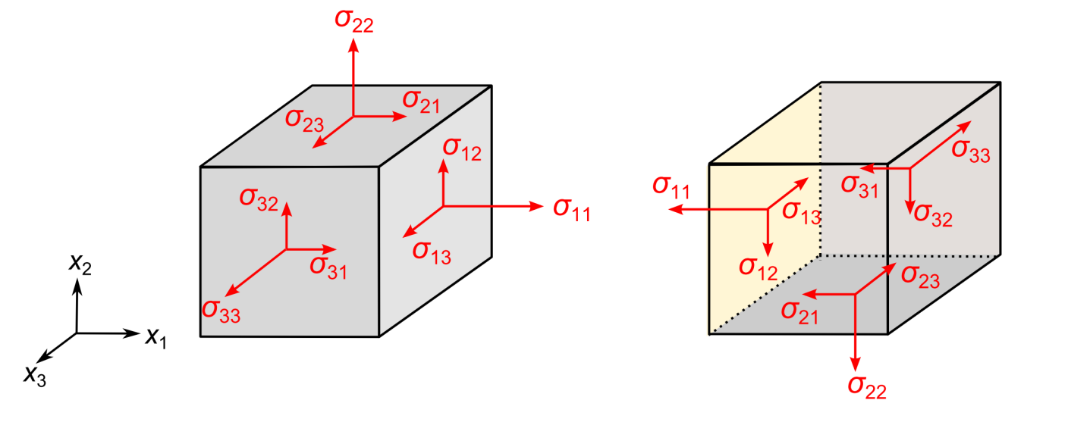
2.2 Stress
Stress tensor
Stress components in three perpenticular cross sections.
Alternatively we can write all the components in one matrix

Slide 9
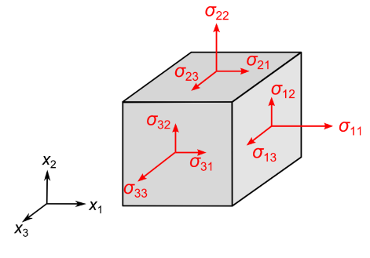
2.2 Stress
Stress tensor
Comments
Double indices notation: the first index describes the direction of the normal vector of the cross section, while the second indicates the direction of the stress component itself.
Symmetry of the stress tensor, and thus also the symmetry of the matrix: This is due to the momentum balance, the shear components in two perpenticular sections.

Slide 10
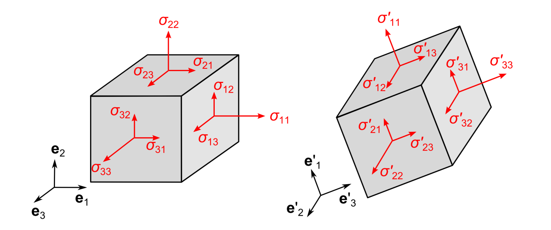




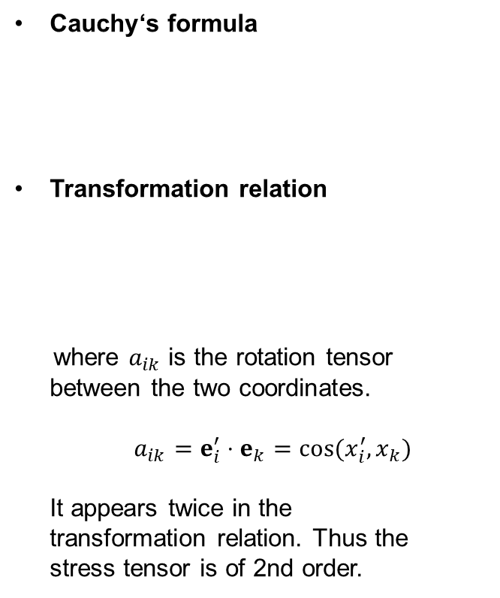


2.2 Stress
Stress tensor
Cauchy‘s formula
Transformation relation
where $a_{ik}$ is the rotation tensor
between the two coordinates.
$a_{ik}=e_{i}^{′}⋅e_{k}=cos⁡(x_{i}^{′},x_{k})$
It appears twice in the
transformation relation. Thus the
stress tensor is of 2nd order.

Slide 11
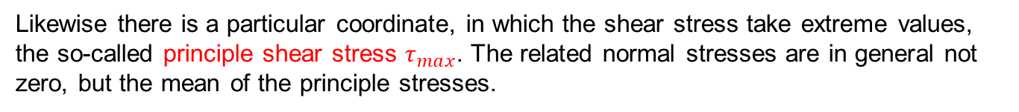
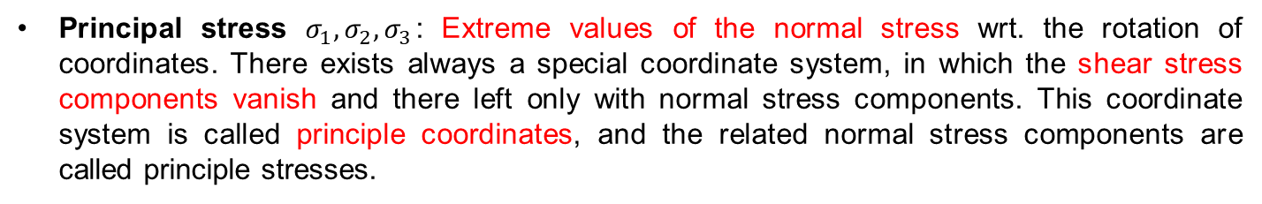
2.2 Stress
Stress tensor
Principal stress $σ_{1}, σ_{2},σ_{3}$: Extreme values of the normal stress wrt. the rotation of coordinates. There exists always a special coordinate system, in which the shear stress components vanish and there left only with normal stress components. This coordinate system is called principle coordinates, and the related normal stress components are called principle stresses.
Likewise there is a particular coordinate, in which the shear stress take extreme values, the so-called principle shear stress $τ_{max}$. The related normal stresses are in general not zero, but the mean of the principle stresses.
The related normal stresses are in general not zero, but the mean of the principle stresses.

Slide 12
2.2 Stress
Stress tensor
Invariants: quantities which do not change during rotation of coordinates

Slide 13
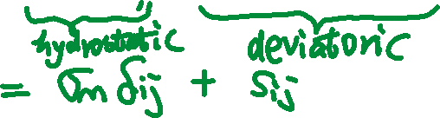
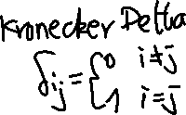

2.2 Stress
Stress tensor
Decomposition of the stress state into the hydrostatic state and the deviatoric state
The second invariant of the stress deviator:

Slide 14
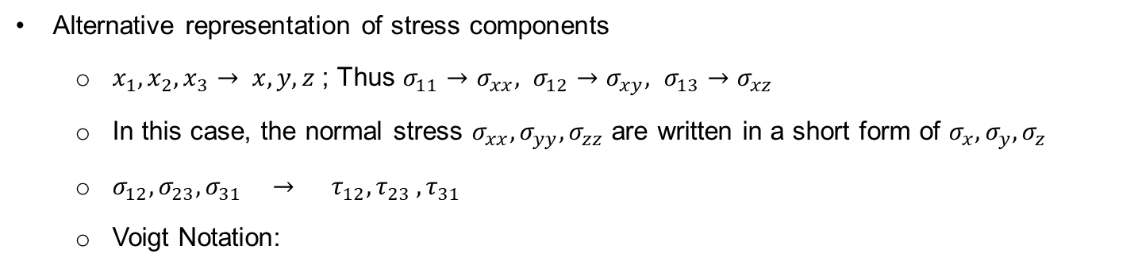
2.2 Stress
Stress tensor
Alternative representation of stress components
  $x_{1},x_{2},x_{3}→ x,y,z$ ; Thus $σ_{11}→σ_{xx}, σ_{12}→σ_{xy}, σ_{13}→σ_{xz}$
  In this case, the normal stress $σ_{xx}, σ_{yy}, σ_{zz}$ are written in a short form of $σ_{x}, σ_{y}, σ_{z}$
  $σ_{12}, σ_{23}, σ_{31} → τ_{12}, τ_{23 },τ_{31}$
  Voigt Notation:

Slide 15
2.2 Stress
Stress tensor
The stress tensor in 2D and its analysis:
in principle axis
$\left[σ_{ij}\right]={\left[\begin{matrix}σ_{x} & τ_{xy} \\ τ_{yx} & σ_{y}\end{matrix}\right]}_{xy−co.}=$ ${\left[\begin{matrix}σ_{ξ} & τ_{ξη} \\ τ_{ηξ} & σ_{η}\end{matrix}\right]}_{ξη−co.}={\left[\begin{matrix}σ_{1} & 0 \\ 0 & σ_{2}\end{matrix}\right]}_{principle co.}$

Slide 16


2.2 Stress
Stress tensor
The stress tensor in 2D and its analysis:
$a_{ik}=cos⁡(e_{i}^{′}⋅e_{k})$
$$= \left[\begin{matrix}\cos{θ} & \sin{θ} \\ −\sin{θ} & \cos{θ}\end{matrix}\right]$$

Slide 17
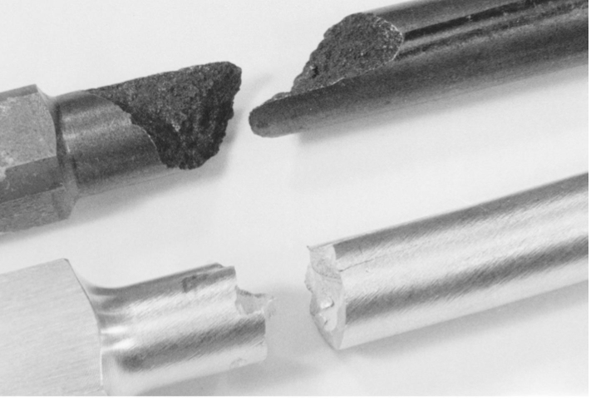
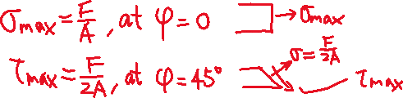
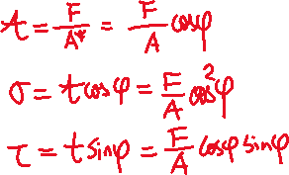
2.2 Stress
Stress analysis
Uniaxial tension test:
Brittle materials fracture along vertical cross section
Ductile materials fracture along 45 degree
Torsion test
Brittle materials fracture along 45 degree
Ductile material fracture along vertical cross section

