Slide 1
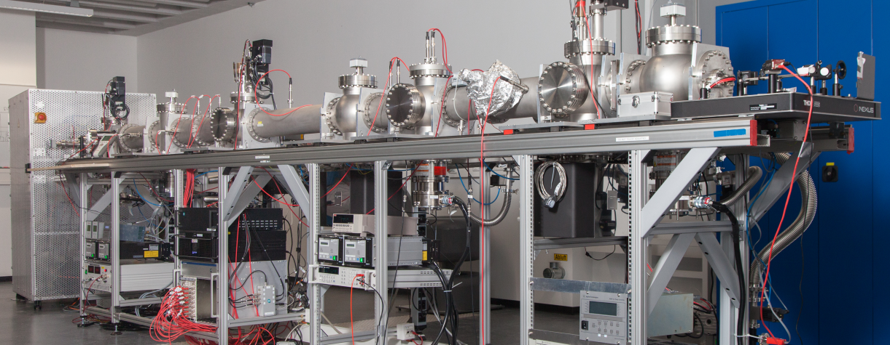
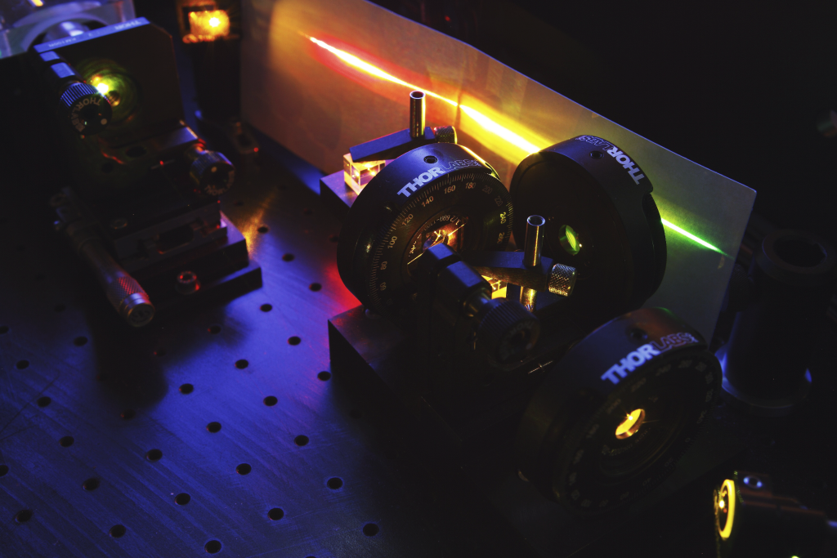
High precision collinear laser spectroscopy – towards the measurement of absolute nuclear charge radii
SFB Workshop 2018

Slide 2
Nuclear charge radius
Mean square charge radius:
Electron Scattering
Makes directly accessible
model dependence
rel. large systematic uncertainties compared to optical meas.
Muonic Spectroscopy
Large influence of CR on muonic spec.
Model independent
only stable and light isotopes (with laser)
Collinear Laserspec.
model independent
also exotic isotopes
small CR influence
provides
Combined Analysis
Nuclear charge radius

Slide 3
Nuclear charge radii purely from collinear laser spectroscopy?
E
r
Field Shift:
p
Electronic Factor
(→ Wavefunction)
Nuclear
Size
s
Requirements
Few electron system where and can be calculated
High-precision measurement of with CLS in <1 MHz regime
→ Barium measurements @ KOALA, IKP, TU Darmstadt

Slide 4
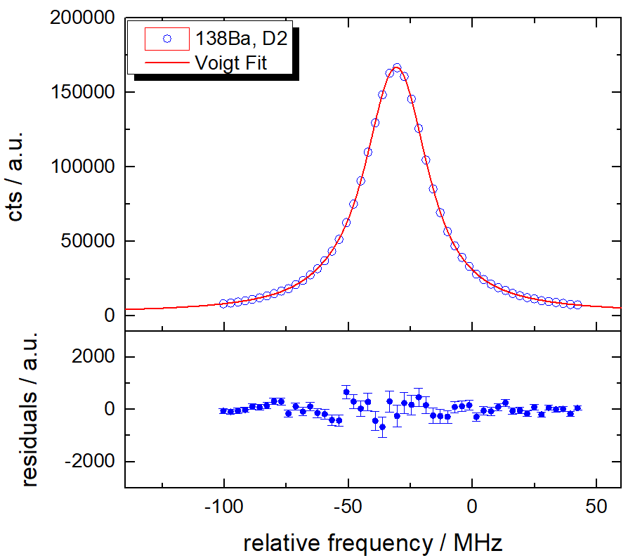
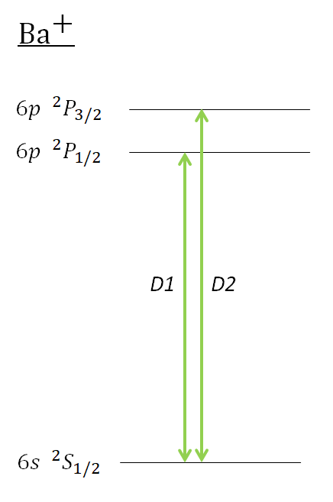
Measuring principle @ KOALA, TU Darmstadt
PO
PO
FC
FC
$$ΔU_{offset }$$

Slide 5
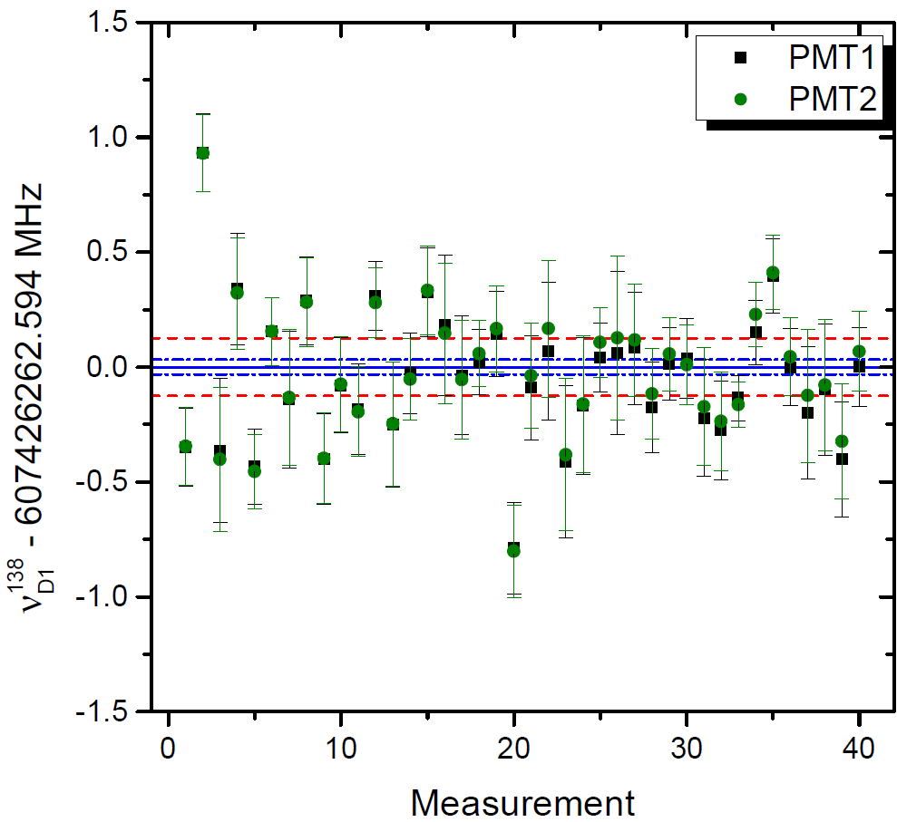
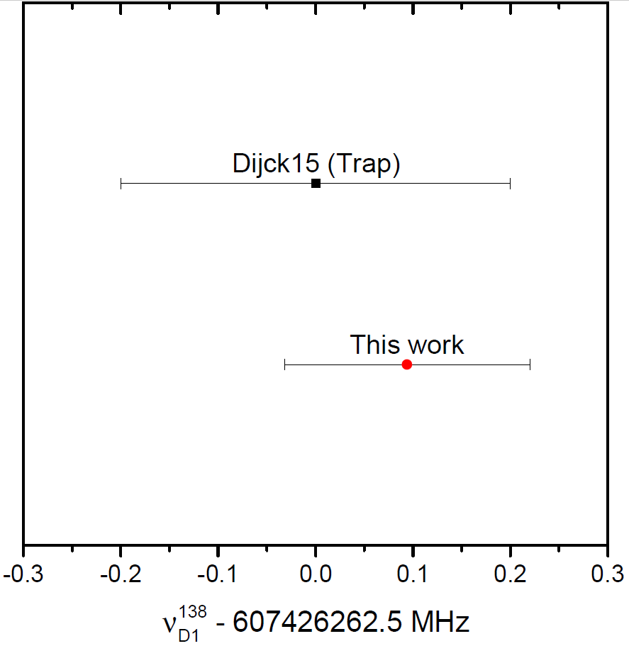
Accuracy benchmark with ${ ^{138}\text{Ba}}^{+}$
measured in trap with 0.2 MHz uncertainty [2]
→ most accurate measurement of an optical transition frequency obtained by collinear laser spectroscopy!
Our value:
[2] Dijck et al., Phys. Rev. A, 91:060501, (2015)

Slide 6
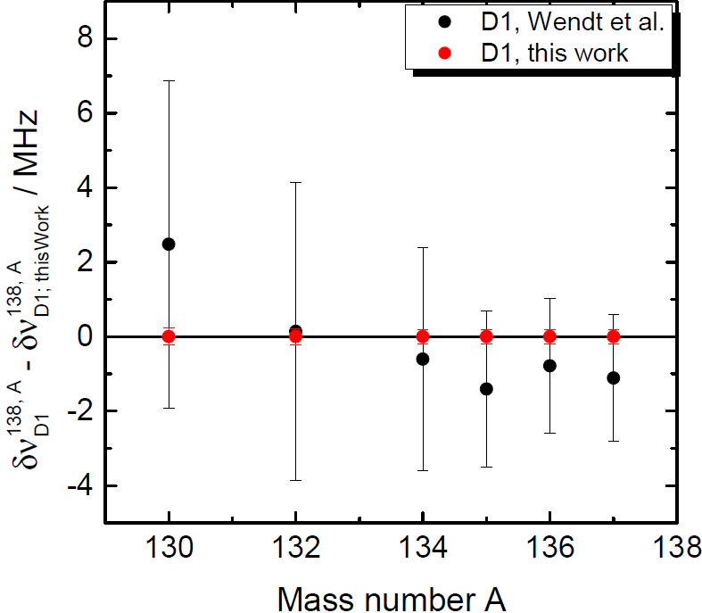
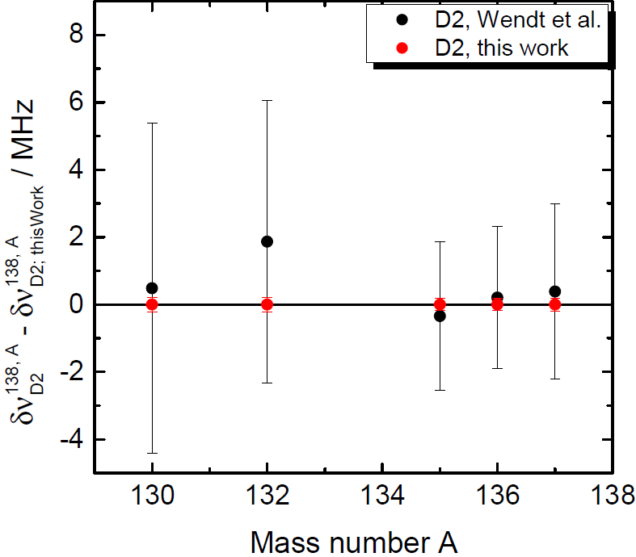
Comparison of isotope shift accuracy
[3] Wendt et al., Z. Pyhs. A, 318:125-129 (1984)

Slide 7
Conclusion & Outlook
Requirements
Few electron system where and can be calculated → ongoing effort by Pachucki et al., but ready in next few years
High-precision measurement of with CLS in <1 MHz regime → Very promising results for Z = 56, precision transfer to Z = 3 – 6 needed
Possible/interesting candidates
${\text{B}}^{3+}$
${\text{Be}}^{2+}$
${\text{C}}^{4+}$
Upcoming improvements at KOALA:
Higher laser frequency stability through frequency comb stabilization
Full automation of the measurement process
Further reduction of stray light

Slide 8
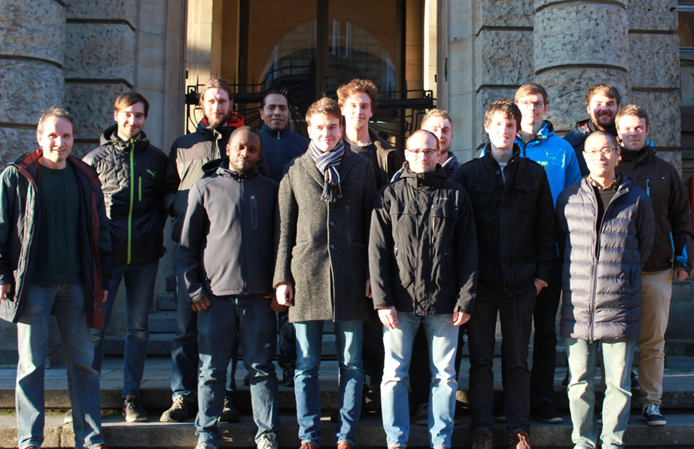
Thank you for your attention!
Funded by:

Slide 10
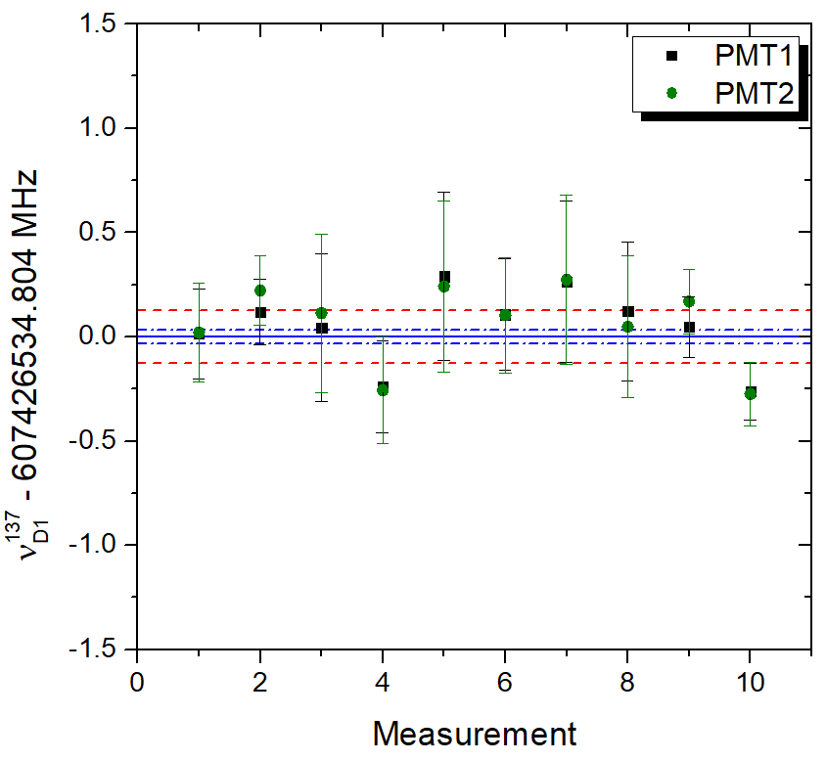
Determination of $ν_{0}$ & Uncertainties
Measurement of $ν_{0}$ was repeated usually 10 times
Evaluation of $ν_{0}$ separately for PMT1&PMT2 → final $ν_{0}$ is the weighted average of all values
Statistical uncertainties:
Error of mean or error propagation → the larger of the two values
Systematic uncertainties:
Angle between laser beams (100 kHz)
Asymmetric line shape (70 kHz)
Voltage dependence only in hyperfine spectra (60 kHz)

Slide 11
Outline
Introduction & Motivation
Measuring principle & setup
Determination of the transition frequencies & their uncertainties
Isotope shift & King plot procedure
Conclusion & outlook

Slide 12
Introduction & Motivation
Isotope shift:
Mass shift
Field shift
Applications:
Nuclear charge radii / Halo nuclei
Ancient isotopic composition
Spatial or temporal change of α
Discovery of a new boson
→ Atomic structure calculations needed
E
r
p
s

Slide 13
Introduction & Motivation
Field shift ratio:
Lower boundary: Non-relativistic limit $f$ → 1
J-Dependence: $f$ > 1
Upper boundary: Hydrogenic approximation Theory ${\text{Ca}}^{+}$: 1.0051, Experiment ${\text{Ca}}^{+}$: 1.0085(12)
⇒ $f$ exceeded upper boundary significantly in ${\text{Ca}}^{+}$
→ rest-frame transition frequency of D1 and D2 line
for all stable Ba isotope in order to access
the isotope shift and to derive $f$

Slide 14
Collinear and anticollinear laser system
ν - Comb
Feedback
TC
To Beamline
ν - Doubler
Matisse Ti:Sa
Shutter
Pump laser
Pump laser
Matisse Ti:Sa
Feedback
WM

Slide 15
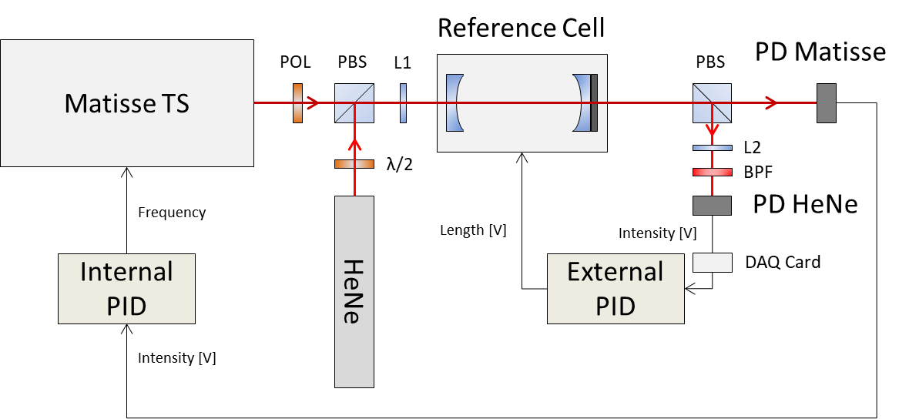
Setup of the transfer cavity

Slide 16
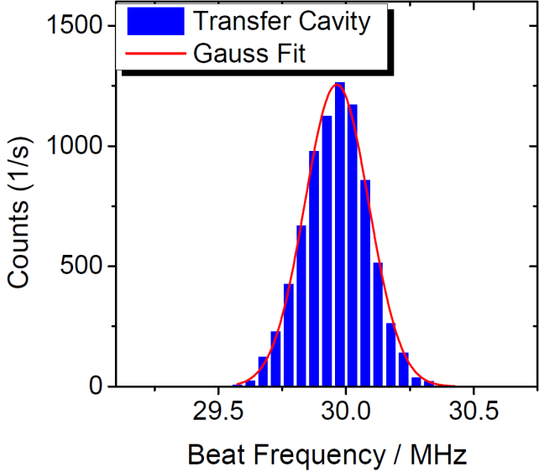
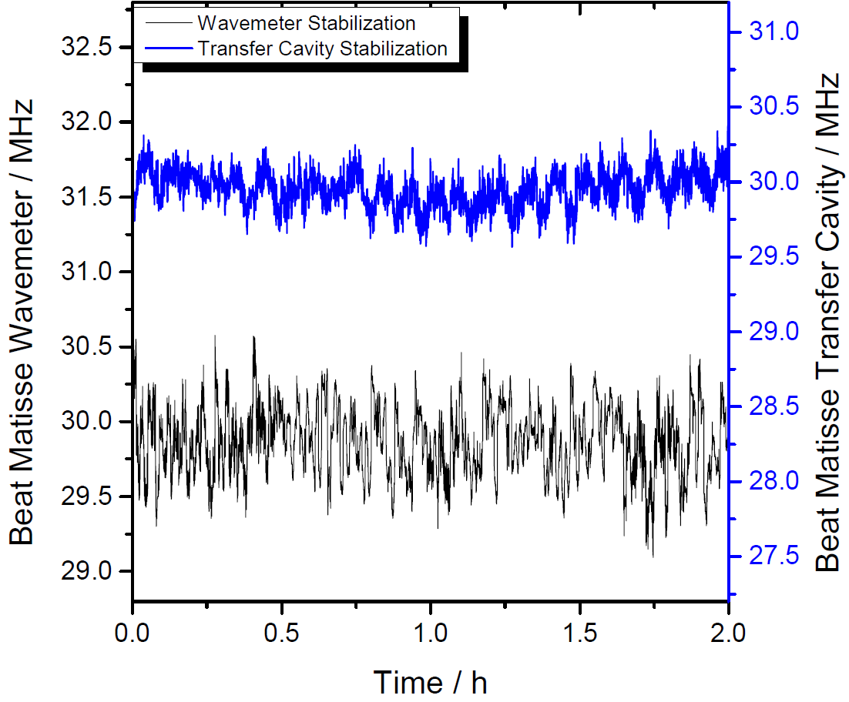
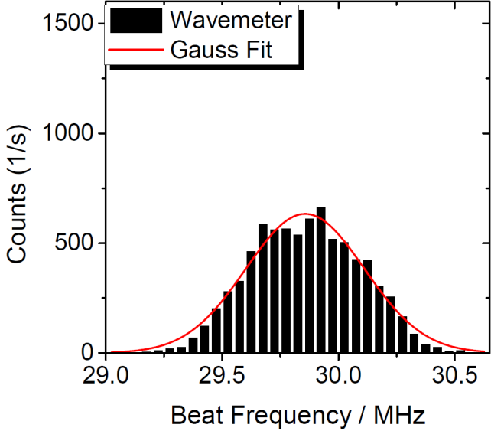
Frequency stability of the laser systems
→ laser system is ready for collinear laser spectroscopy!

Slide 17
Angle between ion and laser beams
Two extreme cases:
Ion beam
Col. laser
Acol. laser
Collinear laser frequency less blue-shifted
Anti-collinear laser frequency less red-shifted
⇒ Effect on $ν_{0}$ is negligible
Only one laser frequency is shifted
⇒ Can lead to a significant shift of $ν_{0}$
⇒ Investigation of influence needed

Slide 18
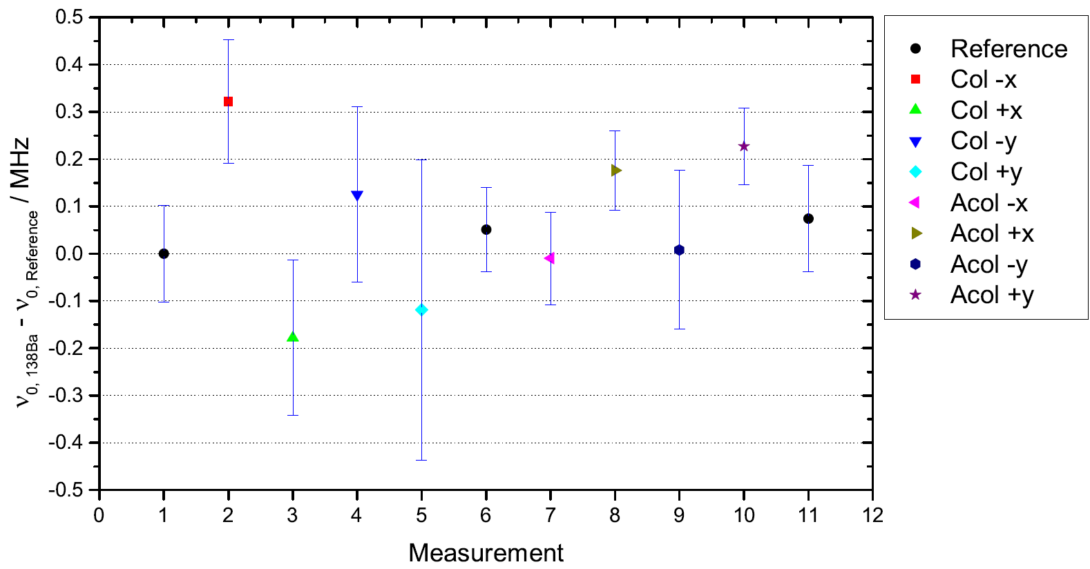
Angle between laser beams
During investigation:
6 mm
During experiment:
10 mm
3 mm

Slide 19
King plot analysis
For two transitions:
→ Straight line with slope $f$

Slide 20
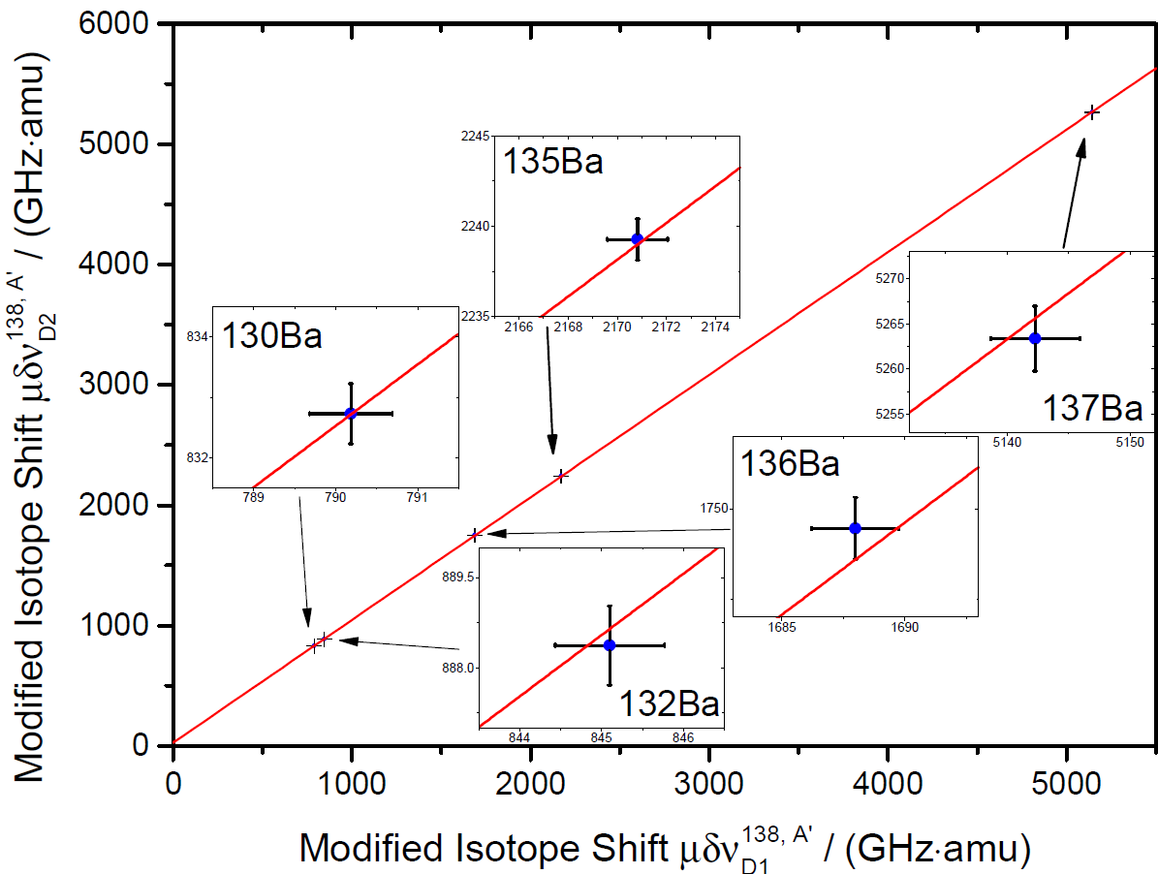
Determination of $f$ through King plot
slope:
→ More precise than
${\text{Ca}}^{\text{+}}$ (trap) value!

Slide 21
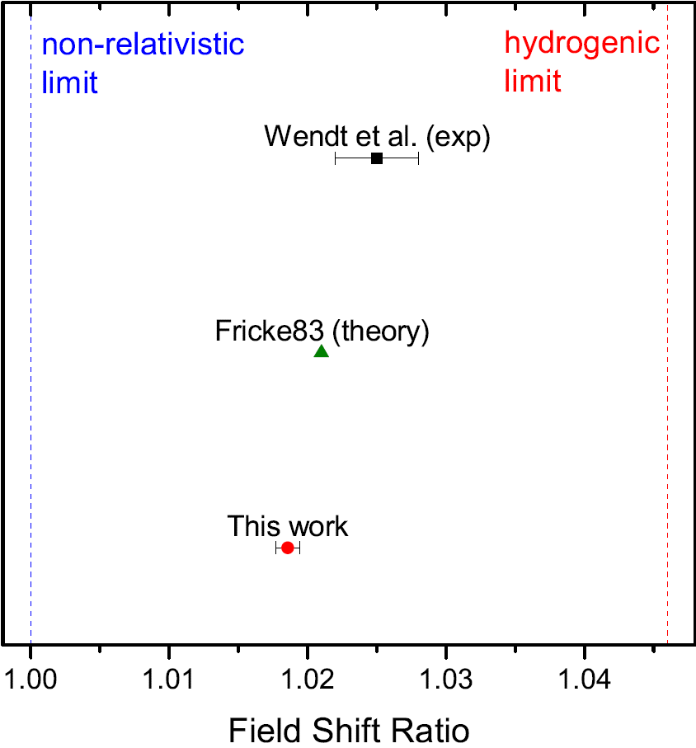
Comparison of $f$
Results:
→ $f$ far below hydrogenic boundary
in ${\text{Ba}}^{+}$, contrary to ${\text{Ca}}^{+}$
→ $f$ a new, more accuracte
Benchmark for atomic structure
calculations

Slide 23
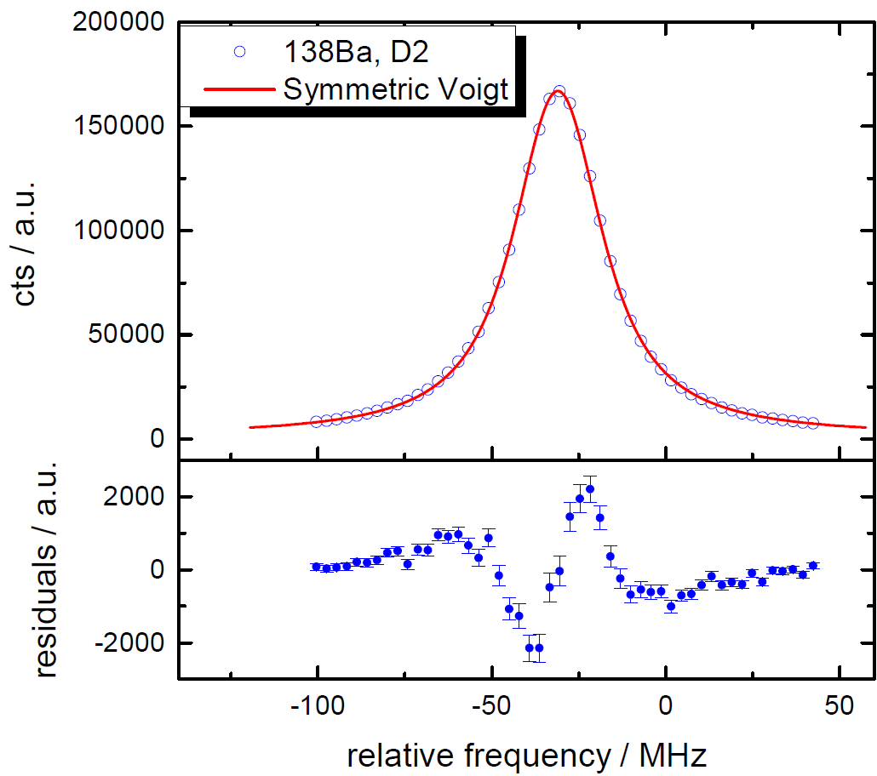
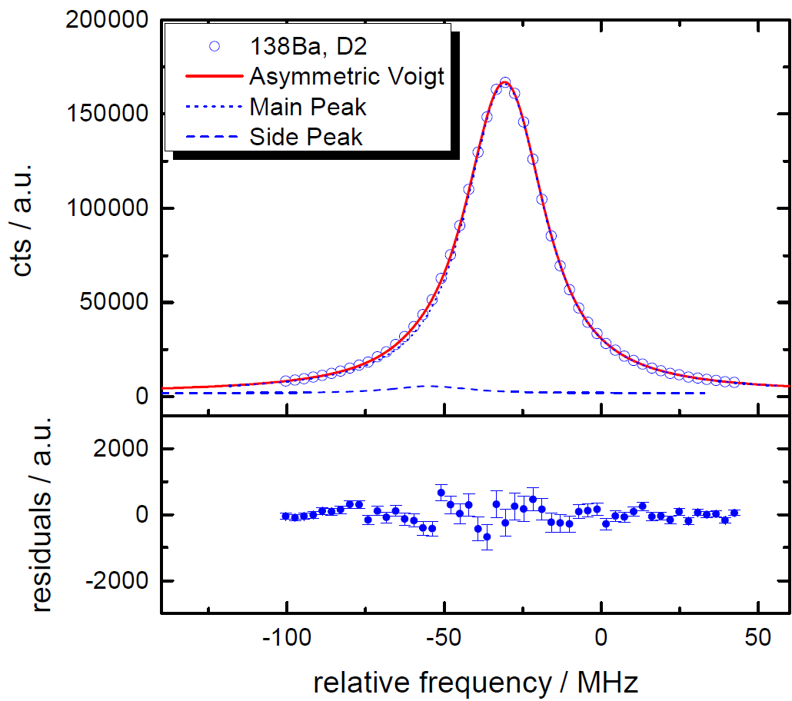
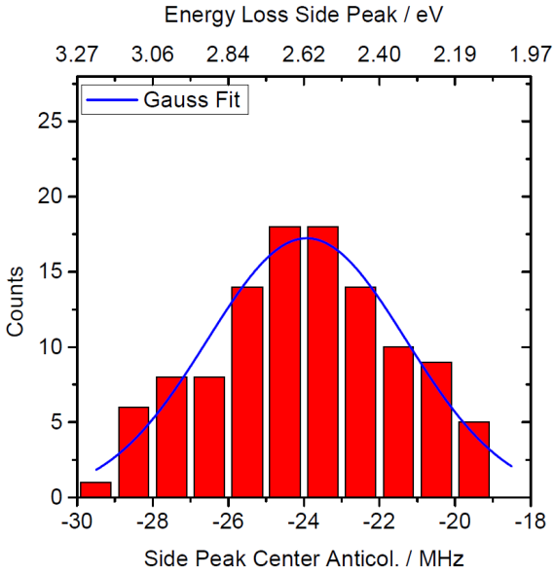
Systematic effect: Line Shape
rChi^2 = 12
rChi^2 = 1.6

Slide 24
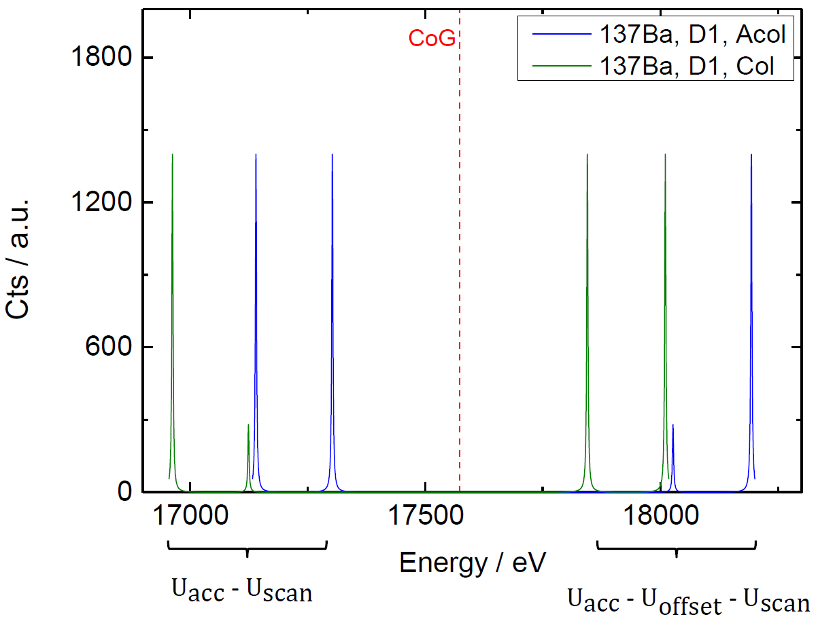
Systematic effect: Voltage dependence in hyperfine spectra
Knowledge of
${\text{U}}_{\text{scan}}$ needed!

Slide 25
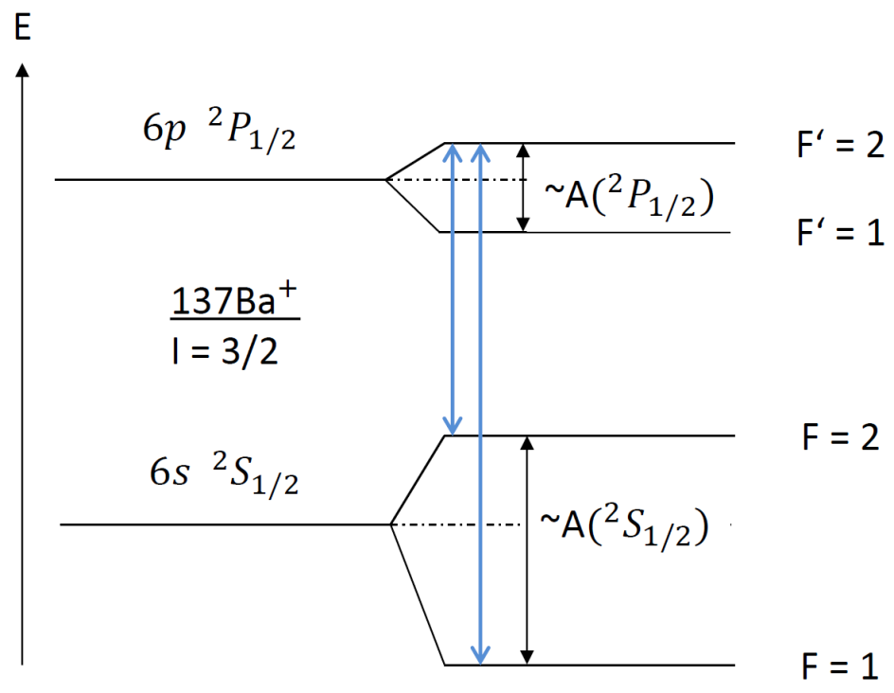
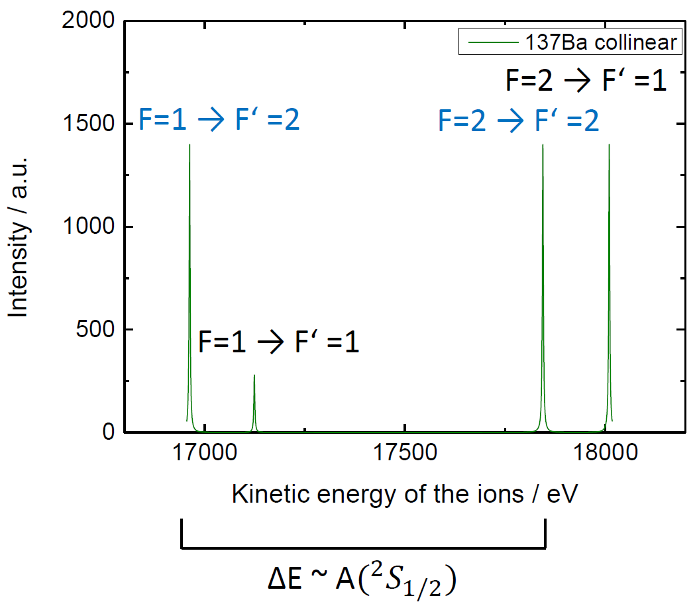
Systematic effect: Voltage dependence in hyperfine spectra

Slide 26
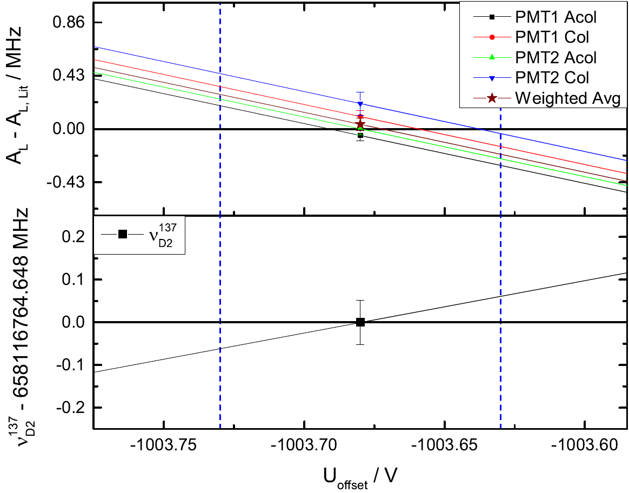
Systematic effect: Voltage dependence in hyperfine spectra

Slide 27
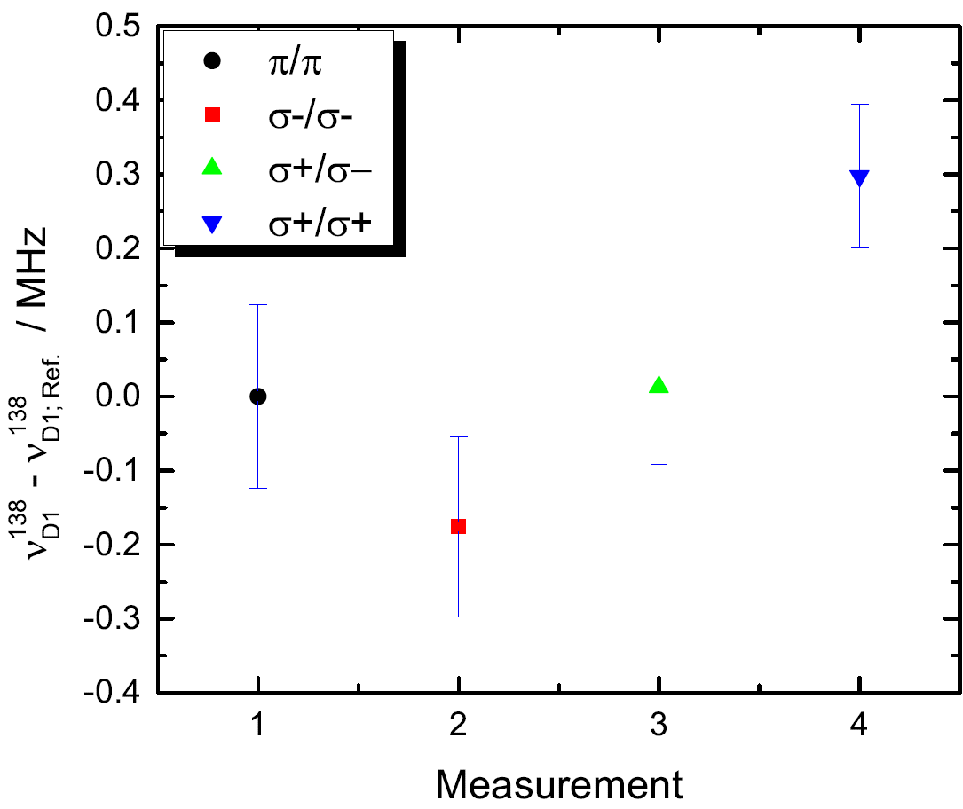
Systematic effect: Polarization of the laser light

