Slide 1
Excitation and Gamma-Decay of Collective Modes
Muhsin N. Harakeh
KVI-CART, Groningen/GSI, Darmstadt
RCNP, Osaka
Collaborative Research Center, SFB 1245, Annual Meeting
Mainz, Germany
4-6 July 2018

Slide 2
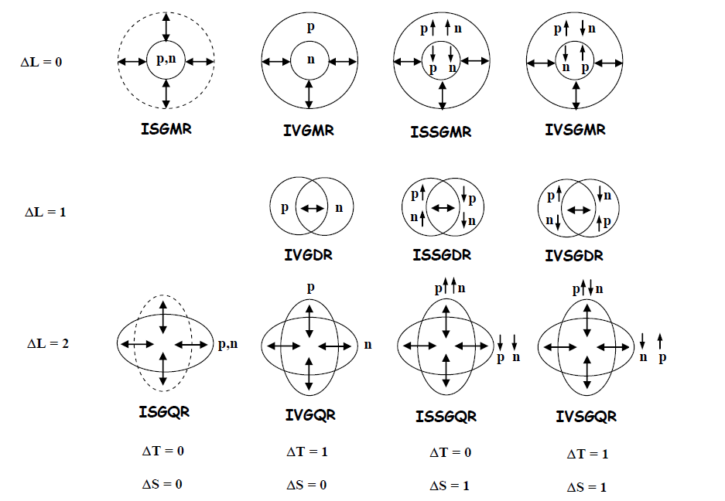
ISGDR
??

Slide 3
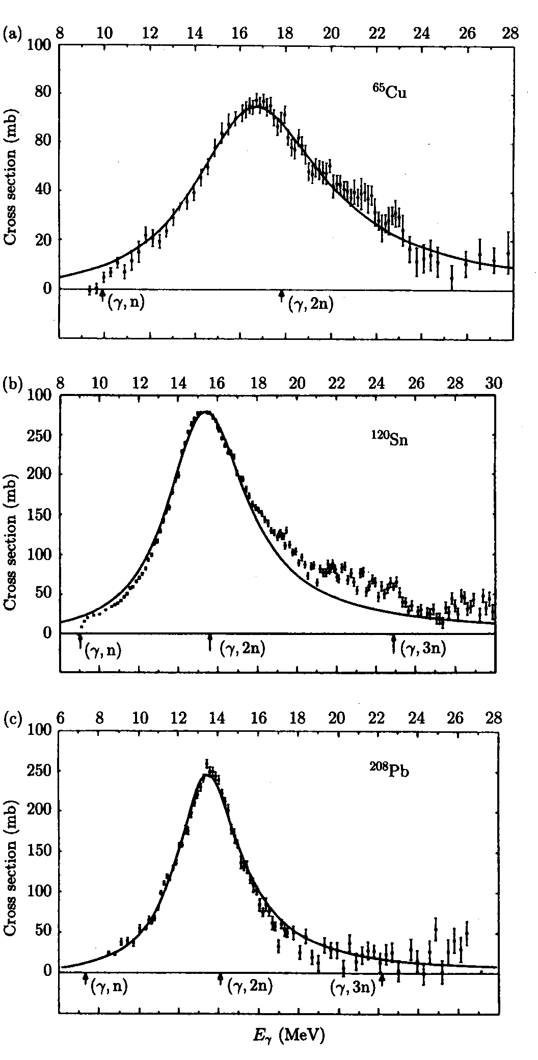
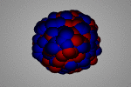
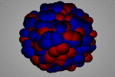
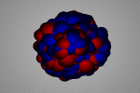
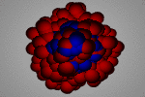
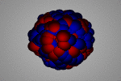

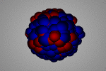
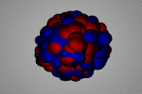
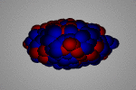
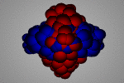
The collective response of the nucleus
Giant Resonances
Electric giant resonances
Photo-neutron cross sections
Isoscalar
Isovector
⁶⁵Cu
Monopole
(GMR)
Dipole
(GDR)
¹²⁰Sn
Berman and Fultz, Rev. Mod. Phys. 47 (1975) 47
²⁰⁸Pb
Quadrupole
(GQR)

Slide 4
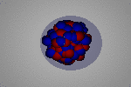
Dipole photo-response of atomic nuclei
S_{n}
E_{x} [MeV]
5
10
15
E1
Pygmy
GDR
GDR
Quadrupole-Octupole
Coupling
Strength (arb. units)
2qp
Gamow
Teller
Strength (arb. units)
M1
5
10
15
E_{x} [MeV]

Slide 5
A. Tamii et al., PRL 107 (2011) 062502

Slide 6
Magnetic dipole (M1)
Electric dipole (E1)
A. Tamii et al., PRL 107 (2011) 062502

Slide 7
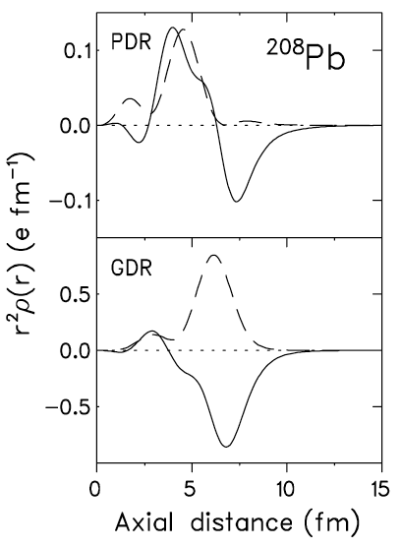
Transition densities by QPM
PDR dipole oscillation of excess neutrons vs core
Electric dipole (E1)
n
p
IVGDR Out-of-phase oscillations of protons vs neutrons.

Slide 9
0°-1.8° inelastic proton
scattering spectrum
shows in addition to
IVGDR low-lying E1
and M1 structures.
Peaks with (*) have been
selected for multipole-
decomposition analysis.
3.75°-5.25° inelastic
proton scattering
spectrum is almost
structure-less.
C. Iwamoto et al., PRL 108 (2012) 262501

Slide 10
E1 (dash-dotted line)
M1 (solid line)
E2 (dashed line)
C. Iwamoto et al., PRL 108 (2012) 262501

Slide 11
C. Iwamoto et al., PRL 108 (2012) 262501

Slide 12


Microscopic structure of ISGMR & ISGDR
Transition operators:
Constant Overtone
2ћω excitation
Spurious c.o.m. motion
Overtone
3ћω excitation (overtone of c.o.m. motion) + a small 1ћω component

Slide 13
g.s. decay
Low-energy isoscalar dipole strength in ⁴⁰Ca, ⁵⁸Ni, ⁹⁰Zr and ²⁰⁸Pb
T.D. Poelhekken et al.,
Phys. Letters B 278 (1992) 423

Slide 15
Excitation of the Isovector Giant Dipole Resonance by Inelastic a Scattering: An Experimental Approach
T. D. Poelhekken et al., Phys. Rev. Lett 62 (1989) 16
Excitation of the isovector GDR by inelastic a‑scattering as a measure of the neutron skin of nuclei
A. Krasznahorkay et al., Phys. Rev. Lett. 66 (1991) 1287 & Nucl. Phys. A567 (1994) 521
Measuring the cross section of the isovector giant dipole resonance (IVGDR) for
^{116,124}Sn( α,α′γ₀), ¹⁵⁰Nd(α,α′γ₀) and ²⁰⁸Pb(α,α′γ₀) reactions at E_{α} = 120 MeV and 0º≤ θ_{α′} ≤3º
⇒ Determine neutron-skin thickness

Slide 16
M. N. Harakeh et al., Phys. Rev. Lett. 38, 676 (1977)
ISGQR at 10.9 MeV
ISGMR at 13.9 MeV
Hatched area ⇒ IVGDR contribution (Coulomb + nuclear)
↑
↑

Slide 17
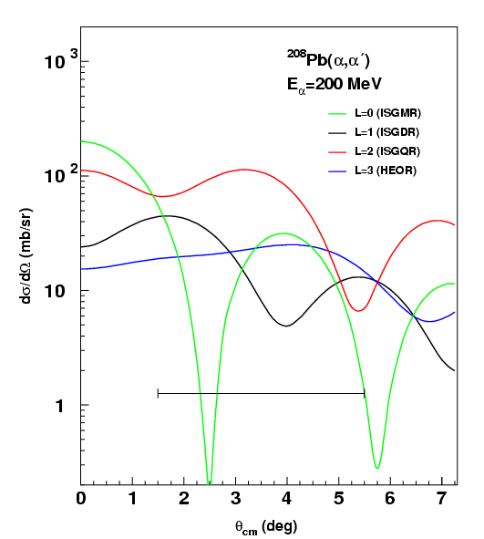
ISGMR L = 0
ISGDR L = 1

Slide 18
Difference of spectra
0° < θ_{α′} < 3°
0° < θ_{α′} < 1.5°
1.5° < θ_{α′} < 3°
Difference

Slide 19
E_{x} of final states
Two-dimensional spectrum showing inelastic α-scattering in coincidence with γ-decay

Slide 20
True
+
Random
Random
True

Slide 21
Isoscalar transition density in the Goldhaber-Teller model for excitation of IVGDR in inelastic α-scattering.
Therefore, DWBA cross sections can be calculated as function of ΔR_{pn}/R₀ for the Goldhaber-Teller model and similarly for the Steinwedel-Jensen model.
γ-decay branching ratios are known from photoabsorption experiments.

Slide 22
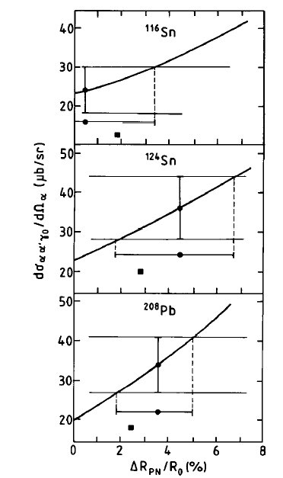
Full line is the calculated αγ₀ coincidence cross section, averaged over the solid angle of the α-particle and integrated over the full γ-ray solid angle (4π) and over the ΔE energy range as function of ΔR_{pn}/R.
The experimental αγ₀ cross sections for the IVGDR are shown as full circles with vertical error bars. The deduced values for ΔR_{pn}/R with the associated uncertainty (full circles with horizontal error bars) are also indicated.

Slide 23
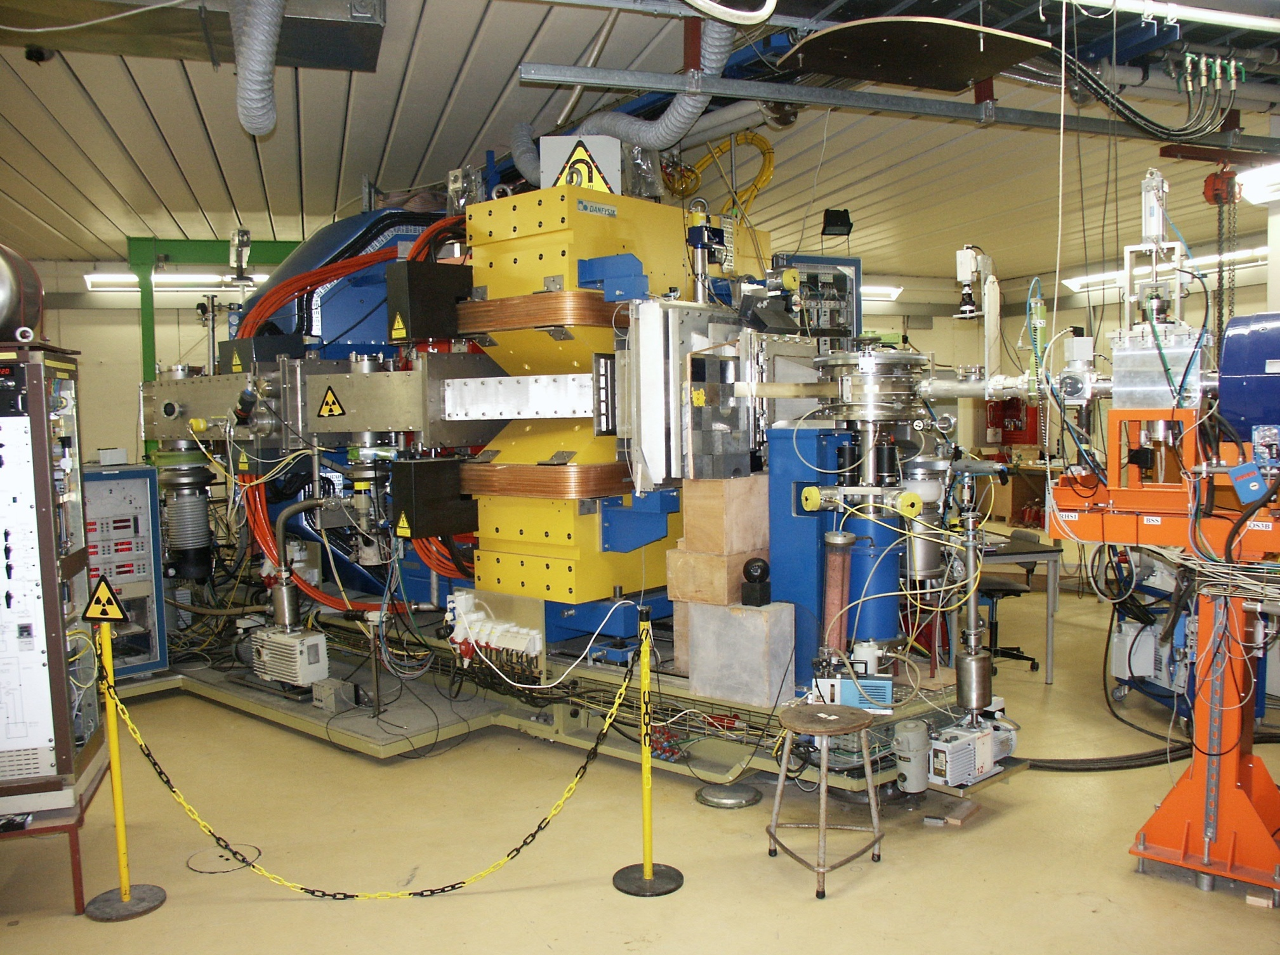

Slide 24
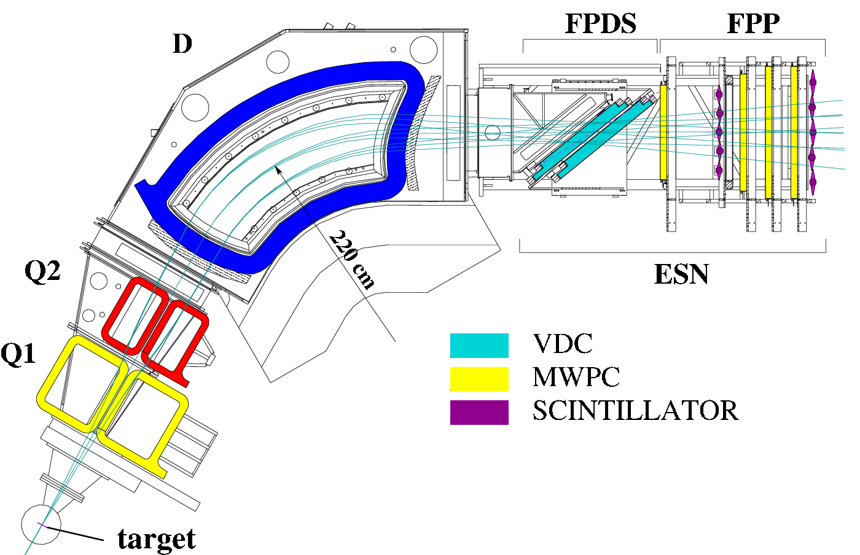
Setup@KVI
2 Super-Clover detectors (GSI)
2 Clover detectors (KVI)
3 Coaxial detectors with BGO
2 Coaxial detectors
(about 100% rel. efficiency each)
⇒ 0.5% absolute photo-peak efficiency
α beam
E_{α}=136 MeV, θ_{α}=3.5°
D. Savran et al., Nucl. Inst. and Meth. Phys. Res. A 564 (2006) 267

Slide 25
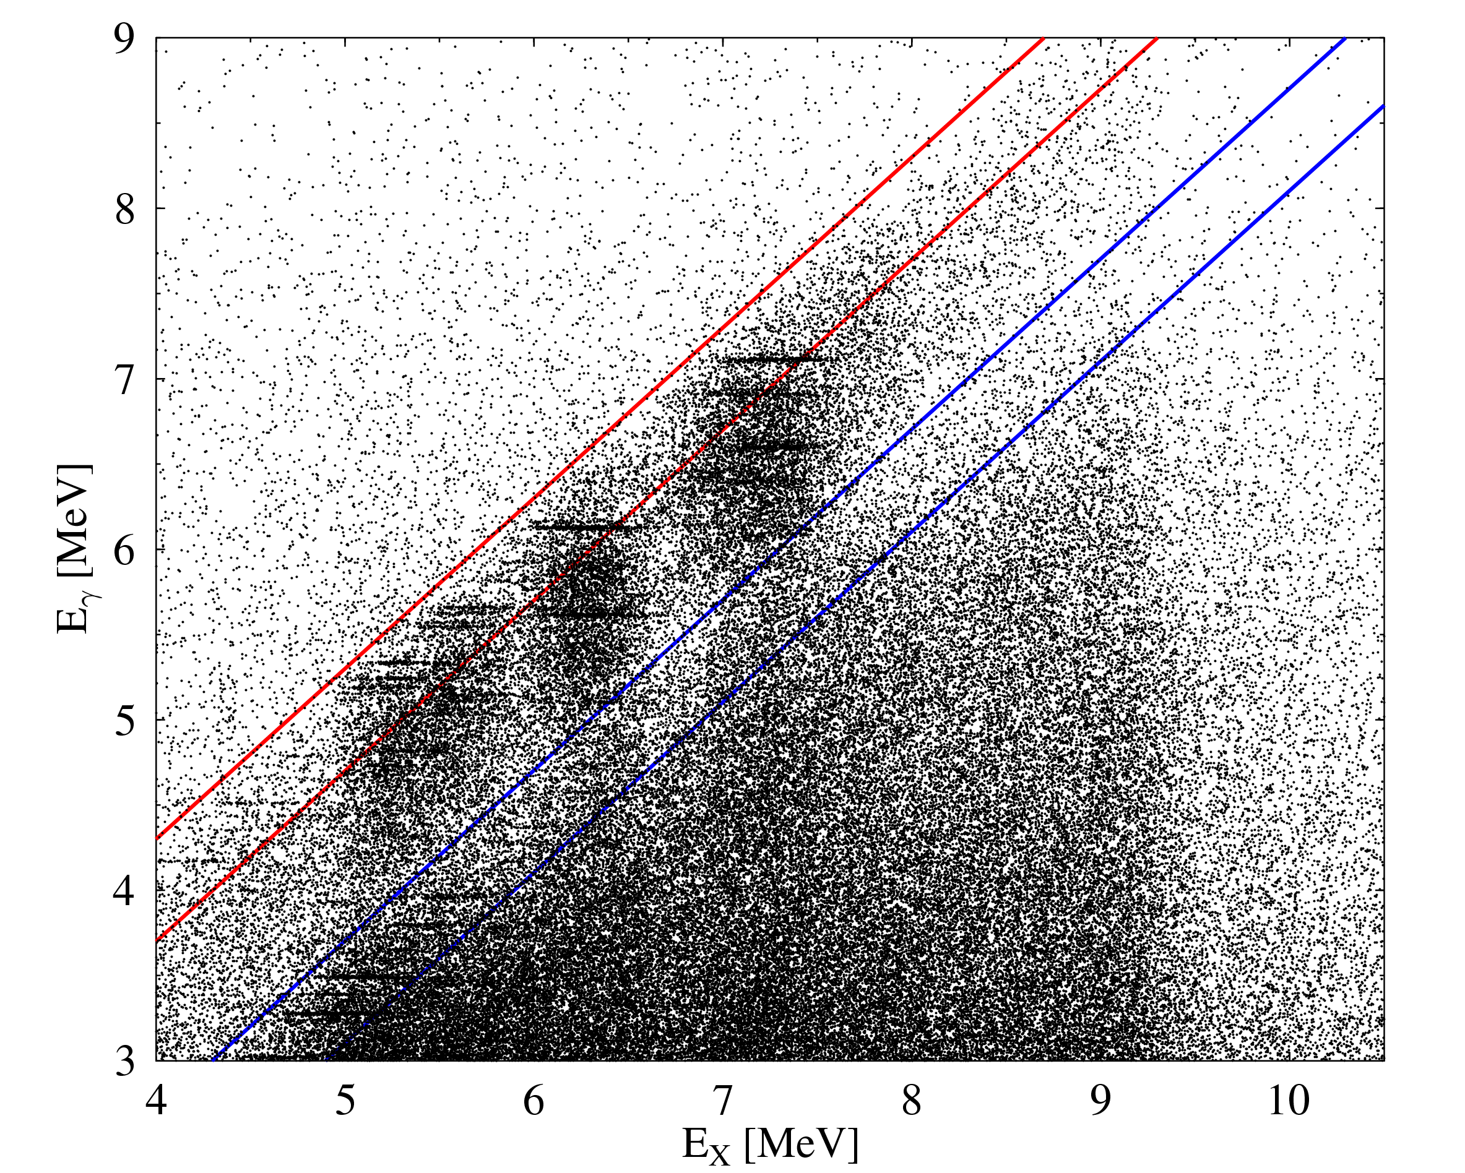
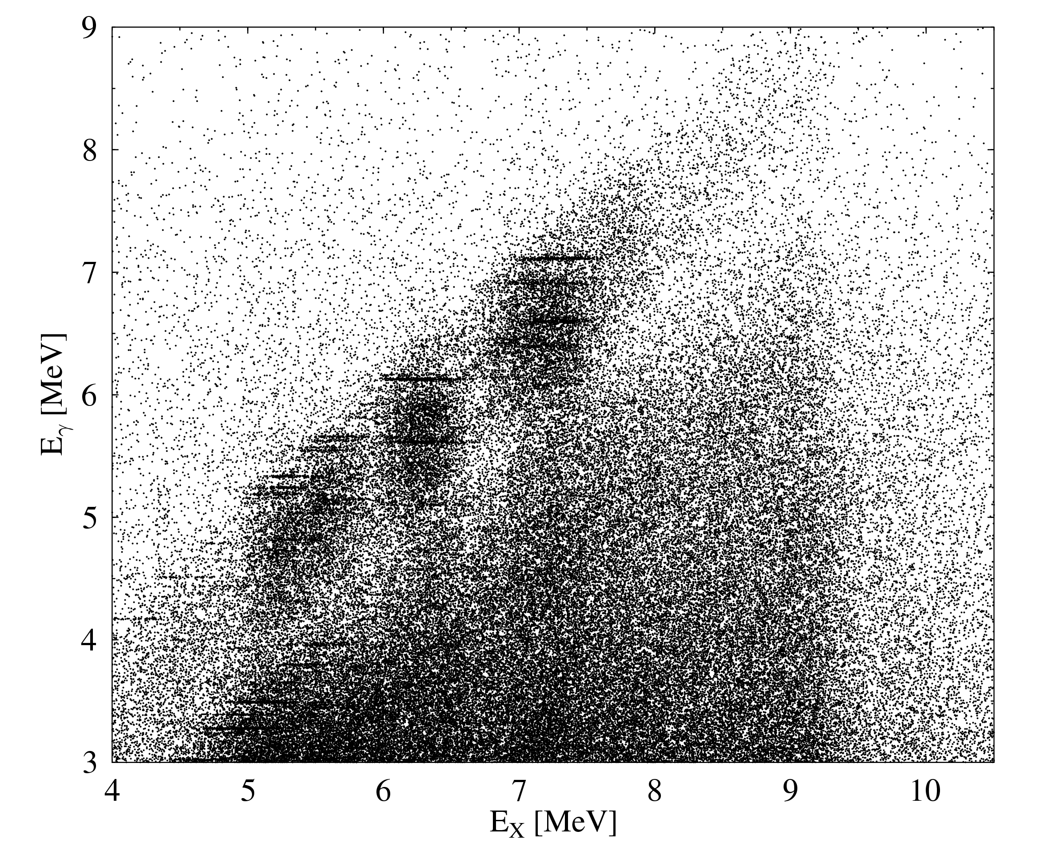
¹⁴⁰Ce(α,α′γ) - coincidence matrix
E_{α} = 136 MeV
θ_{α} = 3.5°

Slide 26
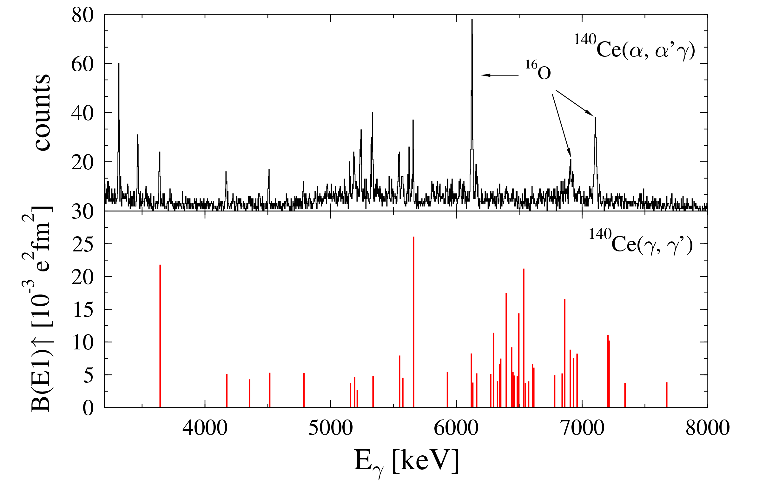
¹⁴⁰Ce(α,α′γ) vs. ¹⁴⁰Ce(γ,γ′)
?
D. Savran et al., Phys. Rev. Lett. 97 (2006) 172502

Slide 27
Multipole assignment with α−γ angular correlation
2.0
Dipole
θ_{γ} = 202°
W(θ_{γ})
1.0
0.0
100
140
180
220
260
θ_{γ}[deg]
θ_{γ} = 264°
2.0
Quadrupole
¹³⁸Ba(α,α′γ)
* ¹²C & ¹⁶O contaminants
W(θ_{γ})
1.0
0.0
100
140
180
220
260
θ_{γ}[deg]
J. Endres et al., Phys. Rev. C 80 (2009) 034302

Slide 28
Multipole assignment with α-γ angular correlation
¹³⁸Ba(α,α′γ)
J. Endres et al., Phys. Rev. C 80 (2009) 034302

Slide 29
Comparison of (α,α′γ) with (γ,γ′) on ¹³⁸Ba
J. Endres et al., Phys. Rev. C 80 (2009) 034302

Slide 30
J. Endres et al., Phys. Rev. C 85 (2012) 064331

Slide 31
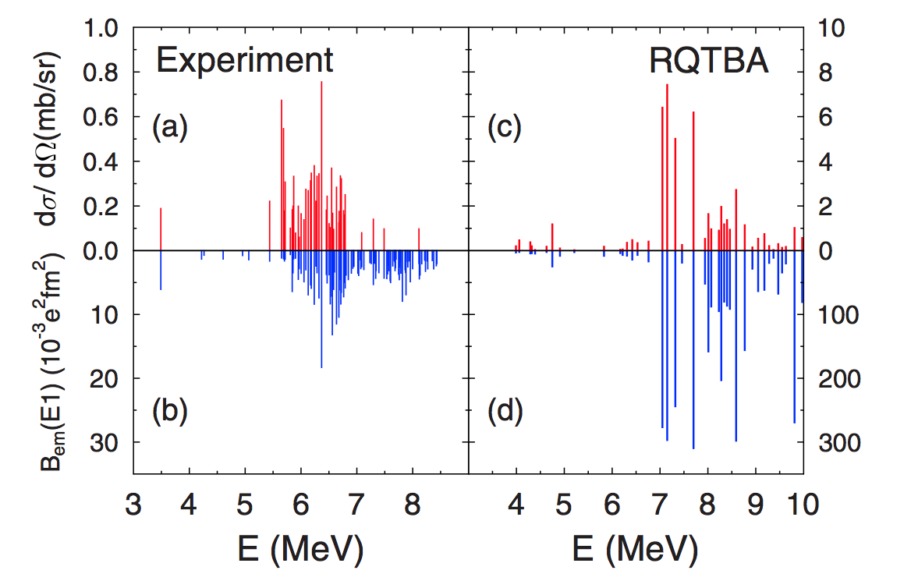
Identification of PDR structure in (α,α′γ)
Good reproduction of experimental results using RQTBA transition densities + semi-classical reaction model
J. Endres et al., PRL 105 (2010) 212503
E. Lanza et al., PRC 89 (2014) 041601(R)
Different response to complementary probes allows identification of PDR structure
¹²⁴Sn

Slide 32
E1 strength distribution in ¹⁴⁰Ce, ¹³⁸Ba, ¹²⁴Sn, and ⁹⁴Mo
¹⁴⁰Ce
(γ,γ′) & (α,α′γ)
(γ,γ′) only
¹³⁸Ba
¹²⁴Sn
⁹⁴Mo

Slide 33
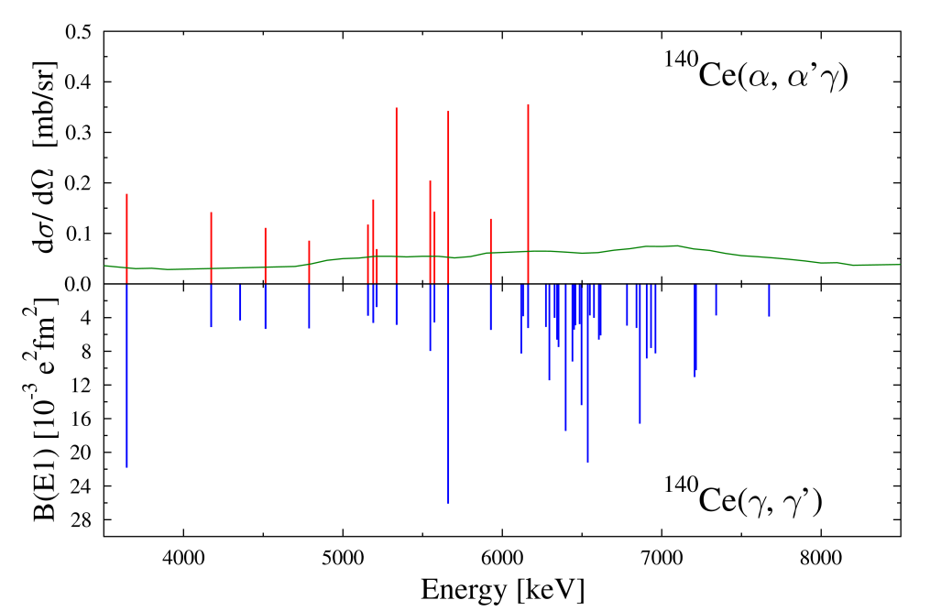
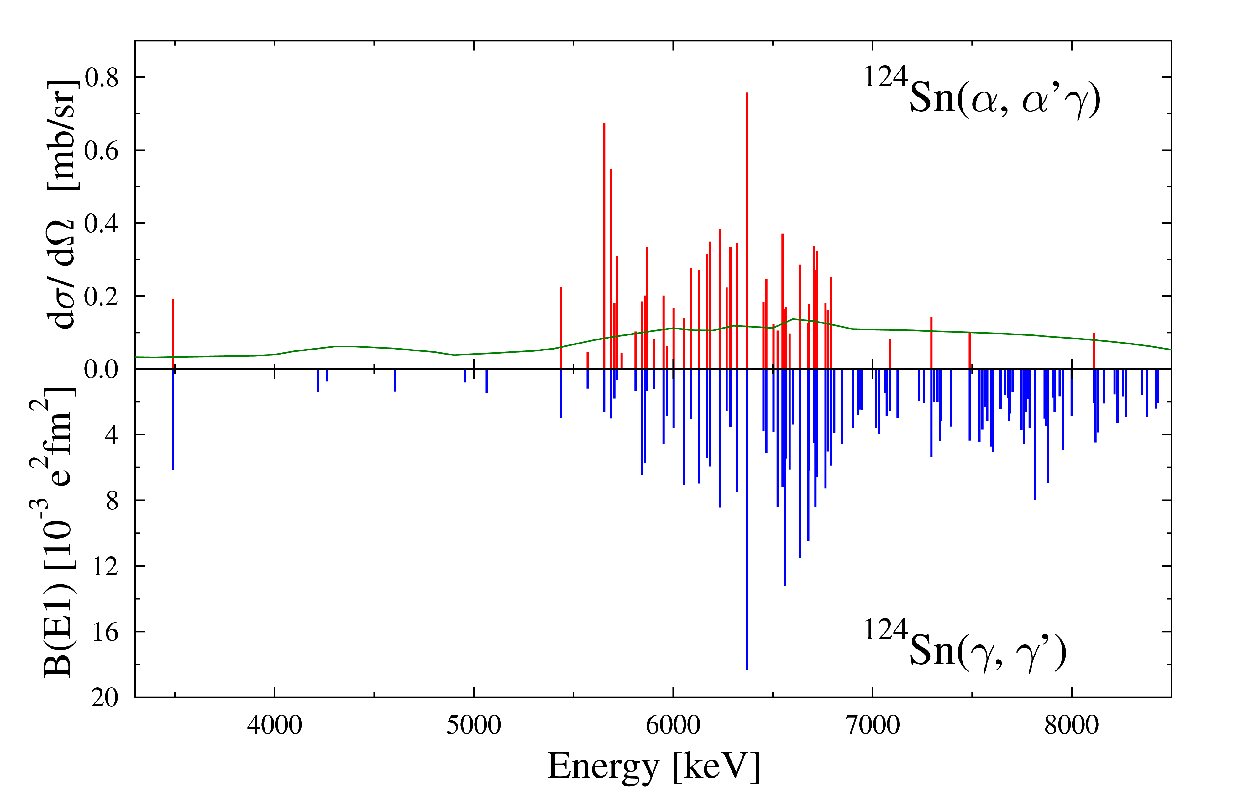
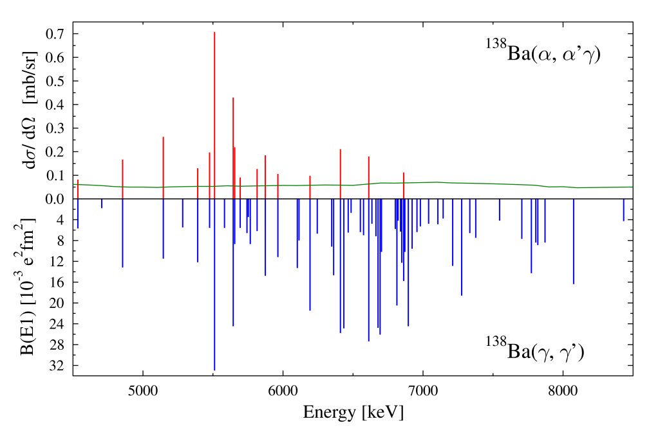
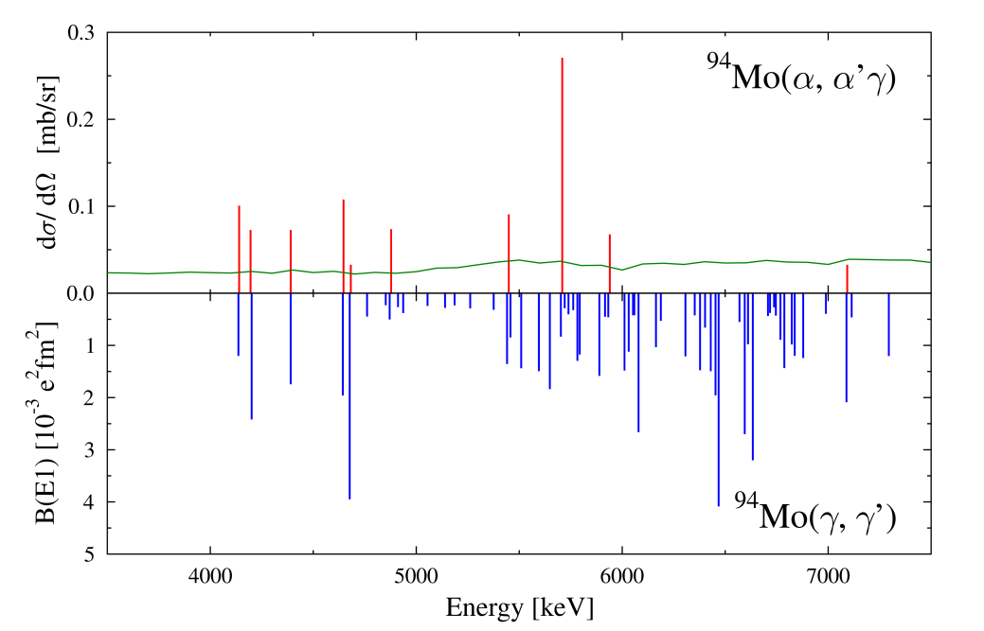
Systematics
D. Savran et al., PRL97 (2006) 172502
J. Endres et al., PRL 105 (2010) 212503
Different response to photons and α-particles points to different underlying structures
J. Endres et al., PRC 80 (2009) 034302
V. Derya et al., NPA906 (2013) 94

Slide 34
V. Derya et al., Phys. Lett. B 730 (2014) 288

Slide 35
RPA Calculations; Gogny D1S interaction
P. Papakonstantinou et al., Phys. Lett. B 709 (2012) 270

Slide 36
The grey histogram corresponds to the total unresolved strength.
Top panel: Discrete level in
α scattering
Centre panel: Discrete levels in ¹⁷O scattering
Bottom panel: photon scattering
L. Pellegri et al., Phys. Lett. B738 (2014) 519

Slide 37
CAGRA array >10 HPGe-clover detectors
To study PDR

Slide 38
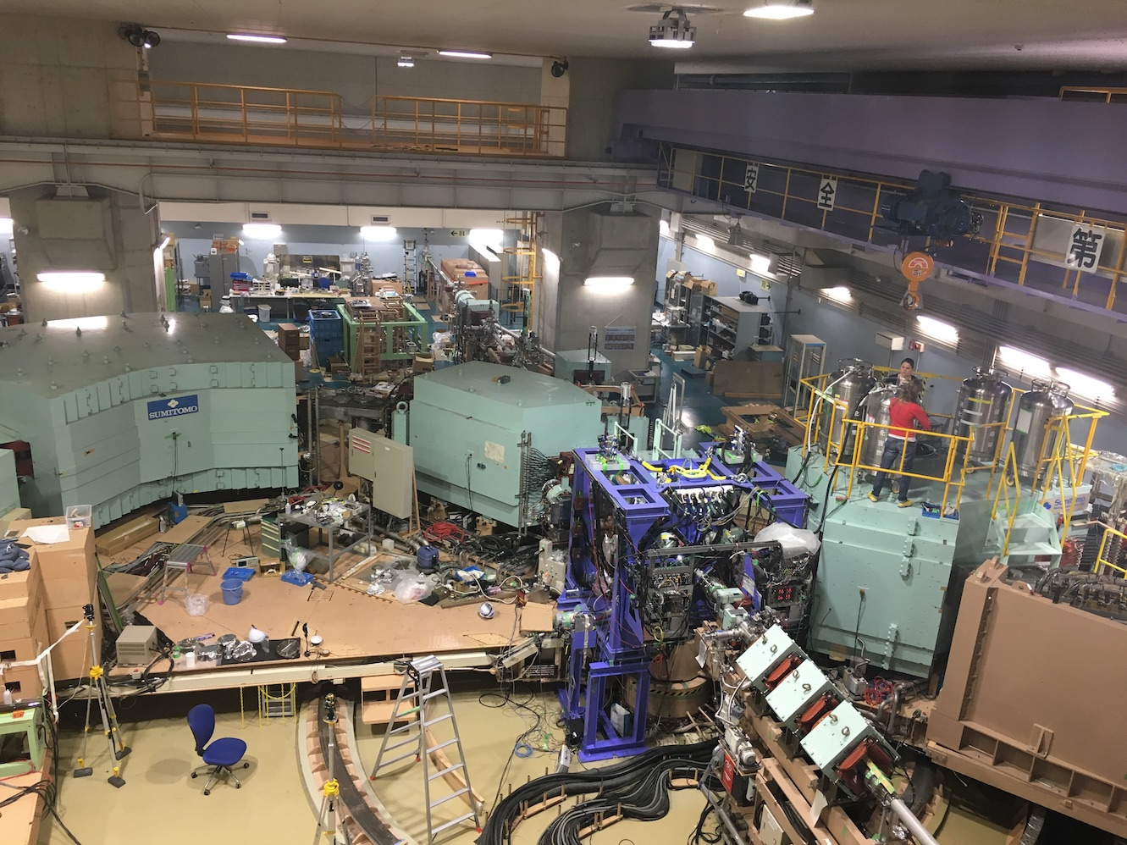
Campaign experiments in Oct. – Dec. 2016 at RCNP
CAGRA
12 Clovers from
ANL, ARL, (Tohoku,) and IMP
+ 4 large-volume LaBr₃ from Milano
Grand Raiden
Notes:
The experiments were performed in Oct to Dec of last year. This is the experimental setup. This is Grand Raiden, and at the target position, we have installed CAGRA which consists of 12 Ge clovers from Argonne national lab., Army research laboratory in US, Tohoku University, and Institute of Modern Physics in China. In addition, at forward angle, we installed LaBr3 detectors from Milano.

Slide 39
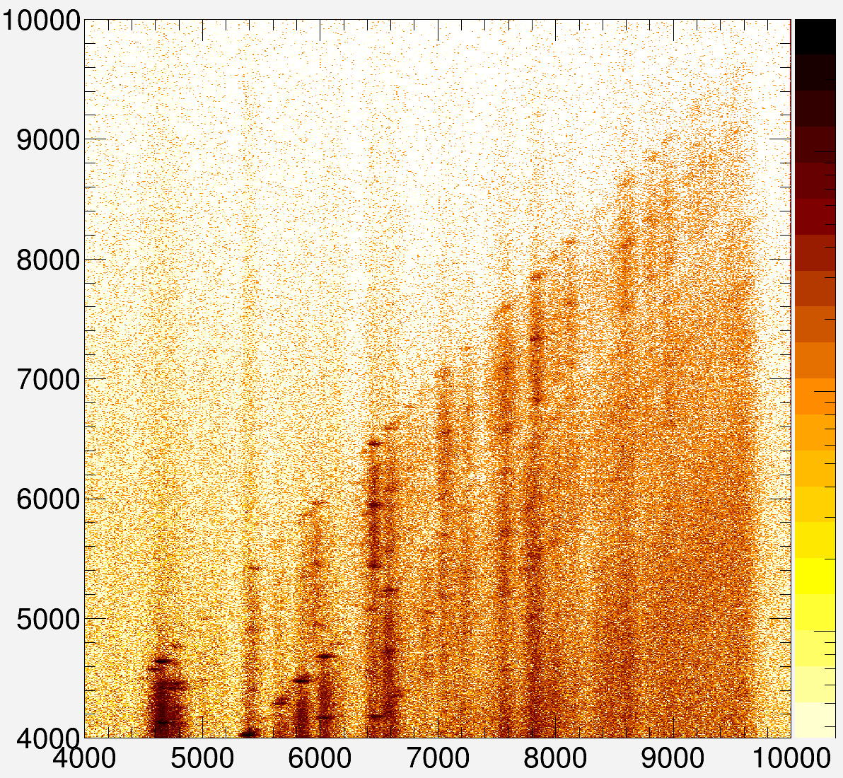


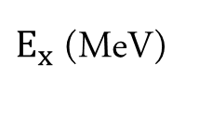

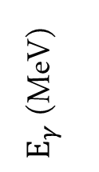
$64Ni(α,α^{′}γ)$ coincidence matrix
preliminary
$$E_{γ}≈E_{x}$$
$$E_{γ}≈E_{x}−E_{2_{1}^{+}}$$
$E_{γ}$ (MeV)
$E_{x}$ (MeV)
Analysis Johann Isaak

Slide 40
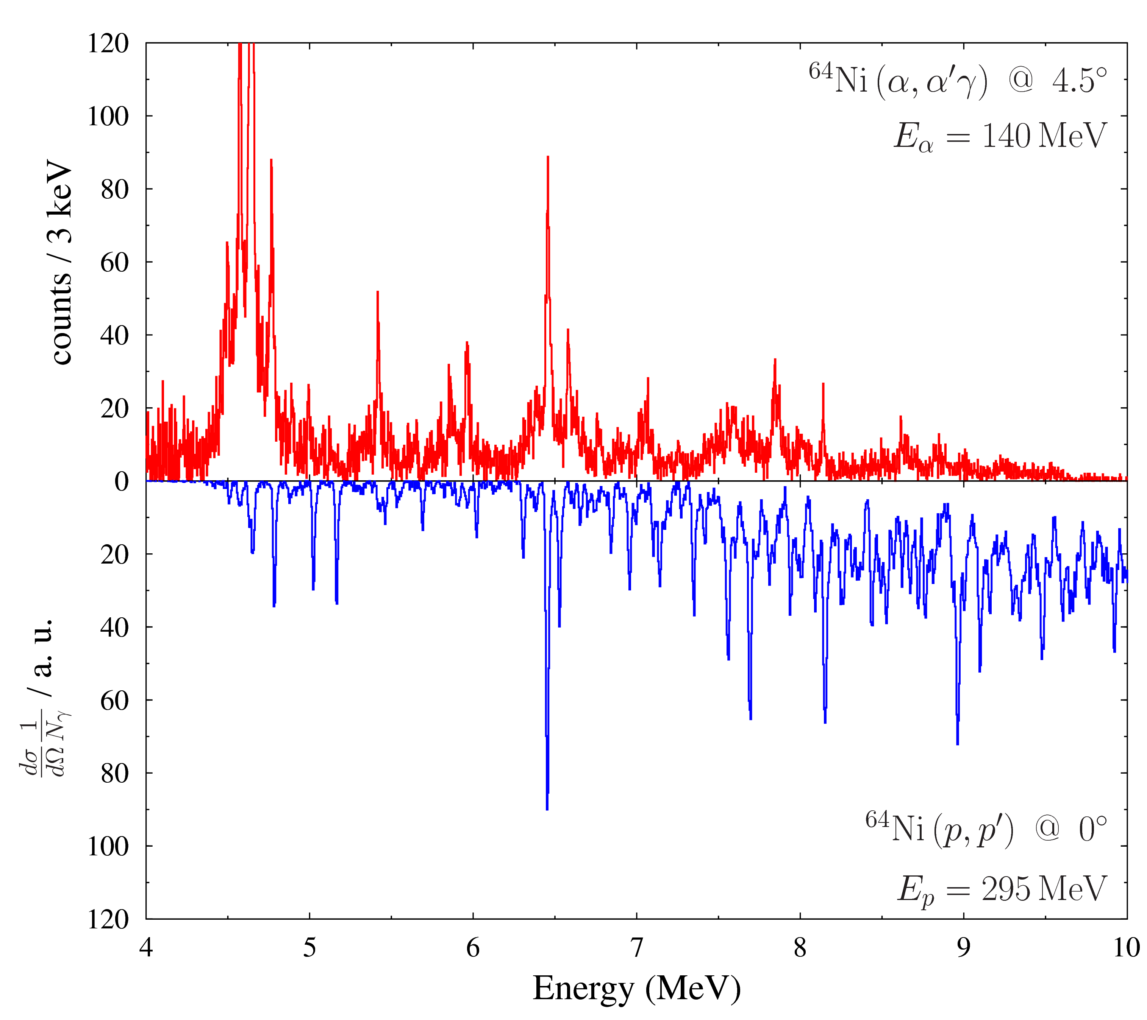
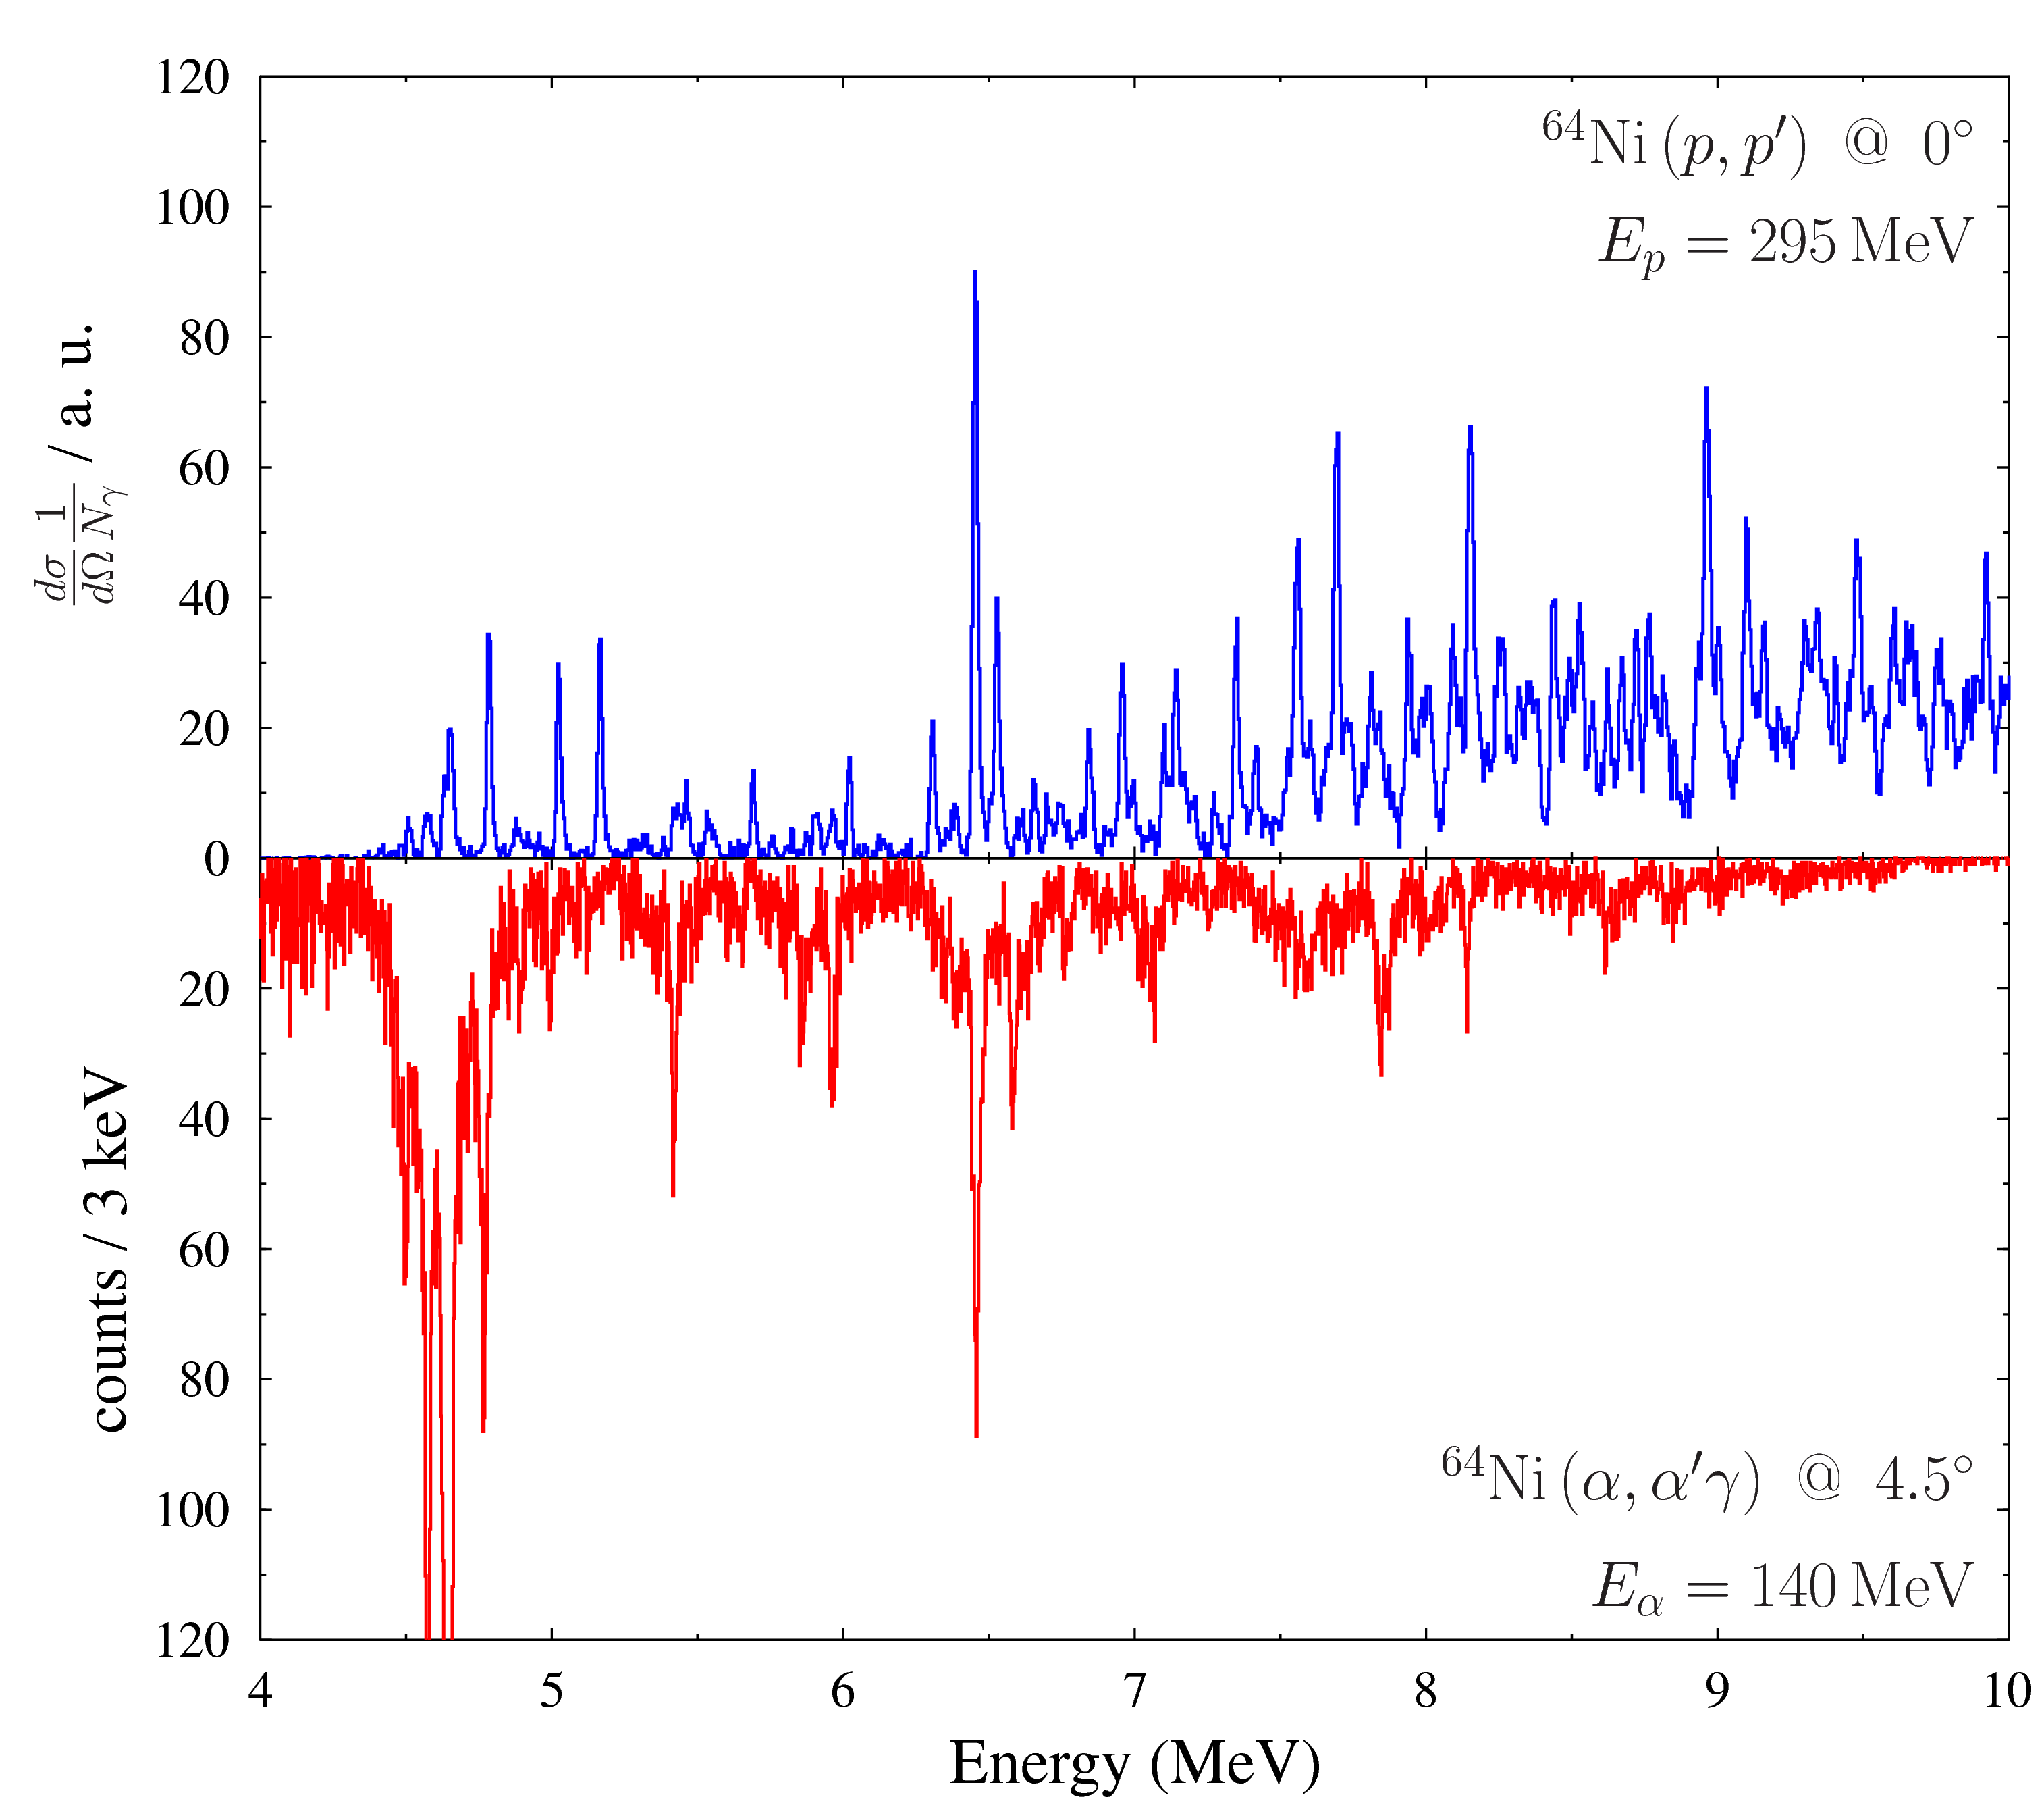
$64Ni\left(α,α^{′}γ\right) E_{γ}$-projection
preliminary
E1, M1 or E2 ?
Analysis Johann Isaak

Slide 41


(α,α′) and (p,p′) off ⁶⁴Ni
Isoscalar and isovector probes
preliminary
comparison of proton and $α$ scattering
evidence for different underlying structure

Slide 42
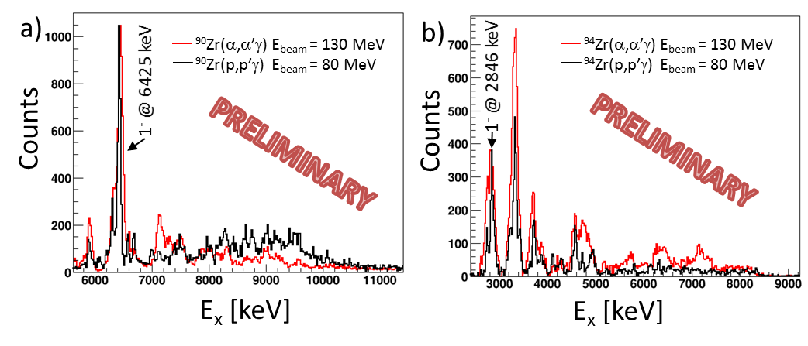
Analysis Fabio Crespi

Slide 43
Study of collective modes excited in inelastic proton scattering
at Cyclotron Center Bronowice
in Krakow
M. Kmiecik, B. Wasilewska, A. Maj et al.
IFJ PAN Krakow

Slide 44
Physics Motivation
Study of gamma-decay of highly excited states in STABLE nuclei
Pygmy
GQR
B_{n}
Pygmy dipole states
(p,p′γ) reaction at E_{beam}=70-120MeV
Comparison to the high resolution measurements at other laboratories (RNCP, iThemba, KVI, HIGS, ELI-NP )
Gamma decay from giant resonances (ISGQR)
(p,p′γ) reaction at E_{beam}=70-200MeV
²⁰⁸Pb, ⁹⁰Zr, ¹²⁰Sn,….
Measurements of the gamma-branching ratio to test the microscopic structure of ISGQR

Slide 45
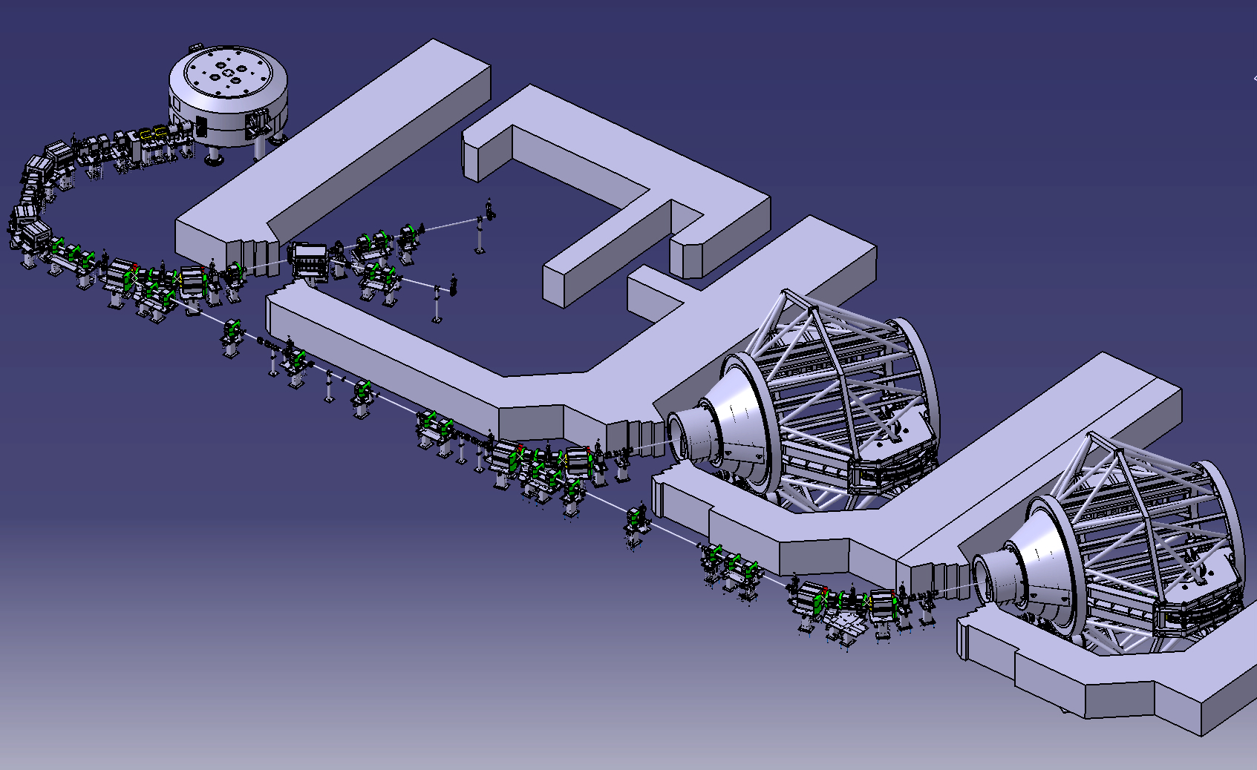
230 MeV proton cyclotron (IBA)
Energy selector
(70-230 MeV, Δp/p<0.7%)
Eye-therapy room
Experimental hall
2 gantries for whole body theraphy

Slide 46
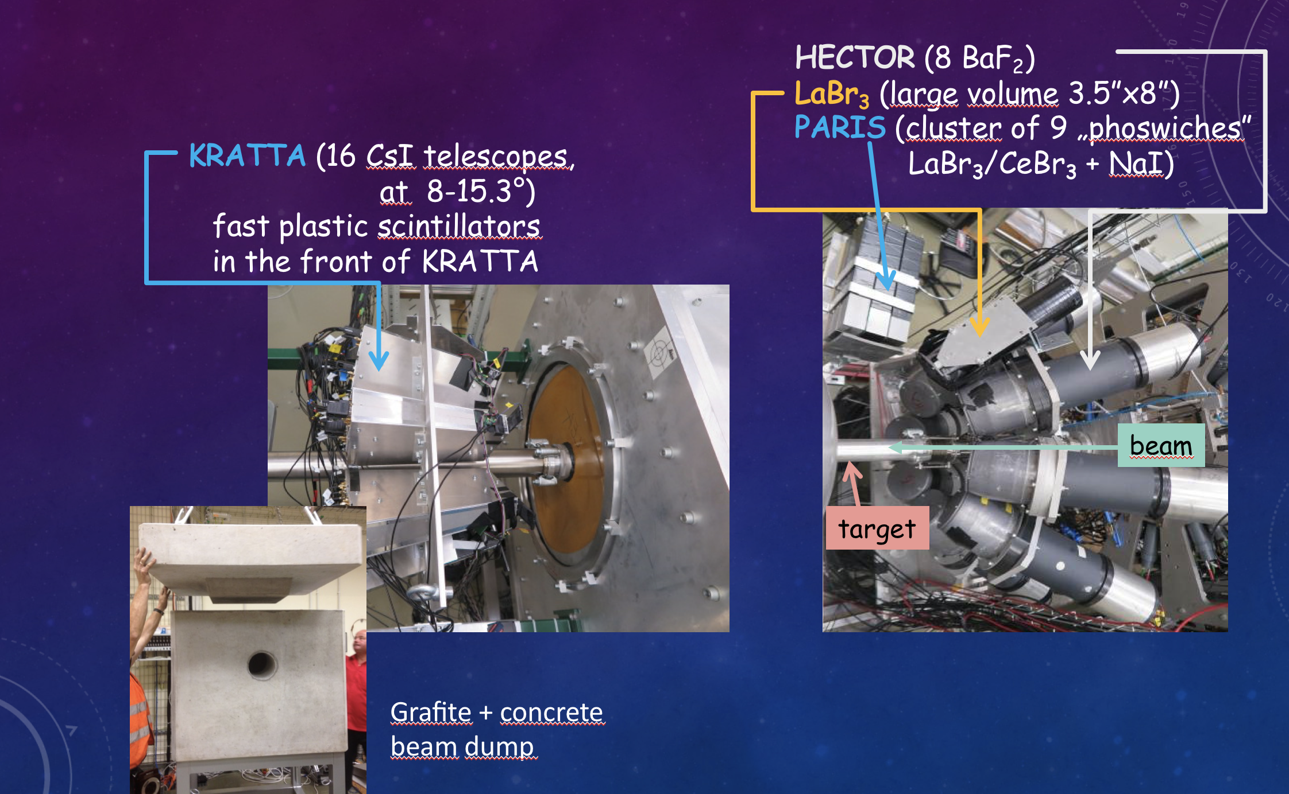
The gamma decay from high-lying states and giant resonances excited in ²⁰⁸Pb via (p,p′γ) reaction at E_{p} = 85 MeV
M. Kmiecik, F. Crespi et al.

Slide 47
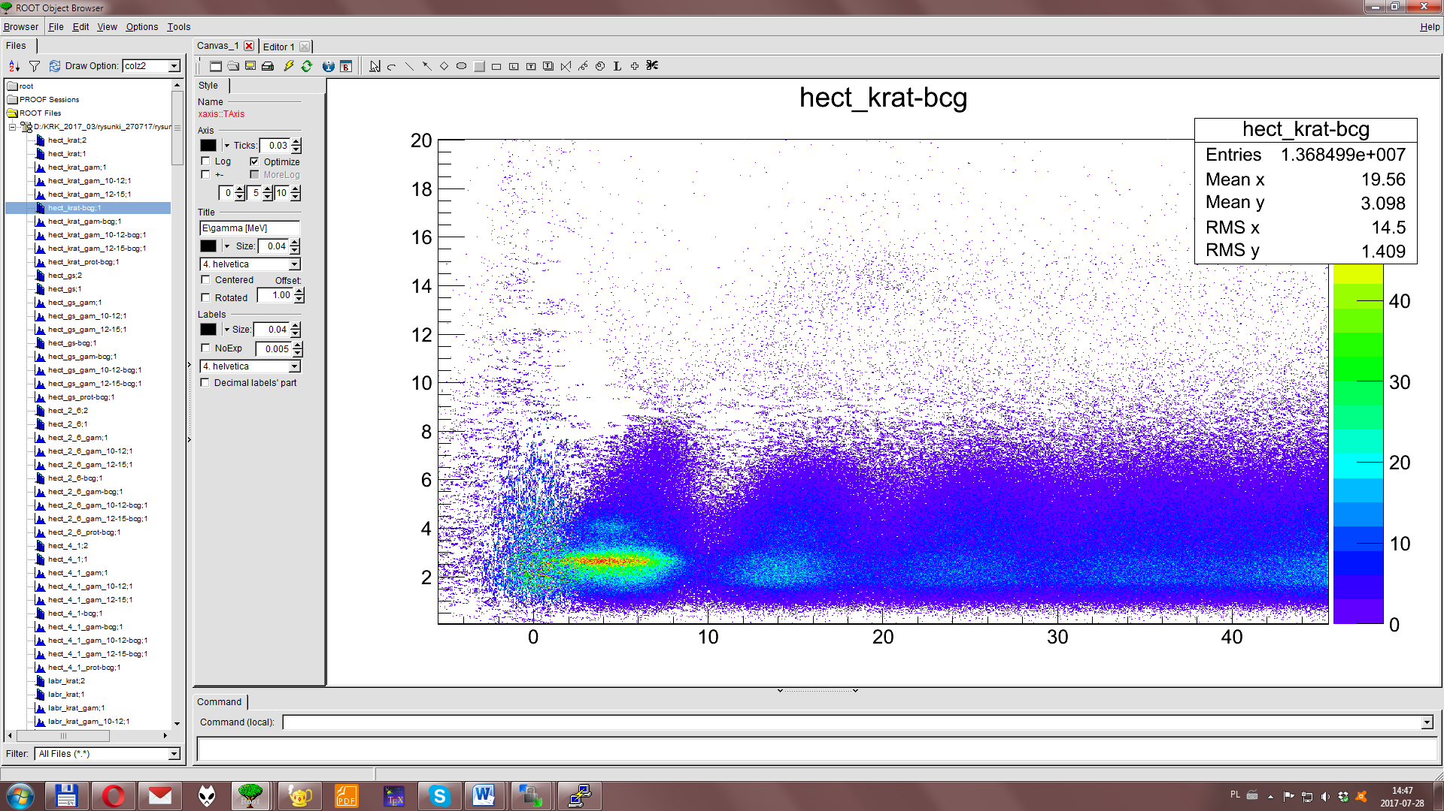
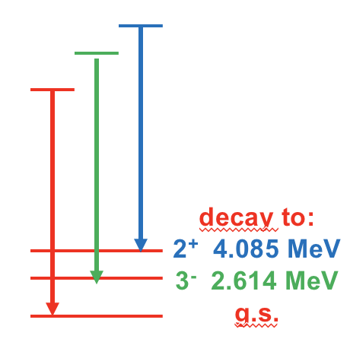
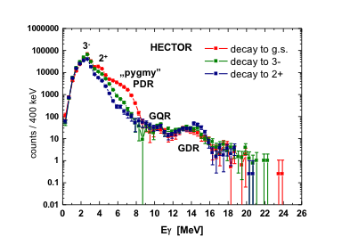
Observation of gamma decay from GDR, GQR and PDR built on different states
Eγ [MeV]
E* [MeV]
S_{n} = 7.4 MeV, S_{p} = 8.0 MeV

Slide 48
E498
8 large LaBr3
4 at 90°
4 at 135°

Slide 50



















M. P. Carpenter, Shaofei Zhu
M. N. Harakeh
James J. Carroll
D. Bazin, J. C. Zamora, S. Lipschutz, J. Schmitt,
C. Sullivan, R. Titus, R. G. T. Zegers
D. L. Balabanski
C. Iwamoto
S. Adachi , N. Aoi, A. Czeszumska, Y. D. Fang,
H. Fujita, Y. Fujita, G. Gey, H. T. Ha, E. Ideguchi,
A. Inoue, J. Isaak, N. Kobayashi, H. J. Ong, M. Kumar Raju, A. Tamii, T. Yamamoto, Y. Yamamoto
S. Noji
C. J. Guess, E. R. Hudson, C. I. Kacir
D. Savran
T. Hashimoto
T. Koike
M. Krzysiek, M. Ciemała, Maria Kmiecik,
A. Maj, B. Wasilewska
Y. N. Watanabe
S. Courtin, G. Fruet, D. Montanari
S. Bassauer, T. Klaus, P. von Neumann-Cosel,
N. Pietralla, G. Steinhilber, V. Werner
N. Blasi, A. Bracco, F. Camera,
F. C. L. Crespi, O. Wieland
Sezione di Milano
L. Donaldson
V. Derya, S. G. Pickstone, M. Spieker,
J. Wilhelmy, A. Zilges
A. S. Brown, D. G. Jenkins,
P. J. Davies, L. Morris
Notes:
So finally, I would like to show you the collaborators. This is the first page of the list of collaborators.

Slide 51
Thank you for your attention

Slide 52
CAGRA+GR Campaign Exps. in Oct-Dec 2016
E441: The (⁶Li,⁶Li’[3:56MeV]) reaction as a novel probe for studying the inelastic neutrino-nucleus response in astrophysical scenarios
5.0 days
(⁶Li, ⁶Li*) on ¹²C etc.
E450: Study of the Structure of the Pygmy Dipole Resonance States via the (p, p’ γ)
and (α,α’γ) Reactions
25.0 days
E454: Study of the Structure of the Pygmy Dipole Resonance States in ⁶⁴Ni via
the (p,p’γ) and (α,α’γ) Reactions
6.0 days
(α,α’γ) and (p,p’γ) on ⁶⁴Ni, ^{90,94}Zr, ^{120,124}Sn, ^{206, 208}Pb
E470: Search for superdeformed states in ²⁸Si via γ-particle coincidence measurements
(α,α’γ) on ²⁸Si
6.0 days
E471: Study of high-spin state population by light-ion reactions
(⁶Li, ⁶Li) on ⁴⁰Ca
3.0 days
In total 45 days of beam time

Slide 53
Future Prospects

Slide 54
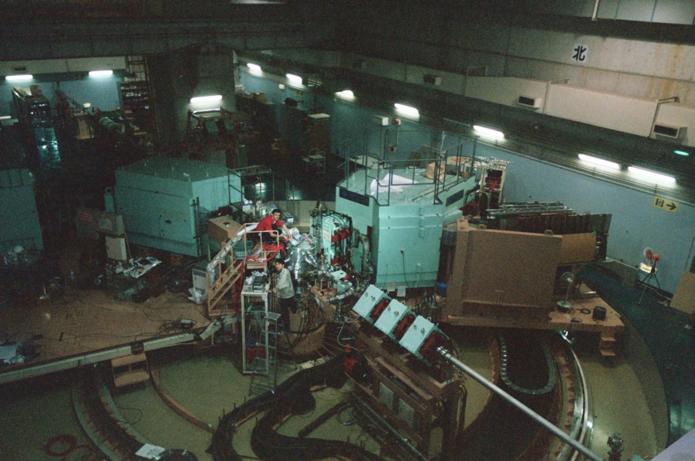
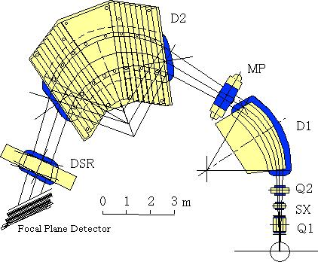
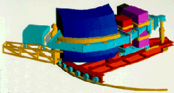
Grand Raiden@
RCNP
(α,α′) at E_{α}~ 400 & 200 MeV at RCNP & KVI,
respectively
BBS@KVI

Slide 57
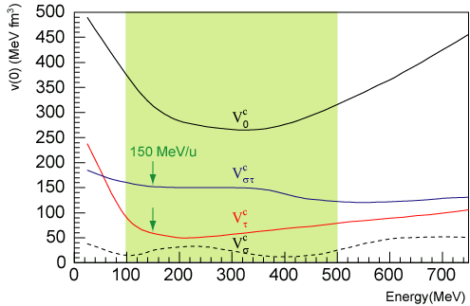
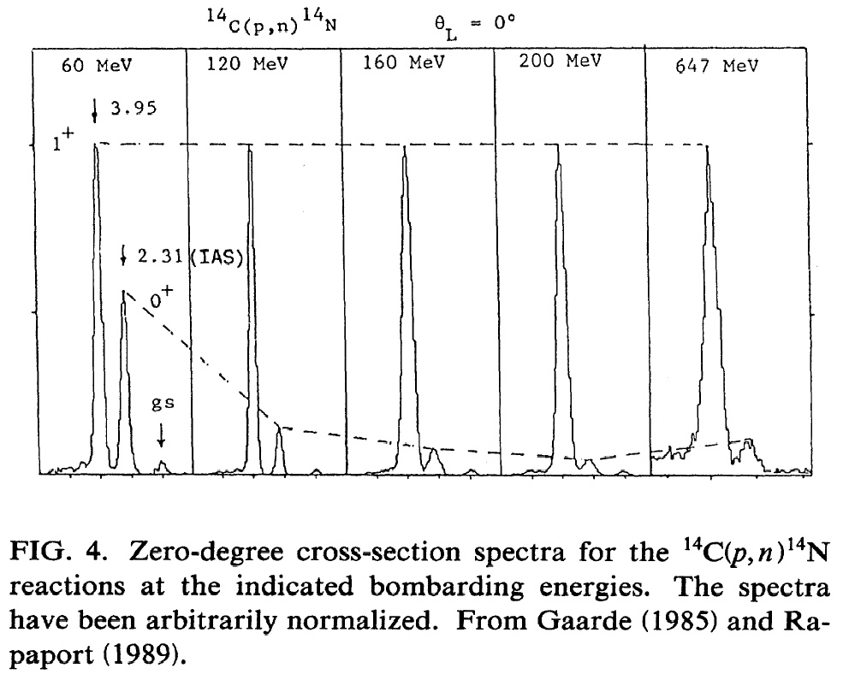
Spin-isospin excitations
n
p
ΔL=0 ΔS=1 ΔT=1
GTR
Gamow-Teller transitions;
Isospin (ΔT=1)
Spin (ΔS=1)
Advantages
Cross section peaks at
θ° (ΔL=0)
Strong excitation of
GT states at
E/A=100-500 MeV/u

Slide 58
Transition density
ISGMR Satchler, Nucl. Phys. A472 (1987) 215
ISGDR Harakeh & Dieperink, Phys. Rev. C23 (1981) 2329
Other modes Bohr-Mottelson (BM) model

