Slide 1

New Impulses on the Experimental Program at the S-DALINAC
N. Pietralla, J. Birkhan & J. Isaak
Direct Evidence for Surface-Neutron Contribution to PDR
(J.Isaak, J. Birkhan, S. Typel, NP)
Test of Dynamical α-Cluster Structure of Light Nuclei
(NP et al.)
Gefördert durch die DFG im Rahmen des SFB 1245

Slide 2
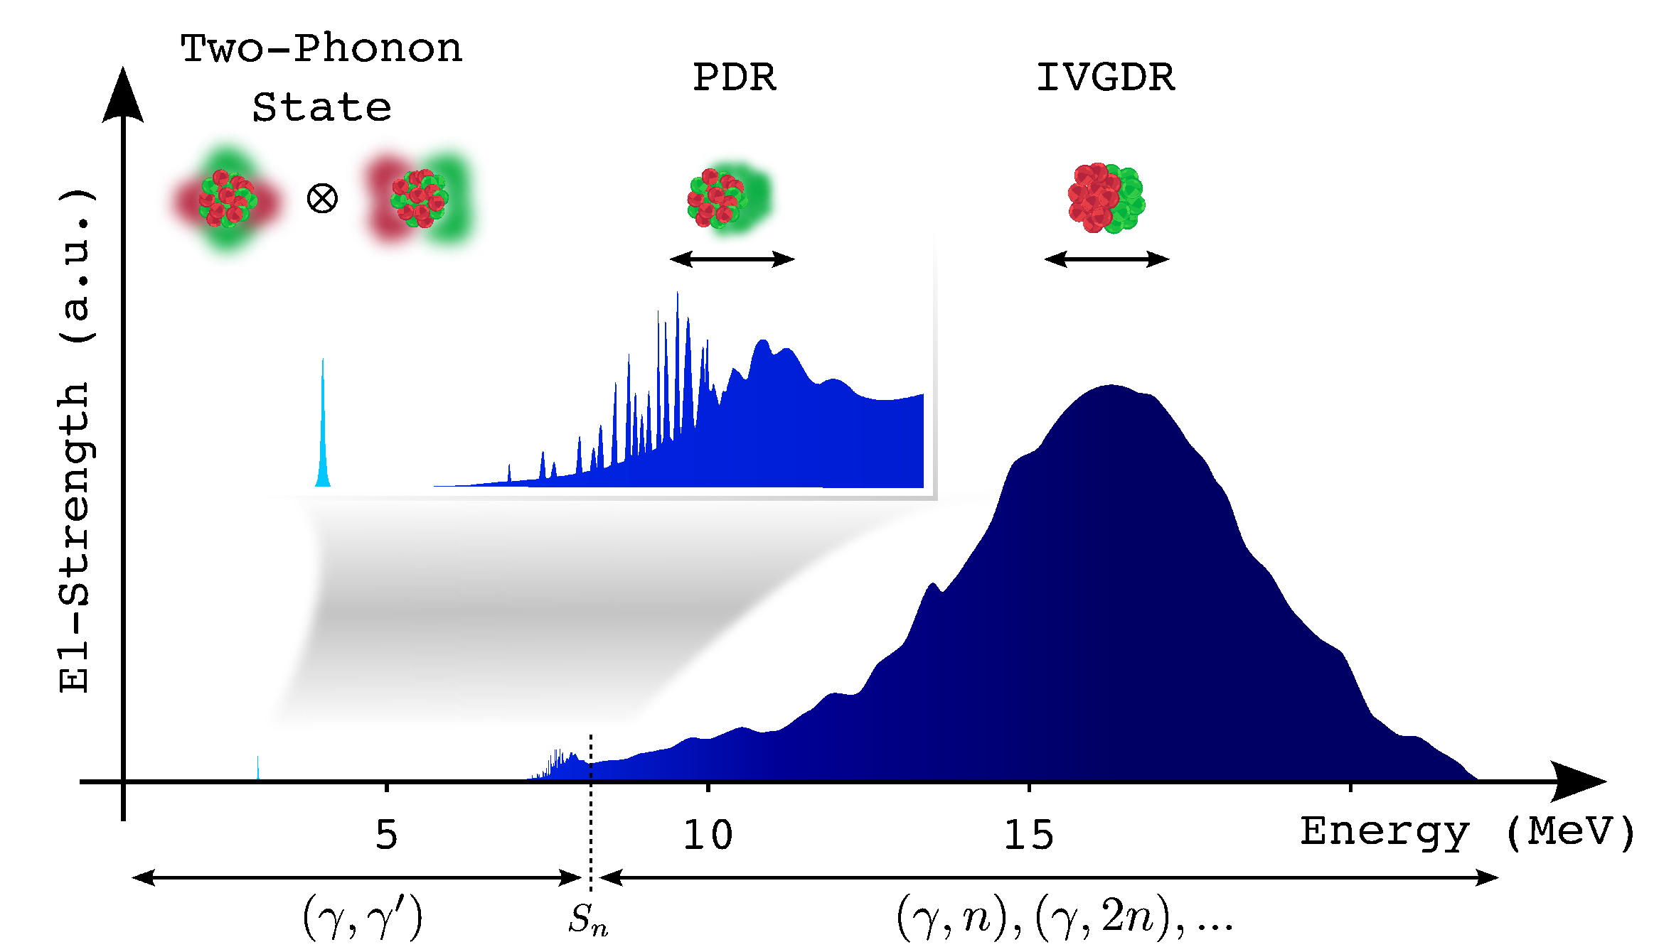
Dipole Response of Spherical Nuclei
What is the nature of this low-lying E1 strength?

Slide 3

Systematics of the PDR
different sensitivities & model dependencies
How to identify the PDR?
D. Savran, T. Aumann, and A. Zilges, Prog. Part. Nucl. Phys. 70 (2013) 210.

Slide 4
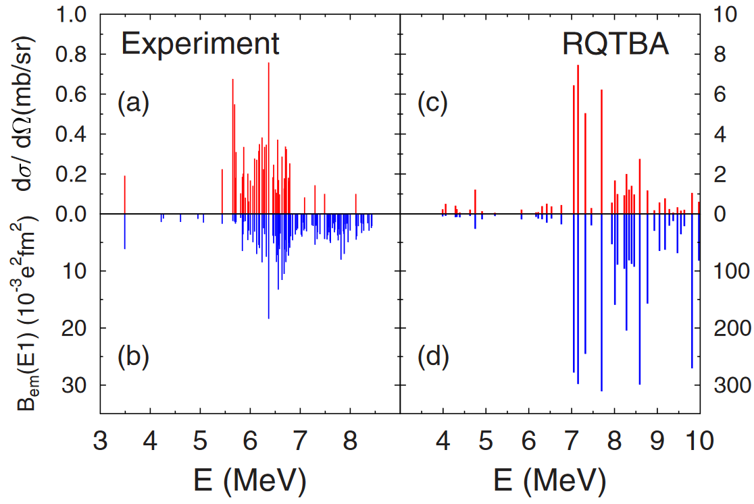



Need for Complementary Probes
$$(α,α^{′}γ)$$
$$(γ, γ′)$$
E. G. Lanza, et al., Phys. Rev. C 89 (2014) 041601(R).
J. Endres, E. Litvinova, et al., Phys. Rev. Lett. 105 (2010) 212503.
For direct evidence for contribution of surface-neutrons need difference of transition radii (form factors) for protons and neutrons

Slide 5

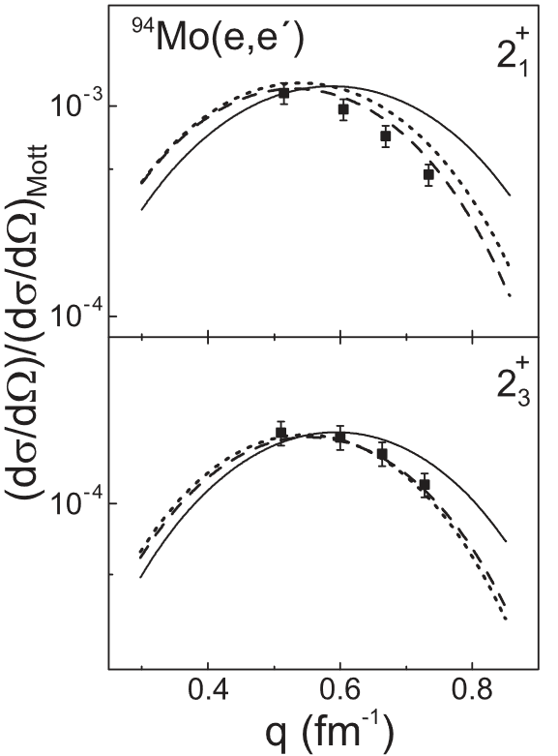
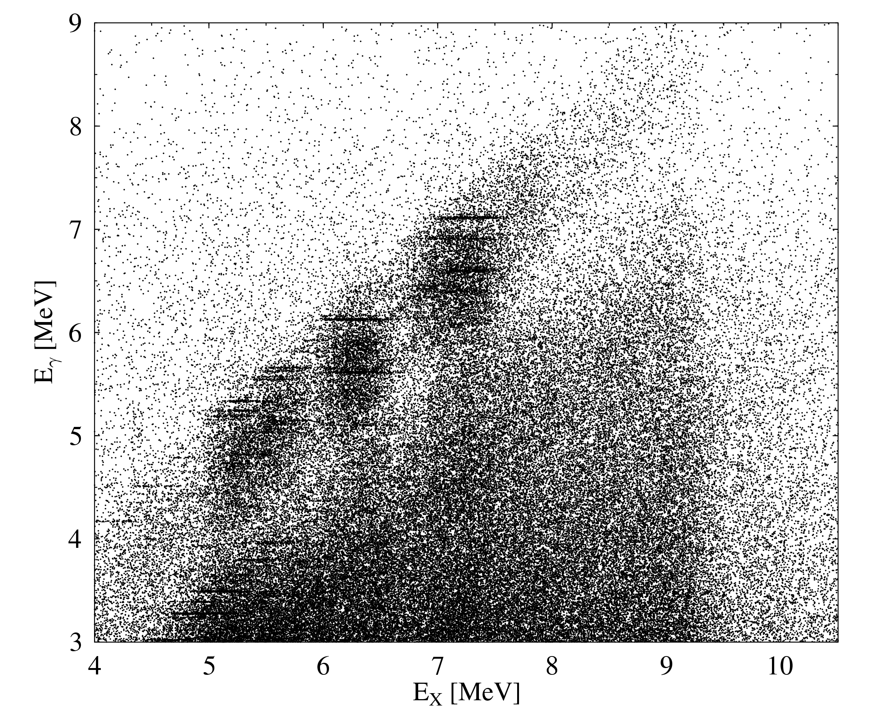



Experimental Idea: alphas vs. electrons
$$(α,α^{′}γ0)$$
$$(e,e^{′}γ0)$$
hadronic & isoscalar probe
electromagnetic & isovector probe
sensitive to protons & neutrons
sensitive to protons only!
selection of ground-state decays
E1 transitions!
e.g.
$${}^{140}Ce(α,α^{′}γ)$$
D. Savran et al., PRL97 (2006) 172502.
O. Burda et al., PRL99 (2007) 092503.

Slide 6








Experimental Idea: alphas vs. electrons
$$(α,α^{′}γ0)$$
$$(e,e^{′}γ0)$$
hadronic & isoscalar probe
electromagnetic & isovector probe
sensitive to protons & neutrons
sensitive to protons only!
different slope
in transition radii
$$R_{tr}$$
$$(α,α′)$$
Sensitive to Neutron contribution
$$(e,e^{′})$$
direct evidence for surface neutron contributions!
$$A$$
$$50$$
$$52$$
$5$4

Slide 7
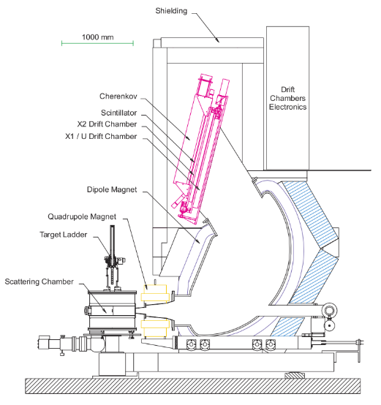
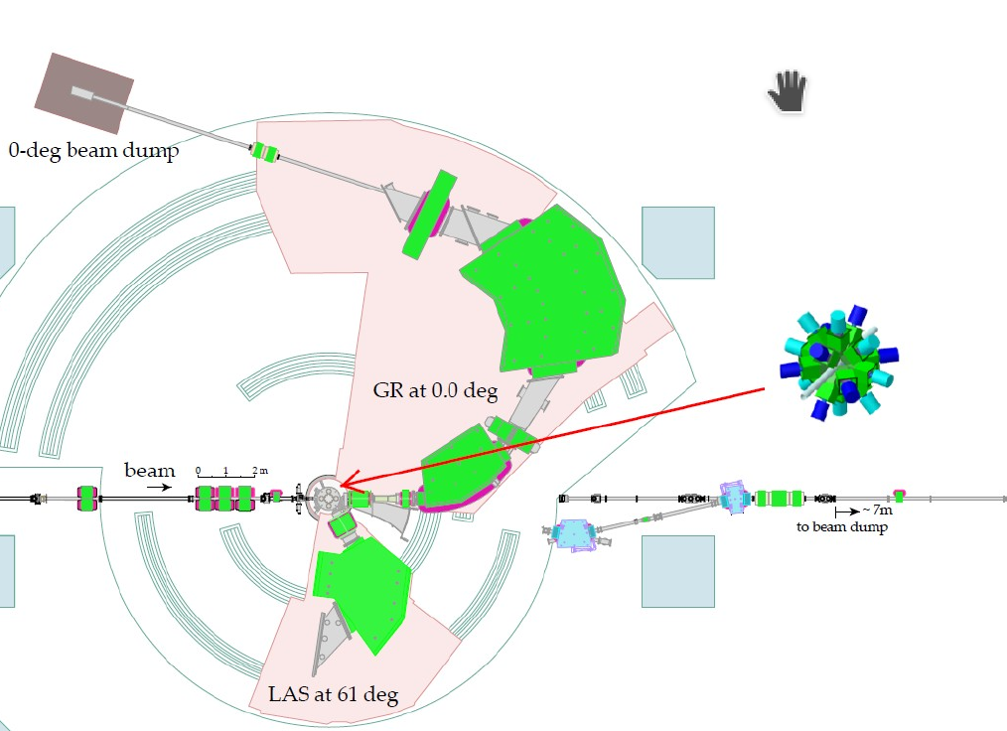
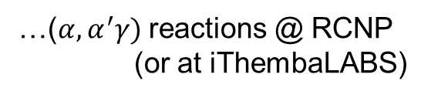

Proposal
“PDR – A neutron skin oscillation?”
- Direct experimental studies to reveal the nature of the PDR -
measure form factors in ^{50,54}Cr isotopes with …
…$(e,e^{′}γ)$ reactions @ QCLAM
…($α,α^{′}γ)$ reactions @ RCNP
(or at iThembaLABS)
Grand Raiden

Slide 8
Dynamical α-Cluster Structure of Light Nuclei
First measurement of the B(E4; 0⁺_{gs} → 4⁺₁)
Comparison to and between D₃H and microscopic ab initio models

Slide 9
Dynamical α-Cluster Structure of Light Nuclei
Valeria Dela Rocca, PhD thesis, Gran Sasso, 2017
⁹Be
Measurement of B(E1; 3/2⁻_{gs} → 5/2⁺₁)
Comparison to and between cluster-model and microscopic ab initio models
Test of multi-center Shell Model
Thanks for your attention!

