Slide 1

Perspectives on the S-DALINAC-Program of the SFB
Overview and Status Report
Gefördert durch die DFG im Rahmen des SFB 1245

Slide 2
Perspectives on the S-DALINAC-Program of the SFB
Overview and Status Report
Reminder at Experimental Program
Overview on Projects at the S-DALINAC
Introduction to Experimental Setups
Upcoming Experiments
Beam Schedule
Gefördert durch die DFG im Rahmen des SFB 1245

Slide 3
Structure of SFB 1245
Notes:
Explain logo

Slide 4
Project Groups and Projects
Projects | Major research goals | Physics case
A01 | Precision structure of light nuclei | Test of ab-initio calculations with χEFT interactions for light nuclei
A03 | Electromagnetic structure of light-to-medium-mass nuclei | Test of χEFT interactions for carbon isotopes and for medium-heavy nuclei
A07 | New electromagnetic properties of collective excitations | Nuclear currents and EM decay pattern of resonances
B02 | Constraining and testing electroweak matrix elements | Momentum-transfer dependence and quenching of electroweak transitions
B03 | Constraining nuclear matrix elements for fundamental symmetries | Nuclear structure relevant for 0νββ decay and dark-matter searches
B04 | Electric dipole response and nuclear EoS | Electric dipole strength in tin isotopes, neutron-skin thickness, symmetry energy

Slide 5
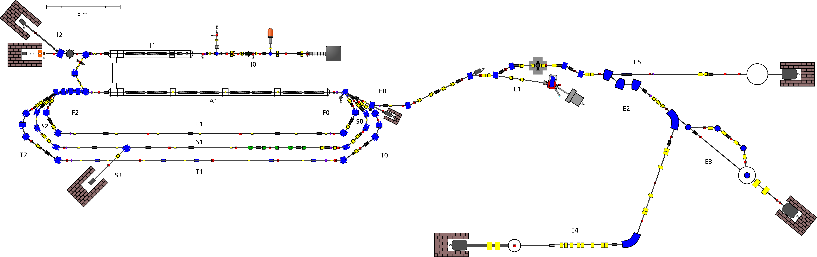
S-DALINAC
Superconducting-DArmstadt-LINear-ACcelerator
Spin-Polarized Electron Gun
5 m
Thermionic Gun
Injector
NEPTUN
DHIPS
LINAC
180° Setup@ QCLAM
Recirculation Beam Lines
169° LINTOTT Magnet Spectrometer
QCLAM Magnet Spectrometer
Thrice recirculating operation
Energy gain injector:
Energy gain LINAC:
7.6 MeV
30.4 MeV
Beam current: up to 20 µA
Beam energy: up to 130 MeV

Slide 6
Experimental Program
Facility | Projects | Experimental techniques and observables
DHIPS | A01 | Relative Self-Absorption: electromagnetic matrix elements
 | A03 | Nuclear Resonance Fluorescence: electromagnetic matrix elements
 | B03 | Nuclear Resonance Fluorescence: electromagnetic matrix elements
NEPTUN | B04 | Nuclear Resonance Fluorescence, Photodisintegration: photo response, contributions to dipole polarizabilty
LINTOTT | A01 | Elastic Electron Scattering (e,e): form factors, transition radii
 | B03 | Inclusive inelastic Electron Scattering (e,e’): form factors
QCLAM | A01 | (e,e‘) on LHe target: monopole transition form factors
 | A03 | (e,e‘) on radioactive ¹⁴C-target: form factors, EM matrix elements
 | A07 | (e,e‘γ)-coincidences: γ-decay/fine structure of GDR, nuclear vorticity
 | B02 | (e,e‘) at 180º: form factors for transversal nuclear excitations
 | B03 | (e,e‘): form factors, E0 matrix elements, shape coexistence

Slide 7
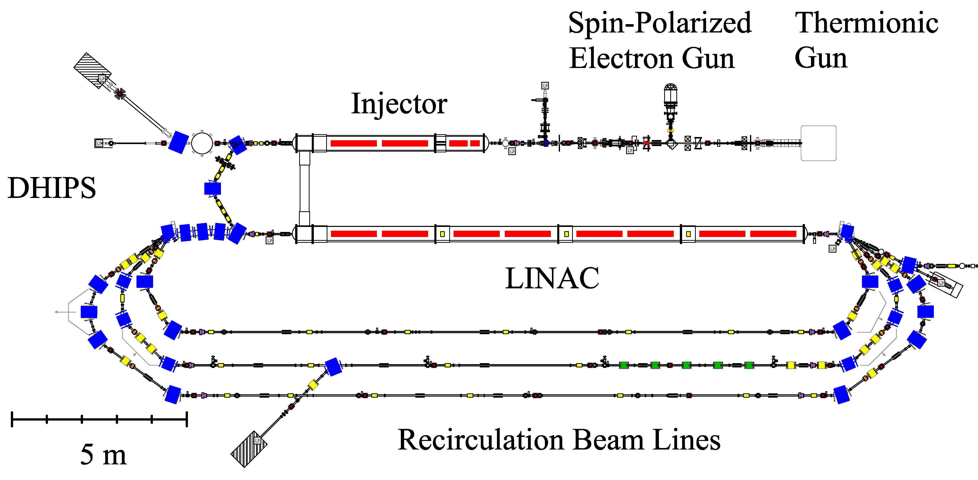
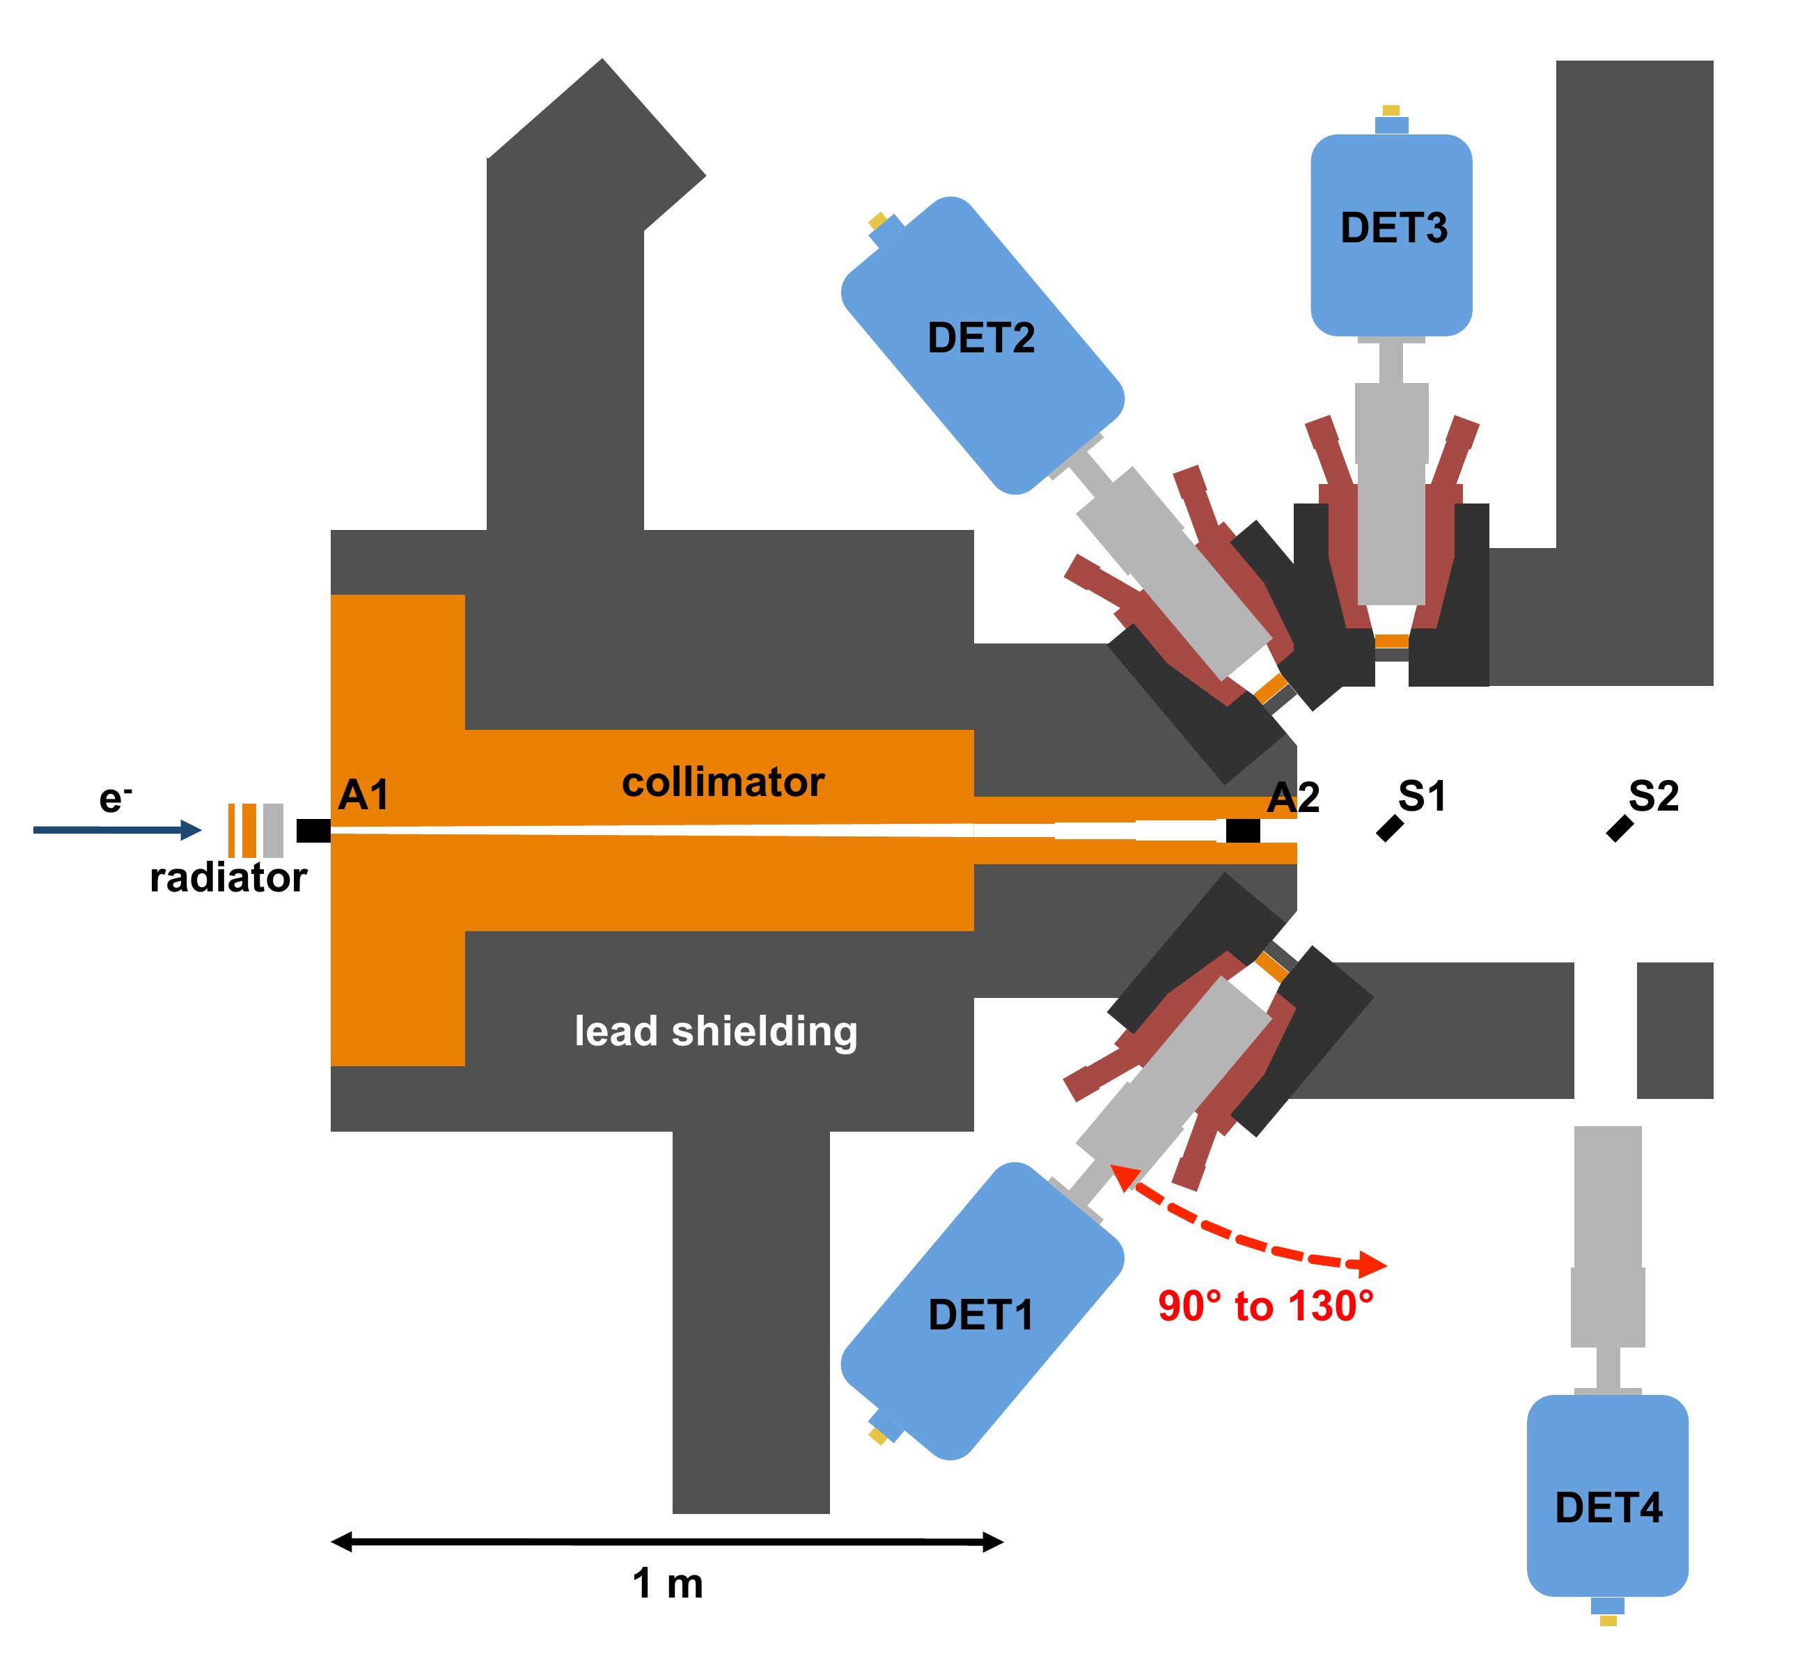
Darmstadt High-Intensity Photon Setup - DHIPS
The DHIPS setup:
  At the S-DALINAC injector for bremsstrahlung beams up to 10 MeV
  High photon flux of about 10² photons/eV/s/cm² for high-resolution spectroscopy after photo-excitation
Observables:
  Excitation cross sections
  Dipole excitation strengths, branching ratios
  Natural line widths
  Spin assignments through angular distributions
Status: Ready to run

Slide 8
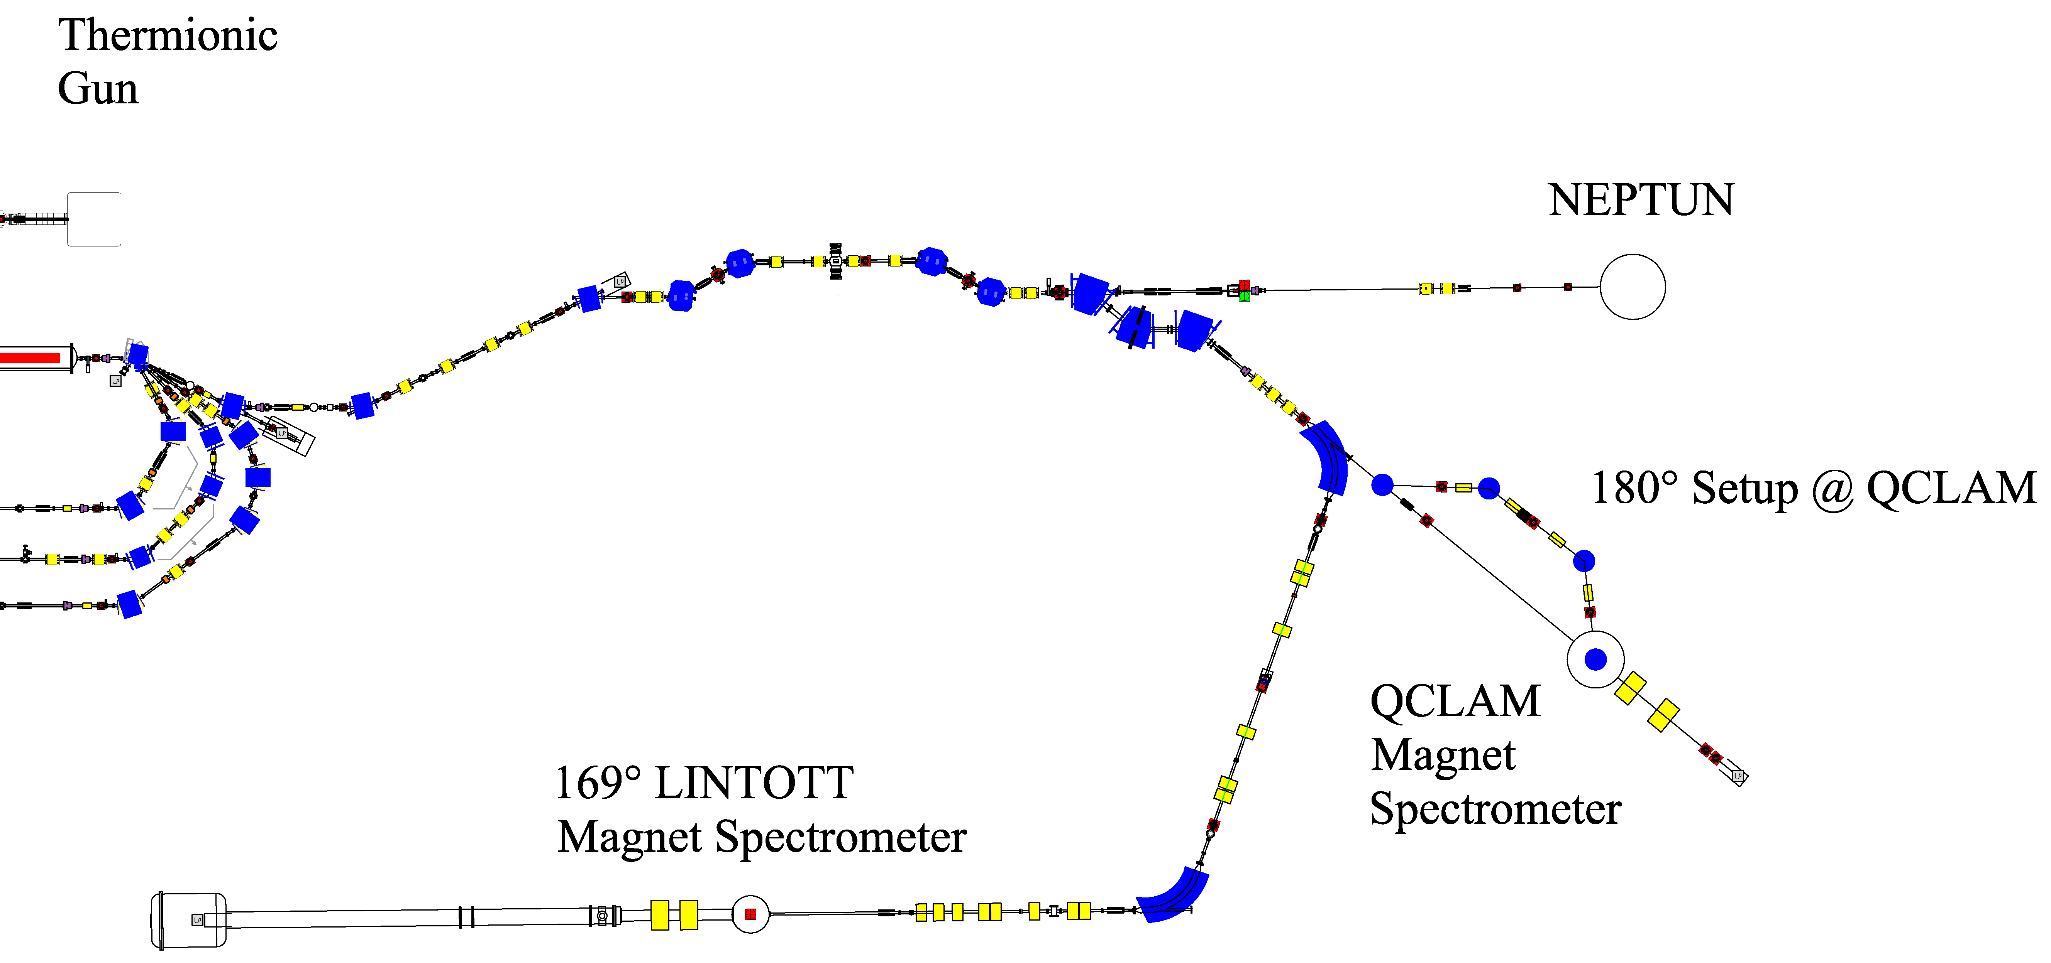
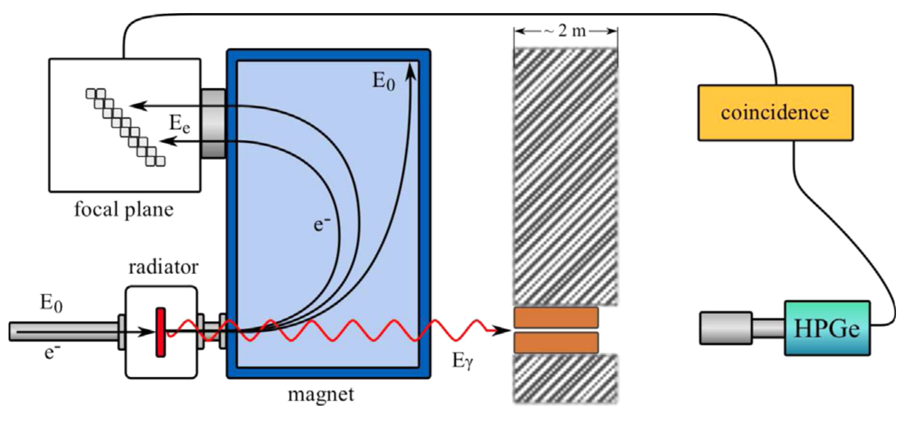
High Resolution Photon Tagger - NEPTUN
The low-energy photon tagger:
  Low-energy (5-35 MeV) quasi-monoenergetic tagged photons with intensities up to 1 photon/eV/s
  Single-photon energy tagging with a resolution of ~ 200 keV
  Tagging a large energy range of 10 MeV in one setting
Observables:
  Photoexcitation cross sections
  E1 strength distribution
  γ/n – decay branching
Status: Beam dump under installation → B04

Slide 9
High Resolution Electron Scattering at the LINTOTT Spectrometer
LINTOTT magnetic electron spectrometer:
  Operated in energy-loss mode (Energy resolution of ΔE/E ~ 1⋅10⁻⁴)
  Solid angle of 4 msr
Observables:
  Elastic-scattering cross sections
  Excitation cross sections
Status:
  New MBS based DAQ in 2017
  Successful test of DAQ in Dec. 2017
  New scattering chamber to be delivered in August 2018
  Currently offline due tue dismounted chamber
Conventional
mode
Energy-loss mode

Slide 10
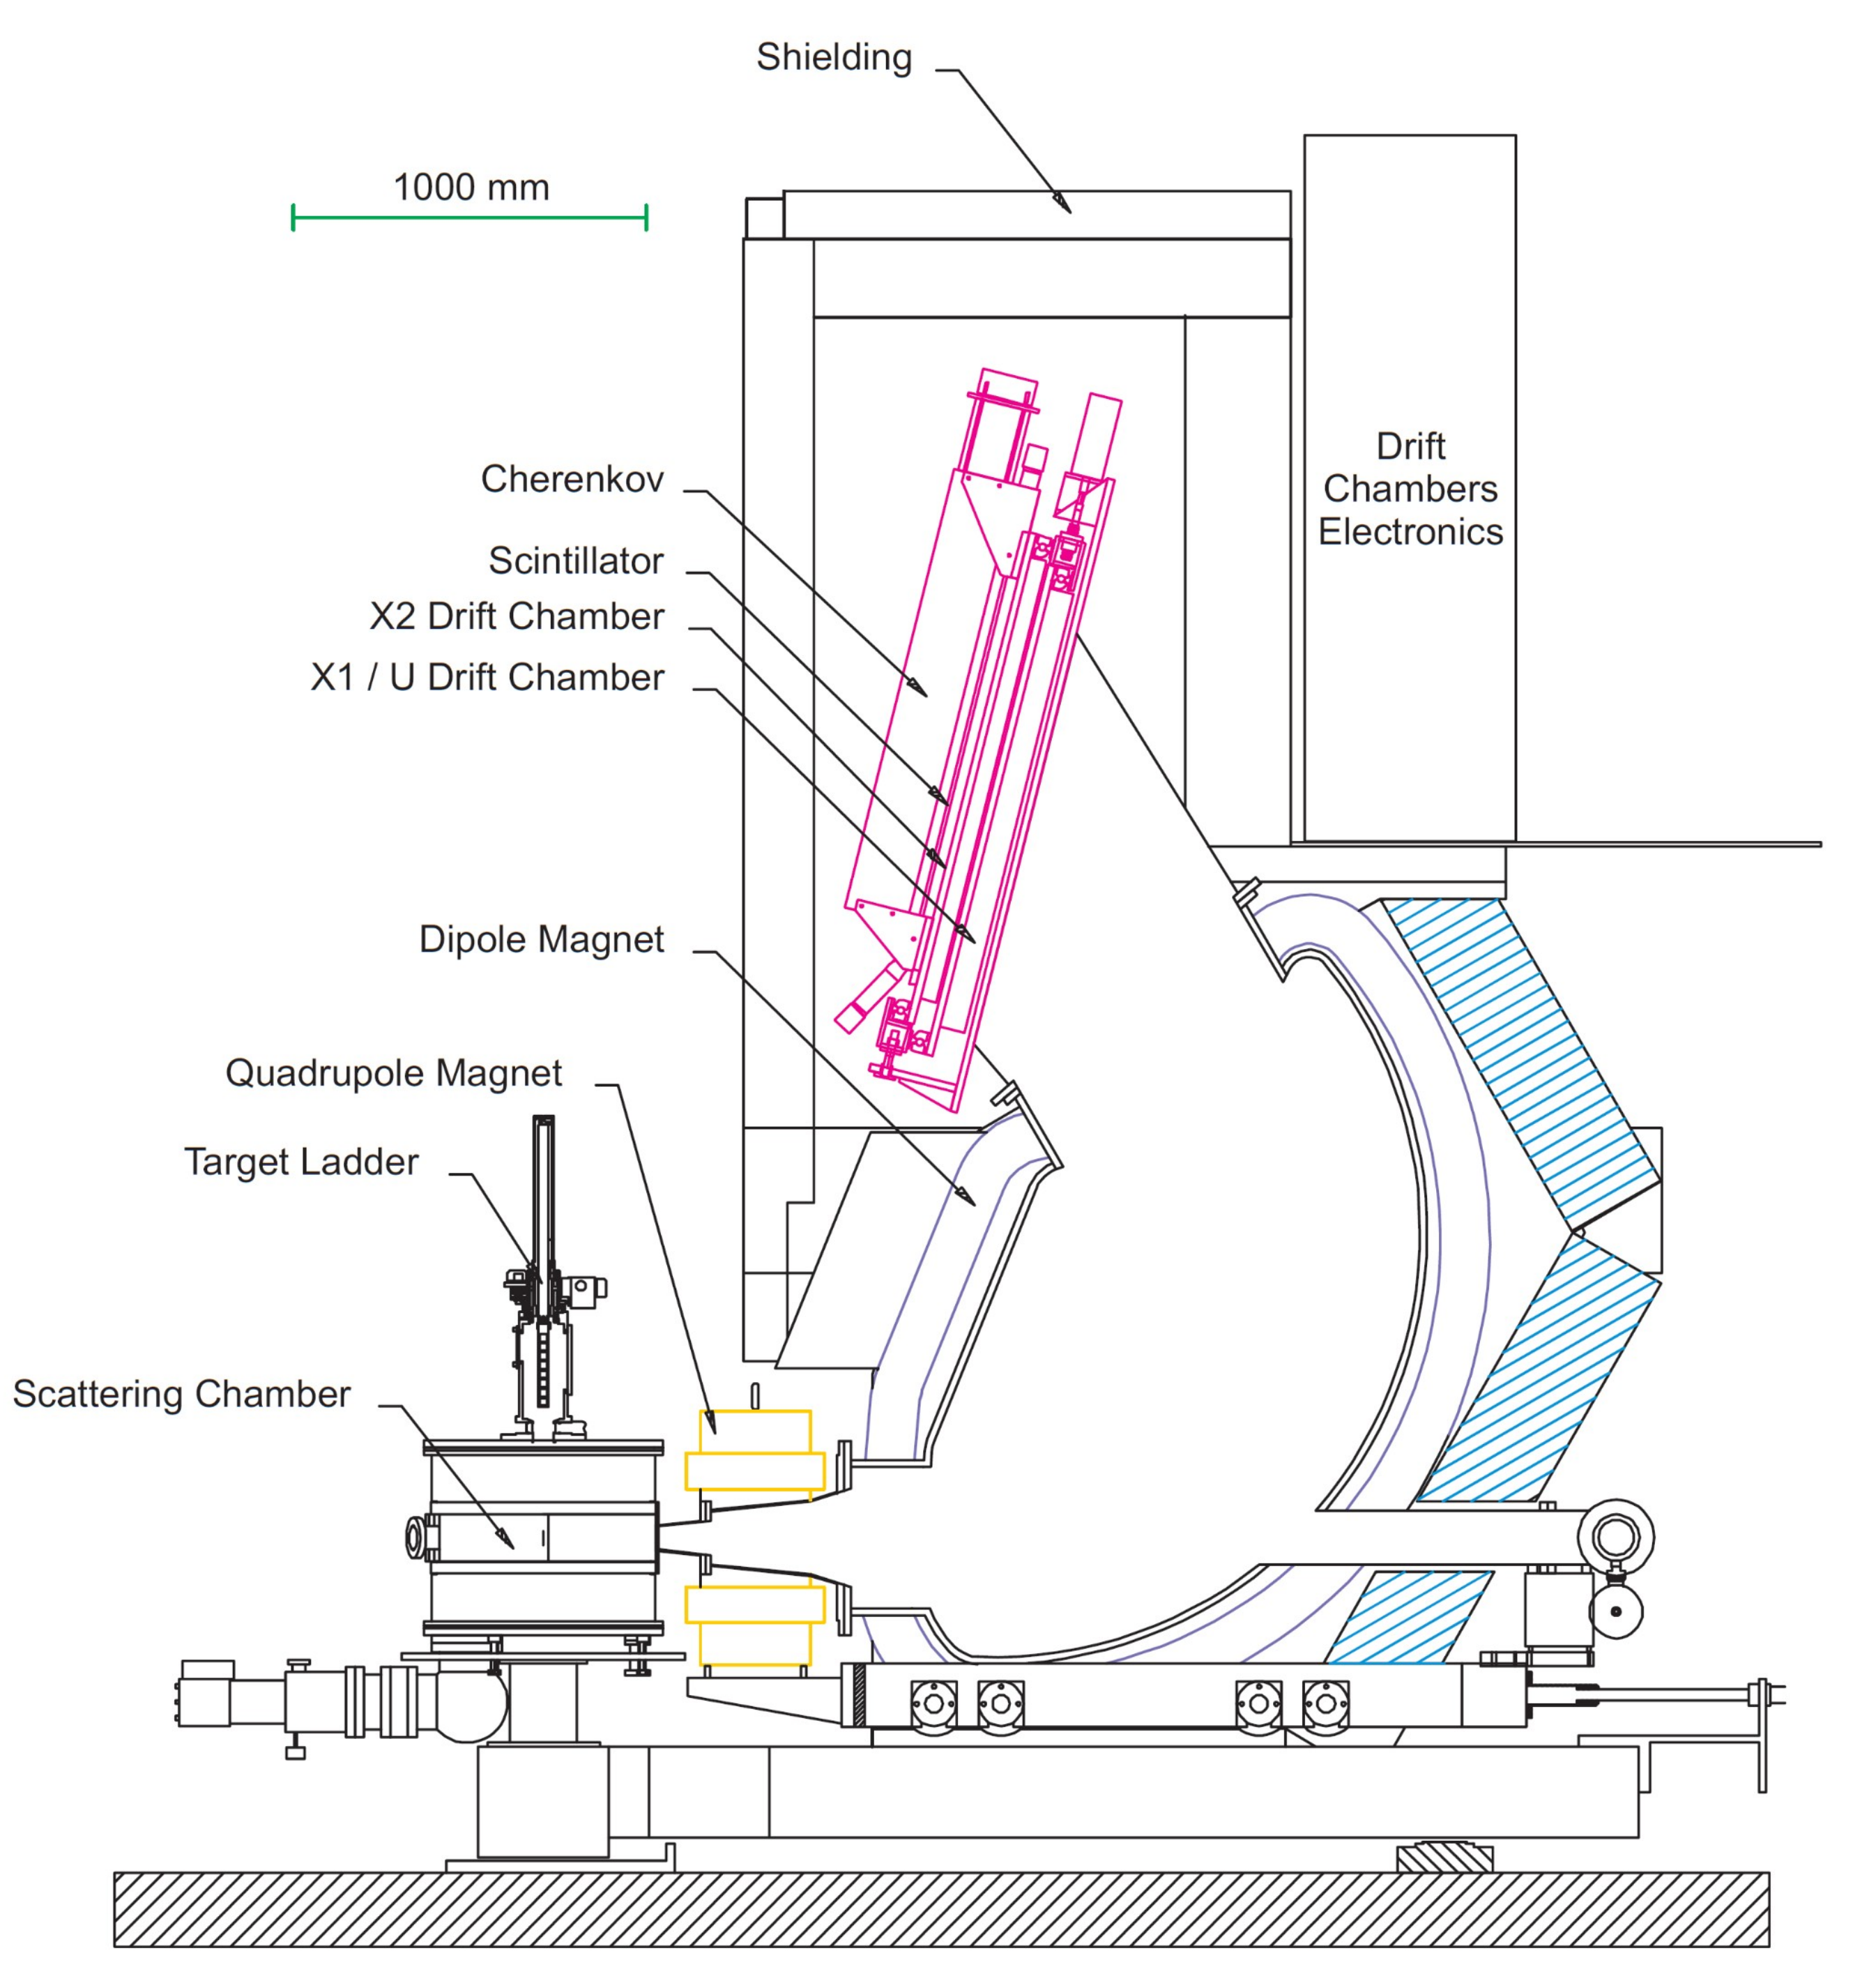
Electron Scattering at the QCLAM Spectrometer
QCLAM magnetic electron spectrometer:
  Energy resolution of ΔE/E = 4⋅10⁻⁴
  Large solid angle of up to 35 msr
  Large momentum bite Δp/p = 20 %
Allows to perform:
  Coincidence experiments
  Measurements at 180° angle
Observables:
  Elastic and inelastic cross sections
  Form factors
Status general overhaul:
  Repaired drift chambers
  New DAQ with basic software readout
  LHe chamber
  Recommissioning of coincidence setup and 180° beam line (close to completion)
  Ready for commissioning, waiting for beam

Slide 11
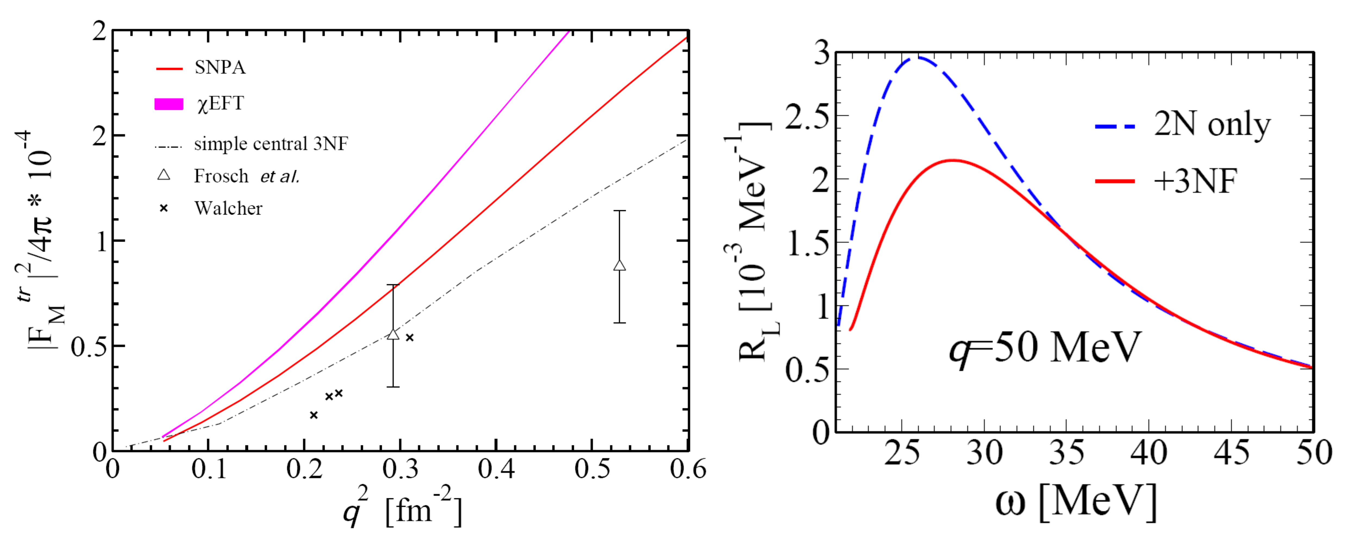
Research Project A01
Precision structure of light nuclei
PI‘s: Nörtershäuser, Wilfried, Prof. Dr., Pietralla, Norbert, Prof. Dr. Dr. h.c.
Research goal:
  Precision measurements of light nuclei to sensitively test ab initio calculations with chiral EFT interactions
Key experiments:
  Electric monopole transition form factor and width of the first excited state of ⁴He
  Magnetic dipole strength of the first excited 0⁺ state of ⁶Li
  Charge radius of the one-proton halo nucleus ⁸B
(0₁⁺→ 0₂⁺)
  ⁴He
  ⁴He

Slide 12
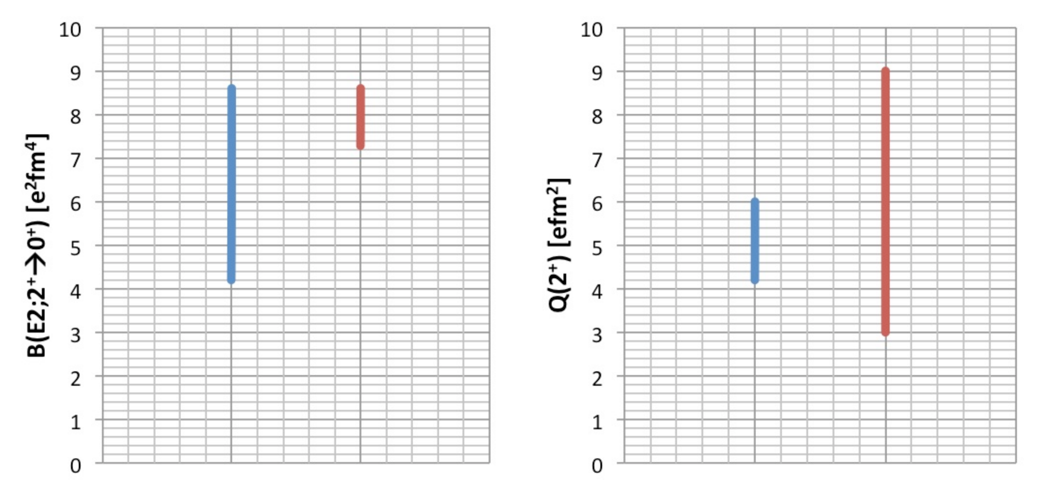
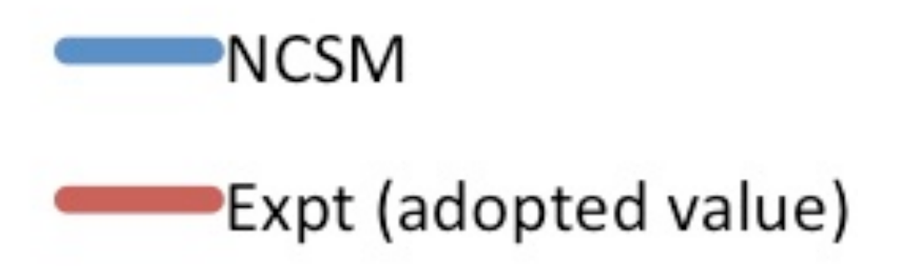
Research Project A03
Electromagnetic structure of light to medium-mass nuclei
PI‘s: Nörtershäuser, Wilfried, Prof. Dr., Petri, Marina, Prof. Ph.D.
Research goals:
  Electromagnetic matrix elements for chiral EFT interactions in the carbon isotopes and its extension into the medium-heavy nuclei
Key experiments:
  Electromagnetic matrix elements for excited states of carbon isotopes ^{12,14,16}C
  Ground-state nuclear moments and charge radii of ^{52,53,55}Fe and of 11/2– isomers of ¹⁰⁹⁻¹¹⁹Pd
¹²C
¹²C

Slide 13
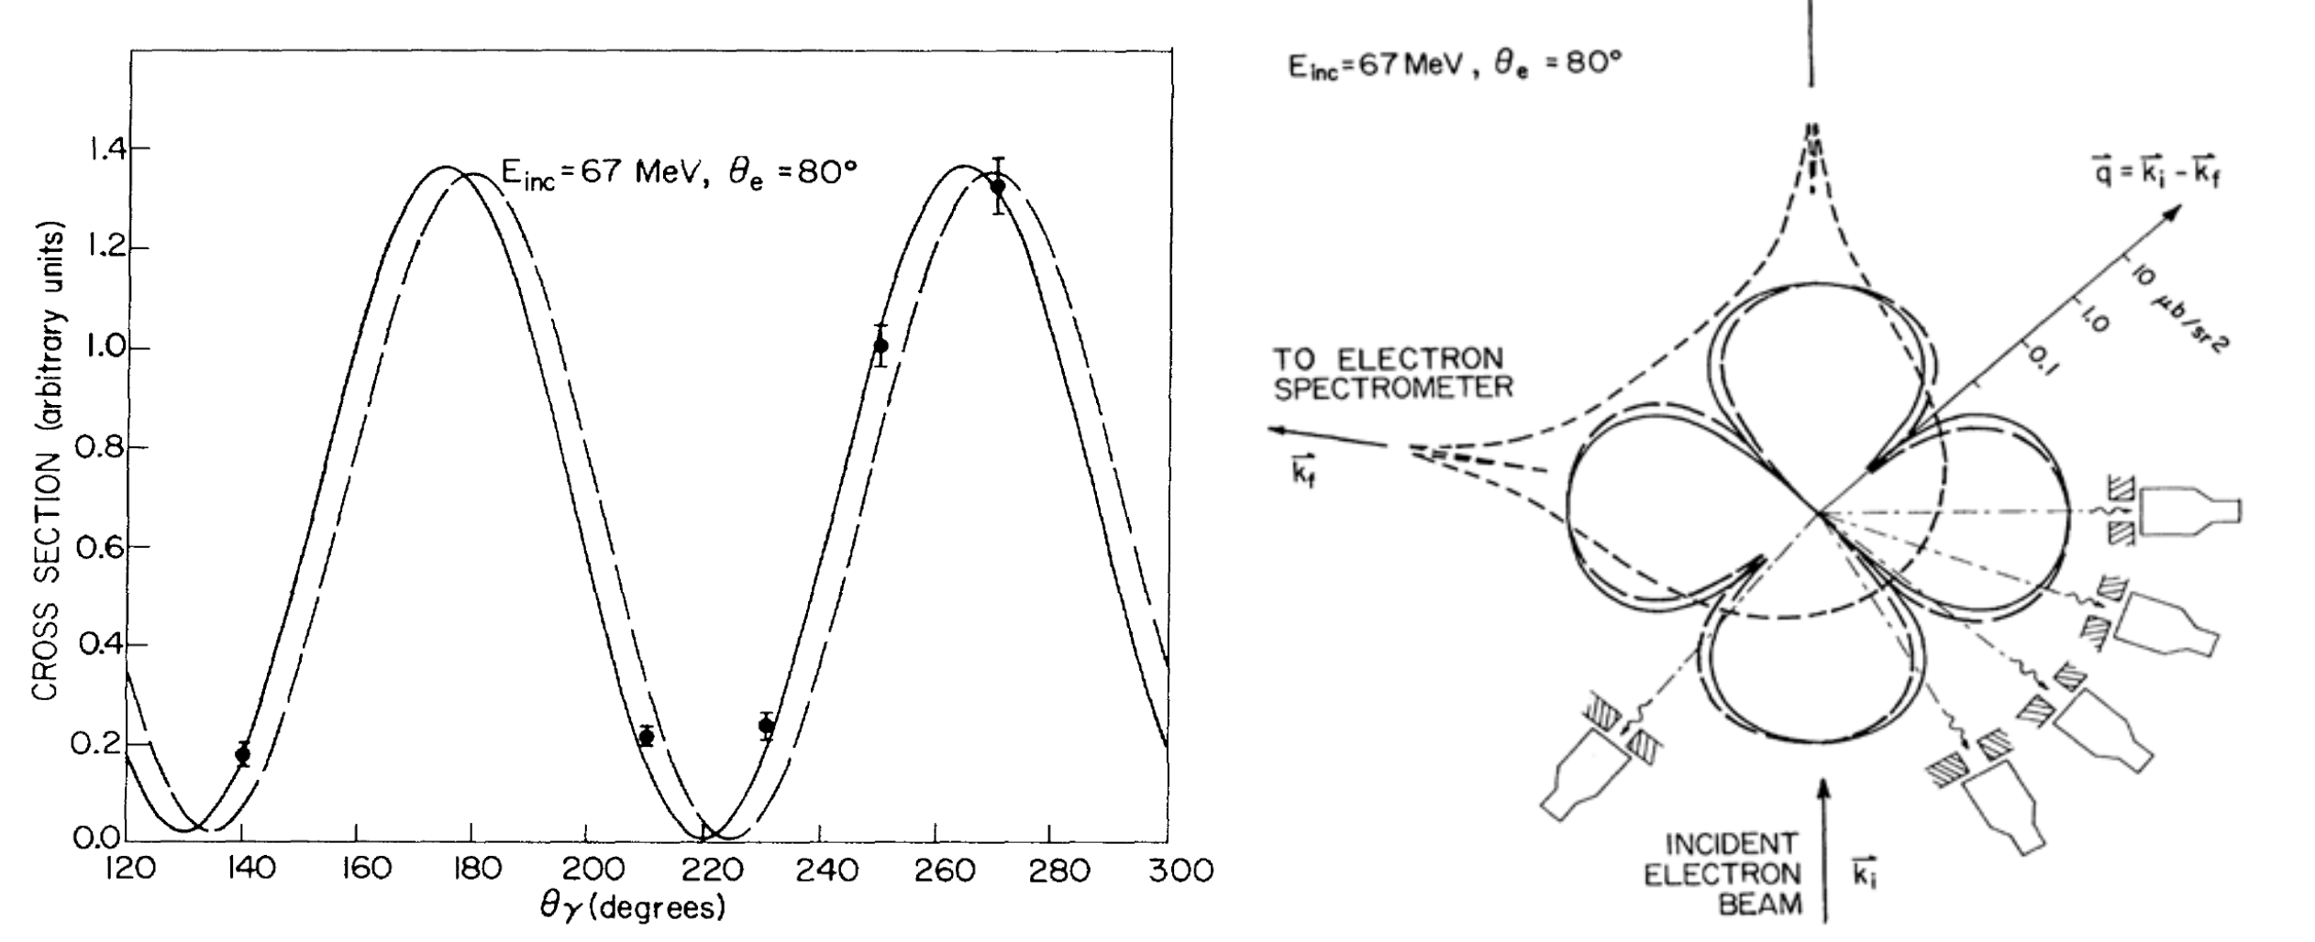
Research Project A07
New electromagnetic properties of collective excitations
PI‘s: Pietralla, Norbert, Prof. Dr. Dr. h.c., Wambach, Jochen, Prof. Dr.
Research goals:
  γ-decay pattern of giant resonances (GDR), doorway concepts for the decay into complex configurations, nuclear currents
Key experiments:
  Establishment of a world-wide unique (e,e‘γ) set-up
  γ-decay of the isovector GDR to low-energy excited states of medium-heavy nuclei (^{112,124}Sn)
  Vorticity of transition currents for valence-shell excitations of a medium-heavy nucleus (⁹²Zr)
Theory developments:
  QPM calculations in a (1+2)-phonon and (1+2+3)-phonon basis for E1-distributions and velocity fields
  Development of a dedicated DWBA code for the (e,e’γ) reaction to properly account for distortion effects of the electron waves in the Coulomb field of heavy nuclei
¹²C, 2₁⁺

Slide 14
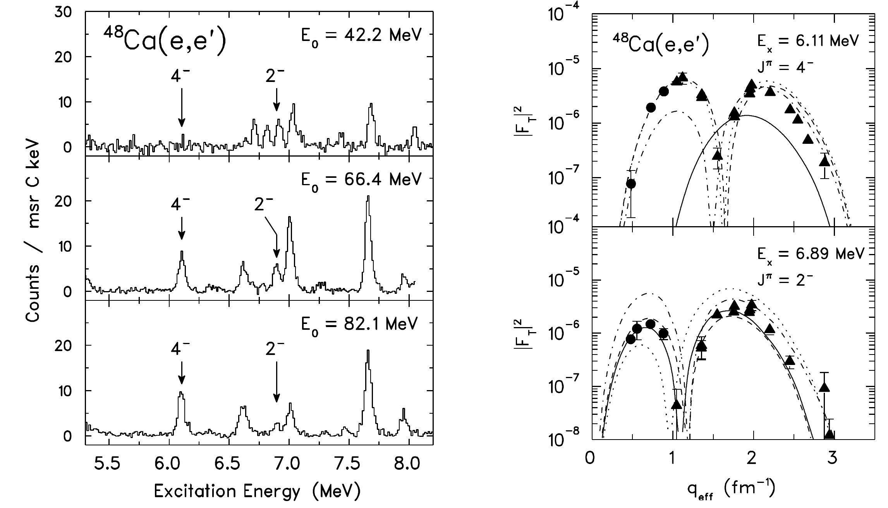
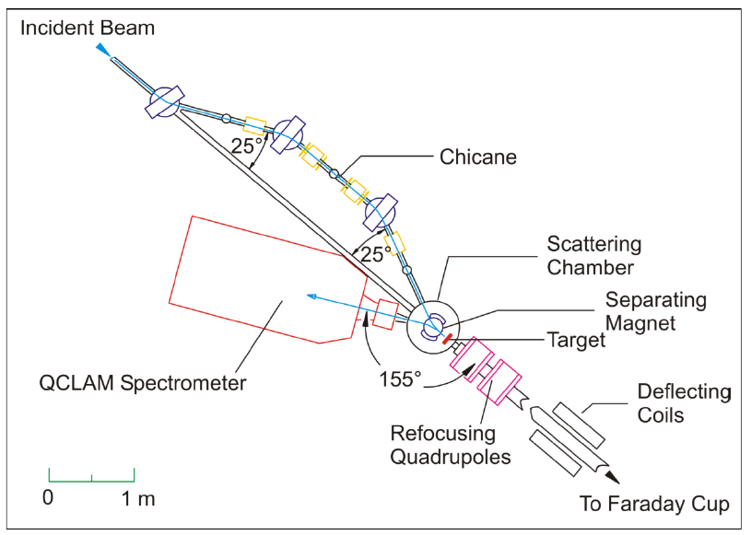
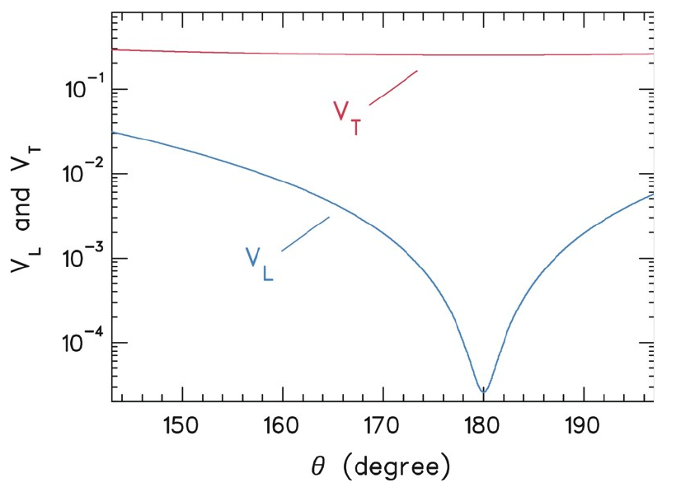
Research Project B02
Testing and simulating electroweak interactions in nuclei
PI‘s: Enders, Joachim, Prof. Dr., von Neumann-Cosel, Peter, Prof. Dr.
Research goals:
  New insights into quenching of the spin-isospin strength in nuclei common to electromagnetic and weak processes
Key experiments:
  Form factors of M2 transitions analog to first-forbidden decay (¹⁶O, ^{42,44}Ca)
  Form factor of an M3 transition analog to second-forbidden decay (¹⁰B)
  Momentum-transfer dependence of quenching of Mλ transitions (^{40,48}Ca)

Slide 15
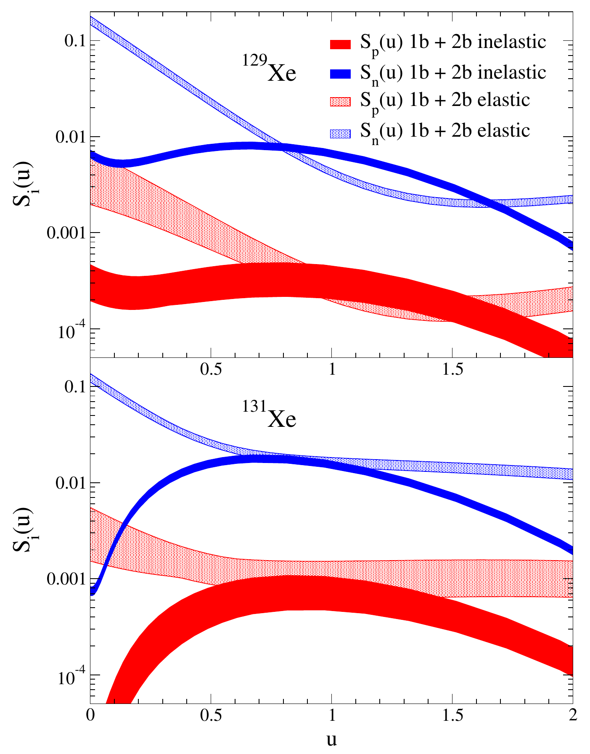
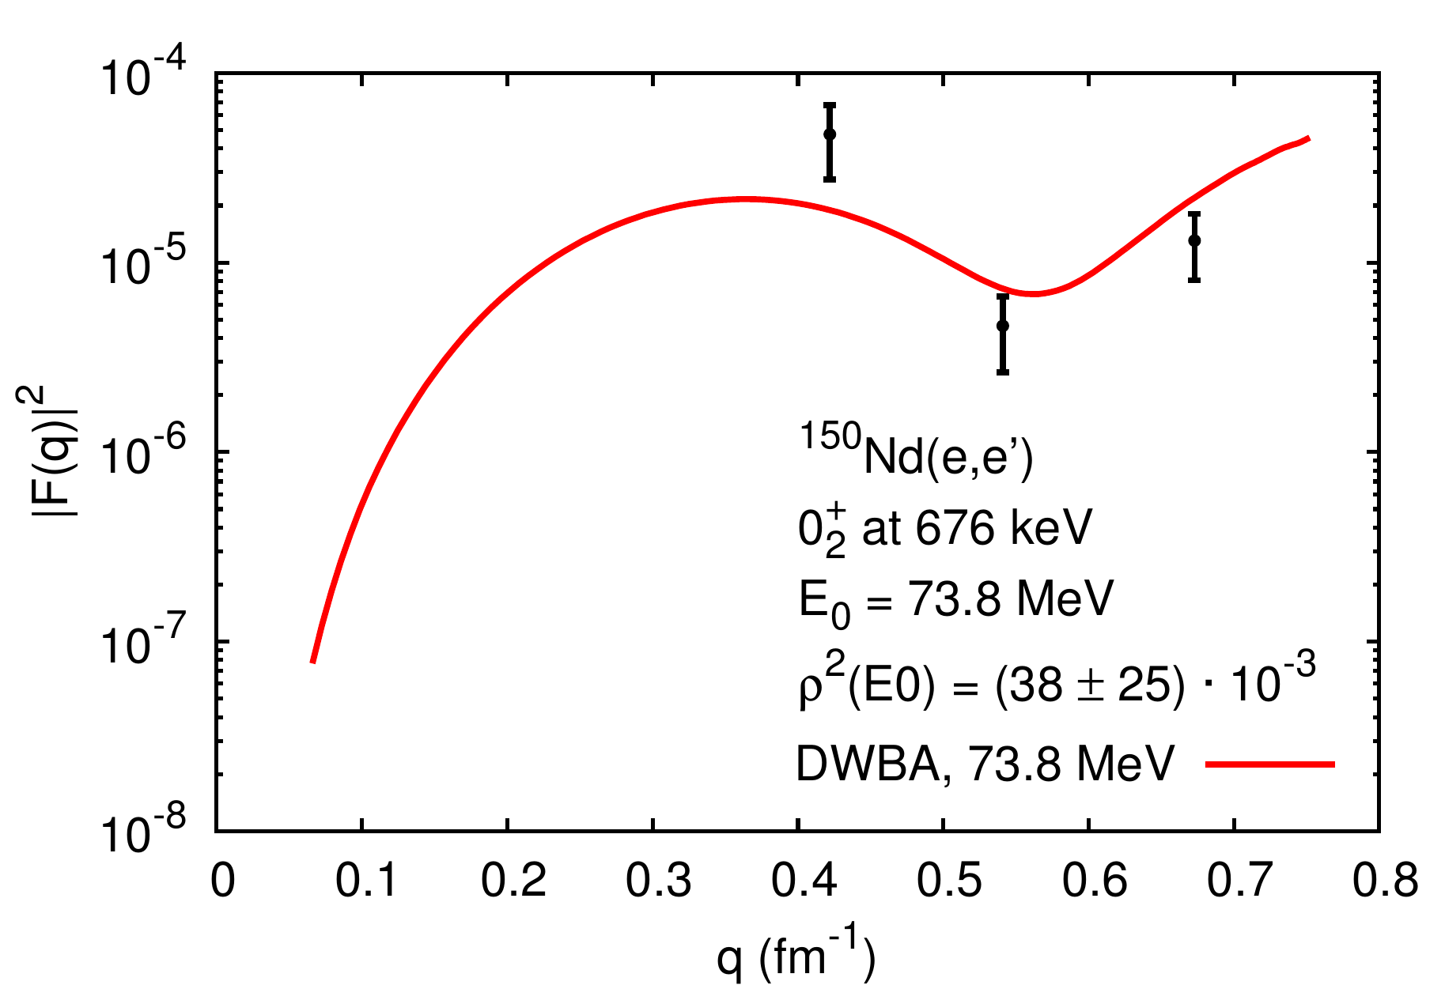
Research Project B03
Constraining nuclear matrix elements for fundamental symmetries
PI‘s: Enders, Joachim, Prof. Dr., Werner, Volker, Dr.
Research goals:
  Nuclear structure aspects relevant to nuclear matrix elements for neutrinoless double-beta (0νββ) decay and in dark-matter direct detection
Key experiments:
  Elastic and transition form factors from electron-scattering off the odd-mass isotopes ^{129,131}Xe
  Constraining shape-mixing effects in the 0νββ partners such as ¹⁵⁰Sm and ¹⁵⁰Nd through the decay behavior of the scissors mode
  Constraining shape-mixing effects in the ββ-emitter ⁷⁶Ge from E0 monopole transition strengths

Slide 16
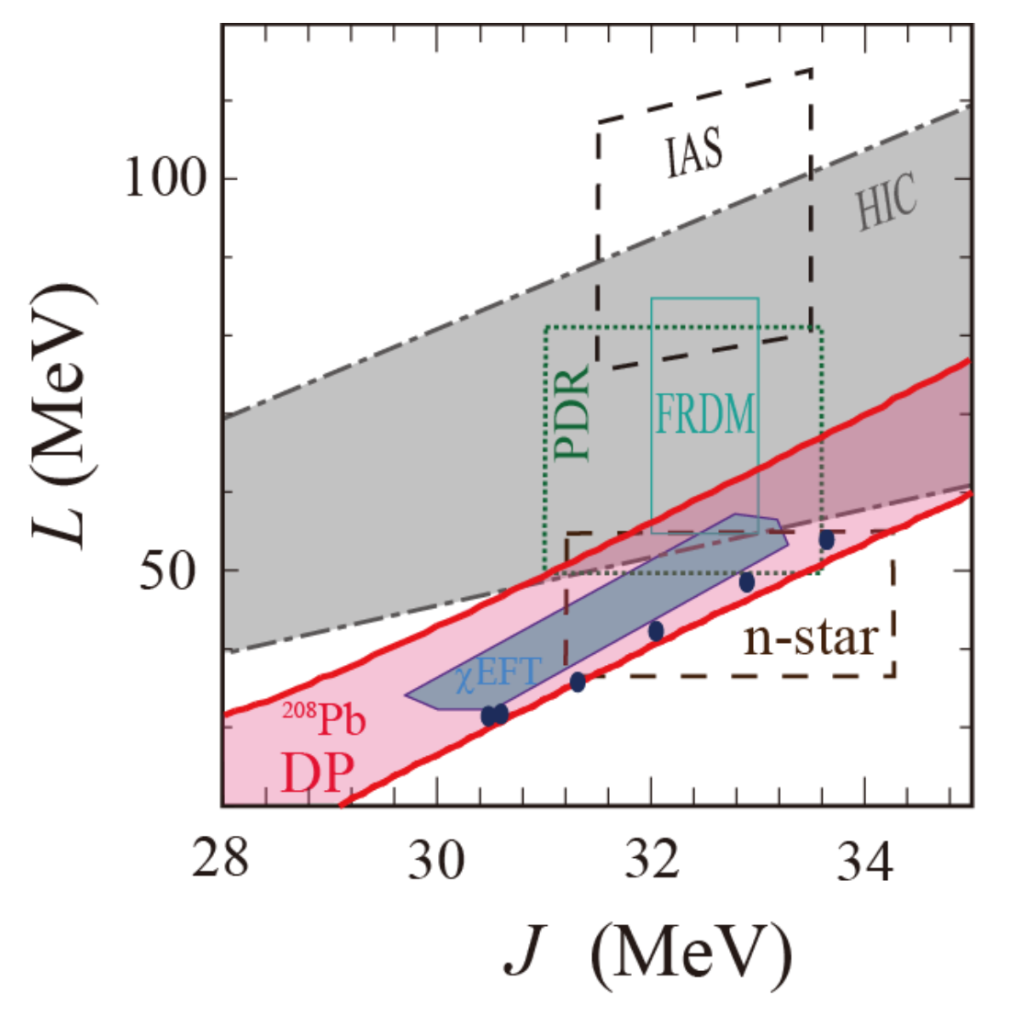
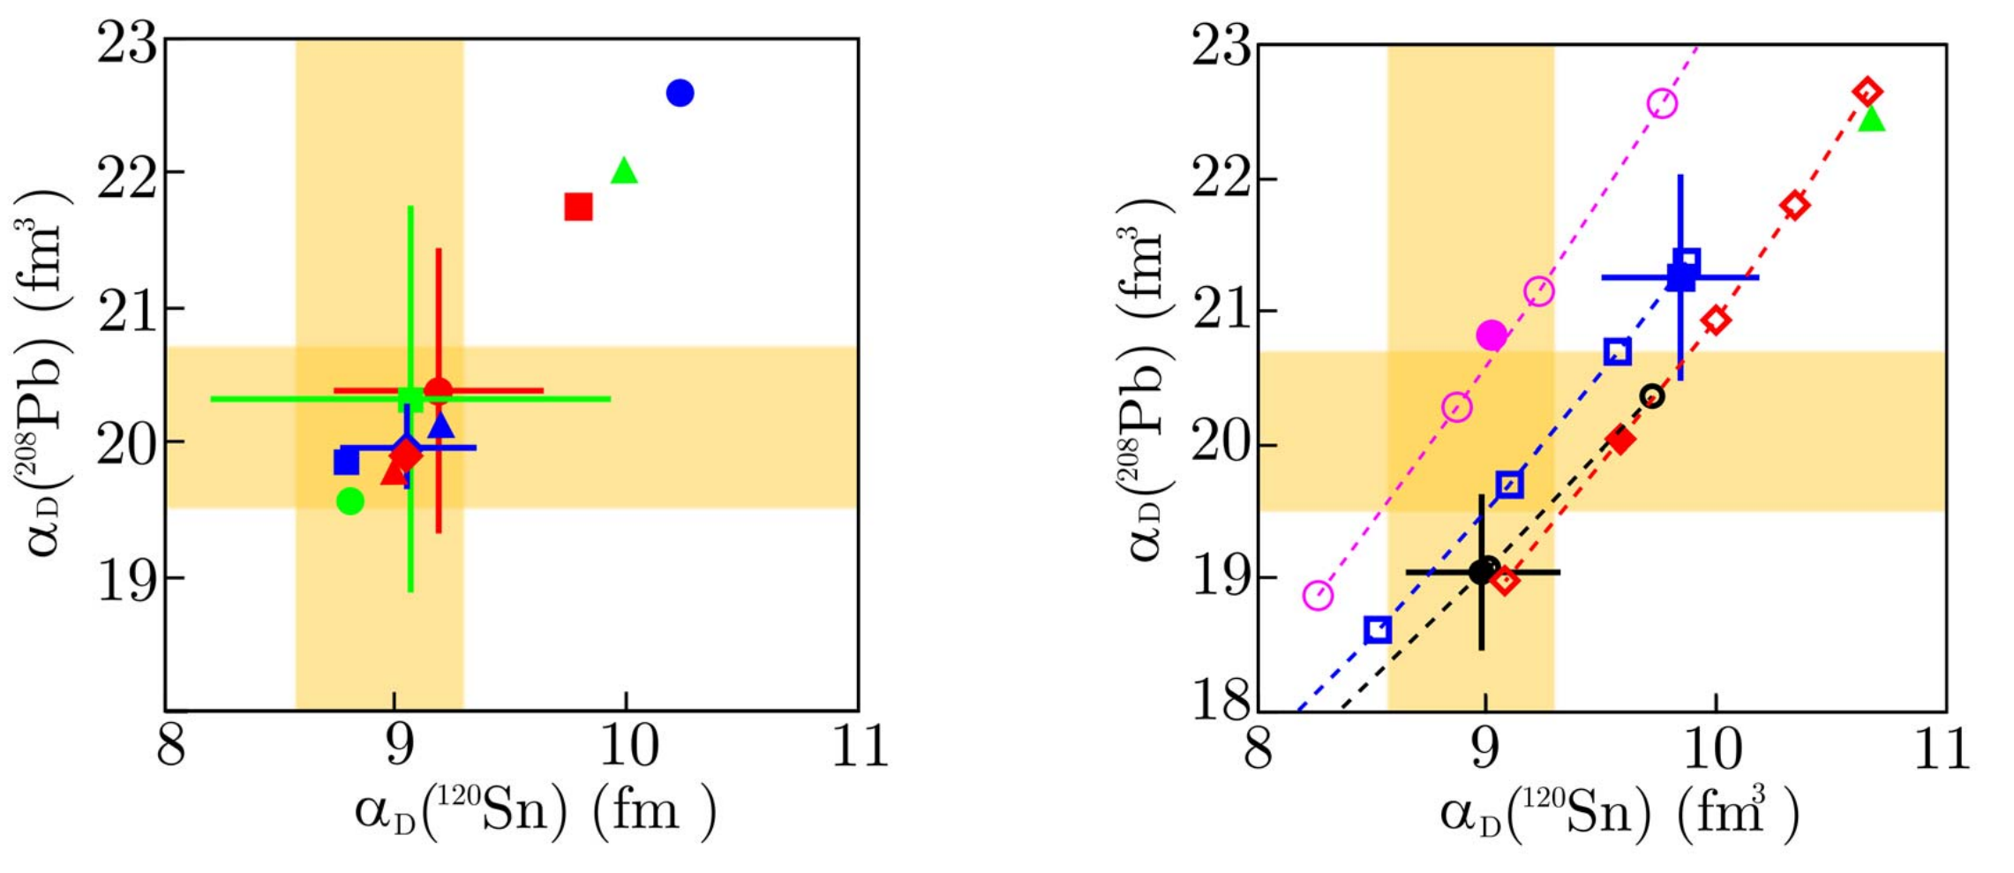
Research Project B04
Electric dipole response and neutron equation of state
PI‘s: von Neumann-Cosel, Peter, Prof. Dr., Scheit, Heiko, Priv.-Doz. Ph.D.
Research goals:
  Systematic understanding of the electric dipole strength distribution in the stable tin isotopes, dipole polarizability, neutron-skin thickness
Key experiments:
  Polarizability of stable tin isotopes (^{112,116,120,124}Sn) from (p,p’) scattering at extreme forward angles
  Complete E1 excitation-strength distributions and decay information in ^{112,116,120,124}Sn from photon scattering at the NEPTUN tagger
  γγ-decay probability of allowed γ-decay transitions

Slide 17
Experiments over the
Upcoming Beam Time
Project | Experiment
A01 | ⁴He(e,e‘): 0₁⁺ → 0₂⁺ @ 20.2 MeV | LHe @ QCLAM, first production run
A03 | ¹²C(e,e‘): B(E2; 0₁⁺ → 2₁⁺) | calibration, performance test QCLAM
A07 | ¹²C(e,e‘γ) | coincidence performance test QCLAM
B02 | ¹⁰B(e,e‘) | recommissioning 180° scattering, first production run
B04 | ¹²⁴Sn(γ_{t},γ‘) | performance test + first production run
Beam-time schedule: end of next presentation
Thanks for your attention!

Slide 18

Current Beam-Time Schedule
Cooldown, tests cavities and He-refrigerator
Q-CLAM 180°
Beam tuning, machine experiments, KW 37 installation of LHe-target
Q-CLAM 180° (35 MeV single pass)
Neptun Tagger
Twice recirculating ERL
Q-CLAM
Diamond detector tests
Q-CLAM He-Target

