Slide 1
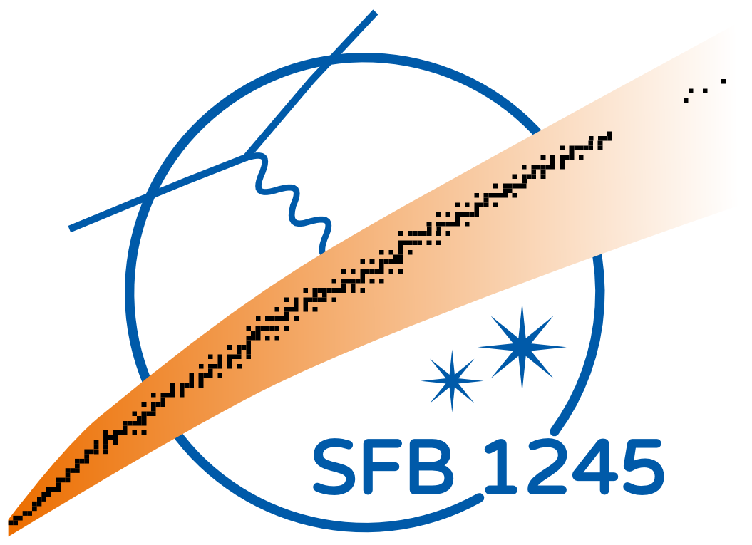
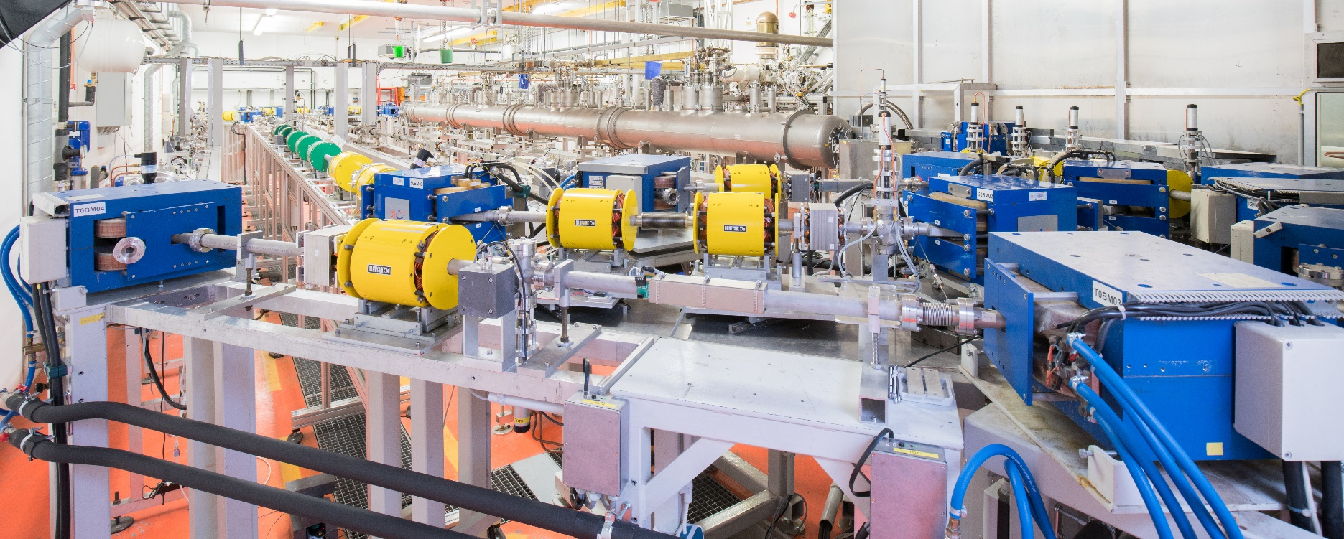
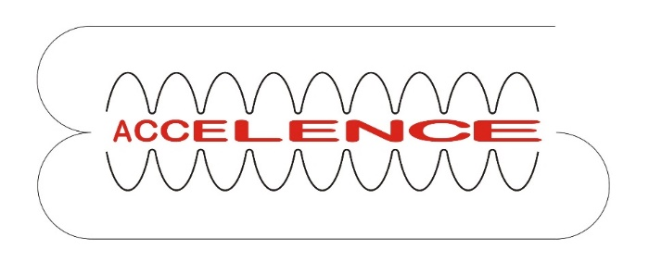
Status of the S-DALINAC
Picture: Jan-Christoph Hartung
Gefördert durch die DFG im Rahmen des SFB 1245 und des GRK 2128

Slide 2
S-DALINAC
Superconducting-DArmstadt-LINear-ACcelerator
Spin-Polarized Electron Gun
5 m
Thermionic Gun
Injector
NEPTUN
DHIPS
LINAC
180° Setup@ QCLAM
Recirculation Beam Lines
169° LINTOTT Magnet Spectrometer
QCLAM Magnet Spectrometer
Thrice recirculating operation
Energy gain injector:
Energy gain LINAC:
7.6 MeV
30.4 MeV
Beam current: up to 20 µA
Beam energy: up to 130 MeV

Slide 3
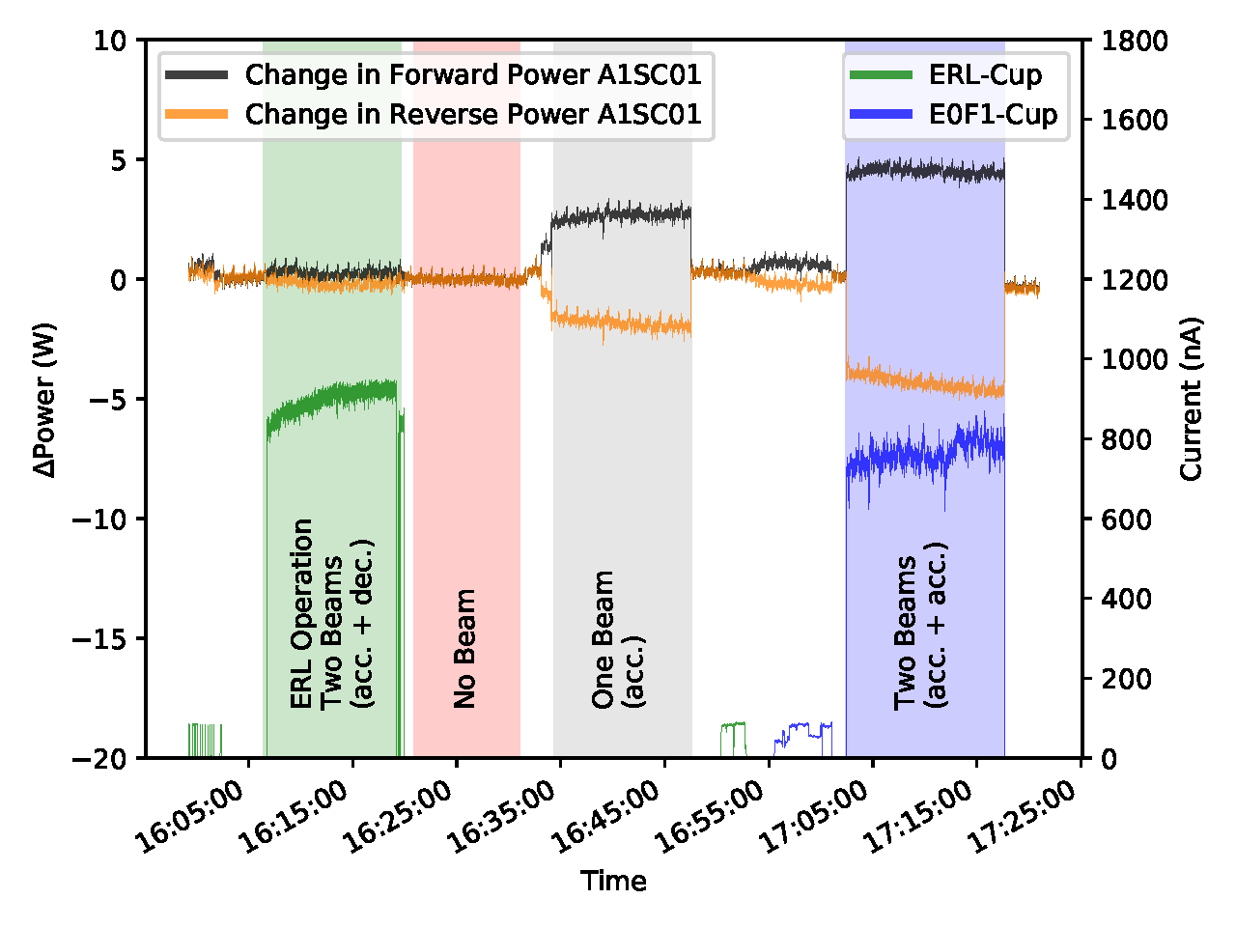
Milestones Since August 2017
August 17
Injector LINAC
Thermionic Gun
Main LINAC
E0F1-Cup
A1SC01
ERL-Cup
Recirculations
2.5 MeV
20.0 MeV
~ 1.2 µA
First ERL in Germany!
Energy gain injector:
Energy gain LINAC:
Current (to injector):
Physik Journal 10/2017; publication in preparation

Slide 4
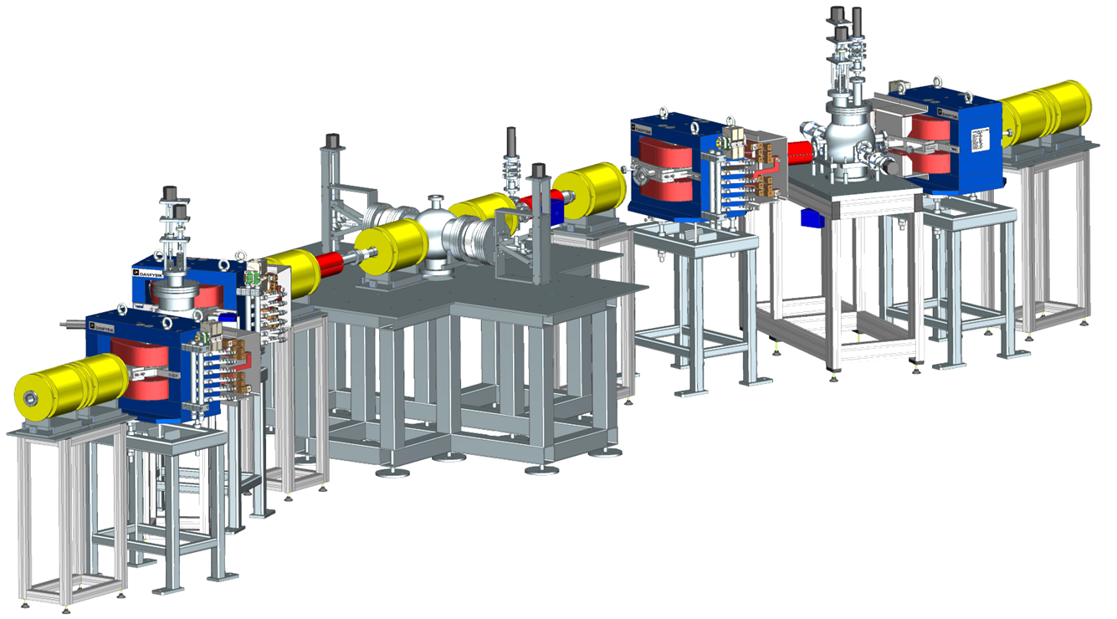
Milestones Since August 2017
August 17
Halo-scraper horizontal
+ vertical
Energy-scraper
Halo-scraper
vertical
October / November 17
7.5 m
High-Energy Scraper-System
First commissioning of high-energy scraper-system: Test of energy-scraper and horizontal halo-scraper
169° LINTOTT Magnet Spectrometer
Lars Jürgensen

Slide 5
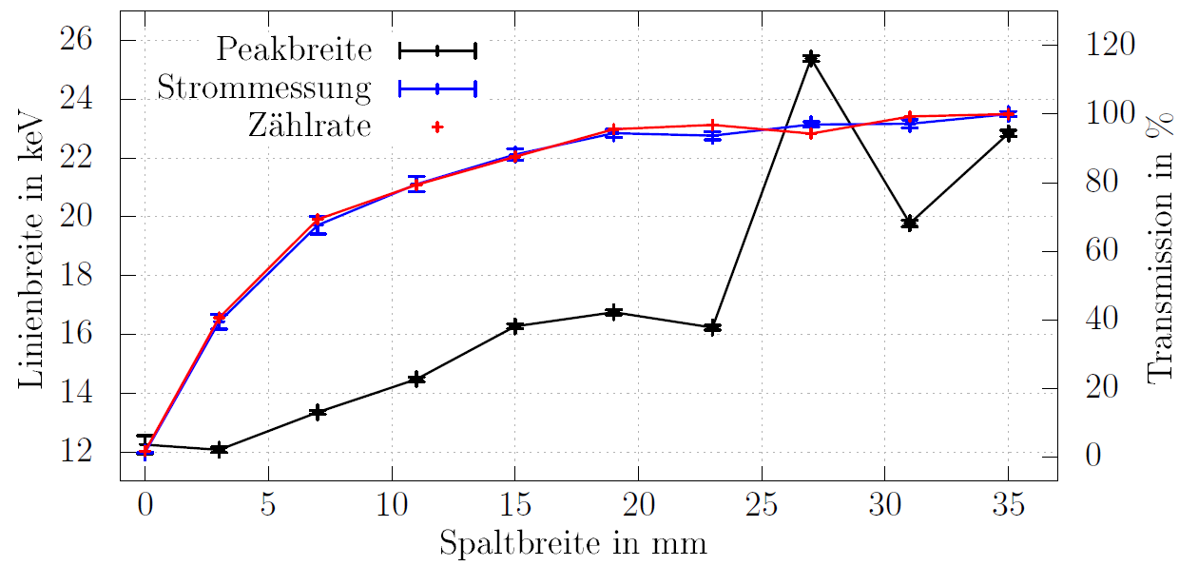
Optimization of Energy Resolution
Linewidth of elastic peak in 169°-spectrometer:
42.5 MeV on 1 mg/cm² gold foil at 93°
Duration of each measurement approx. 5 min
Fluctuation of beam energy
Lars Jürgensen
Notes:
Gemessen wurde die Breite der elastischen Linien, wobei elektronen mit einer Strahlenergie von 42,5 MeV auf ein Goldtarget mit einer Massenbelegung von 1 mg/cm² geschossen wurden. Jeder Messpunkt entspricht einer 5 minütigen Datenaufnahme. Die Grafik zeigt in schwaz die Linienbreite in keV und in Rot und blau zwei verschiedene Methoden zur Bestimmung der Transmission. Die Transmission und die Linienbreite nehmen beim Schließen des Energiescrapers erwartungsgemäß ab. Bei noch großen Spaltbreiten führen Schwankungen der Strahlenergie die in die 5 minütige Messdauer fallen zu starken abweichungen der emittelten Linienbreite.

Slide 6
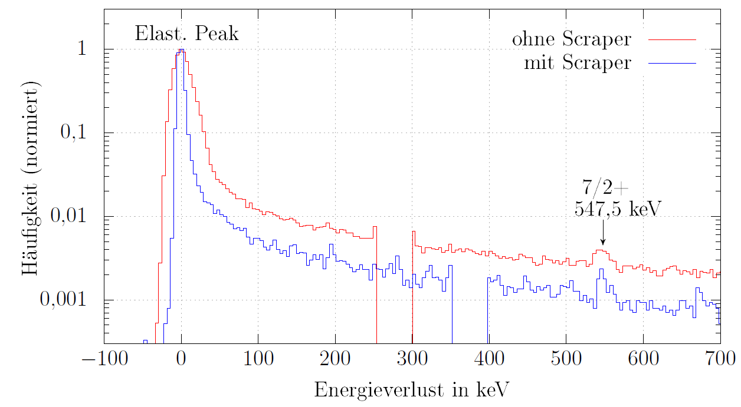
Best Result – New Record
Combination of energy- and horizontal halo-scraper:
Linewidth without scraper: 25 keV
Linewidth with scraper less than 10 keV! → 7.9 keV at 42.5 MeV
(e,e') with energy resolution of gamma spectroscopy (3 – 10 keV)
Lars Jürgensen
Notes:
Bei einzelnen Versuchen zur Kombination von Energiescraper und Haloscraper konnten Linienbreiten unter 10 keV gemessen werden.
Die kleinste erreichte Linienbreite betrug 7,9 keV bei einer Strahlenergie von 42,5 MeV.
Damit bewegen wir uns in der Größenordnung der Detektorauflösung!
Die zugehörige Messung ist hier im Vergleich zu einer Messung ohne Scrapereinsatz gezeigt. Aufgetragen ist die normierte Häufigkeit über dem Energieverlust der gestreuten Elektronen.
Bei einer weiteren Verbesserung des Elektronenstrahls konvergiert die Linienbreite zwangsläufig gegen die verbleibenden Beiträge von Spektrometer und Target.
Detektorauflösung (4 keV) Spektrometermagnet (6,5 keV) und Targetverbreiterung (1 keV)
5 minuten gegen 20 minuten messzeit
25 keV gegen 8 keV
1-2 % Transmission
Messung bei 1uA, System ausgelegt für 20uA , -> Vervierfachung des Stromes bringt messergebnis auch in 5 minuten

Slide 7
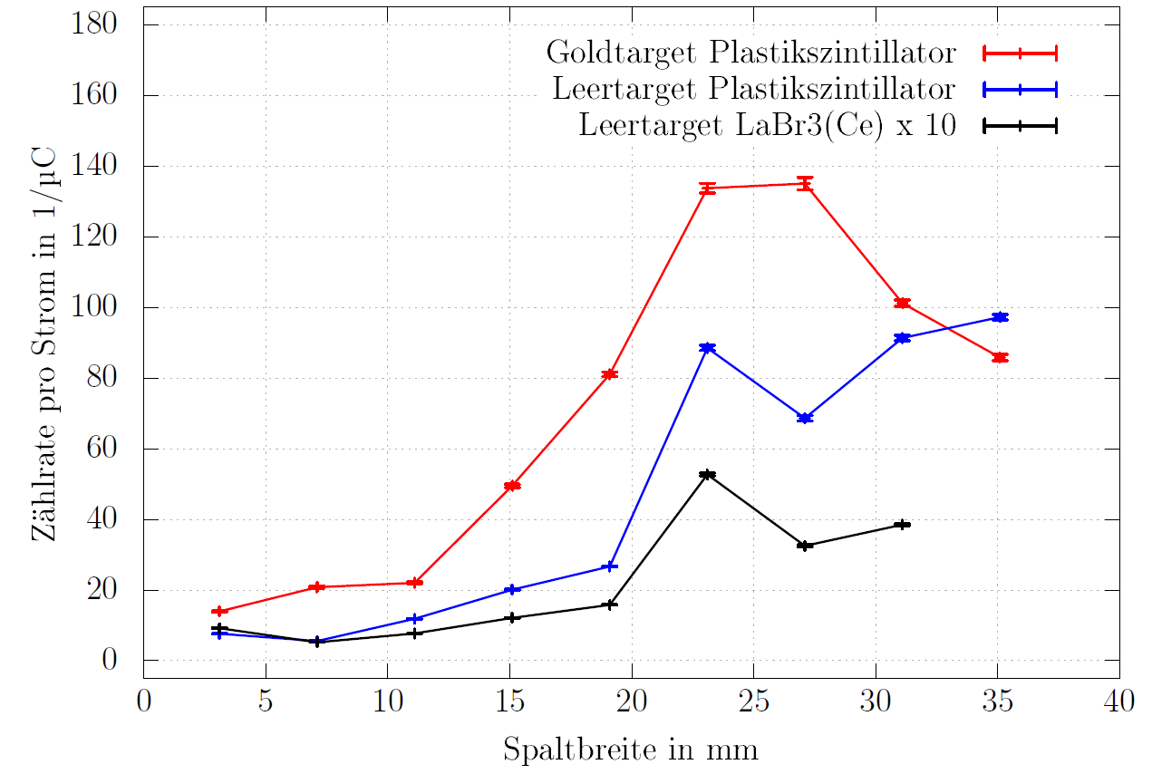
Reduction of Background
Only energy-scraper
Lars Jürgensen
Notes:
Man kann sowohl bei dem Goldtarget als auch beim Leertarget eine deutliche Reduktion des Photonenuntergrunds sehen.

Slide 8
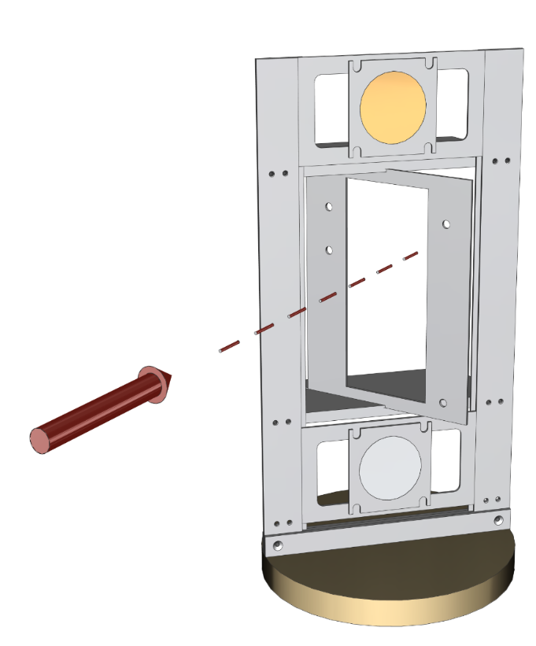
Milestones Since August 2017
August 17
Determination of beam size
To spectrometer
October / November 17
Gold target
Wire scanner
18 cm
Beam
OTR-target
169° LINTOTT Magnet Spectrometer
To camera
Manuel Dutine

Slide 9
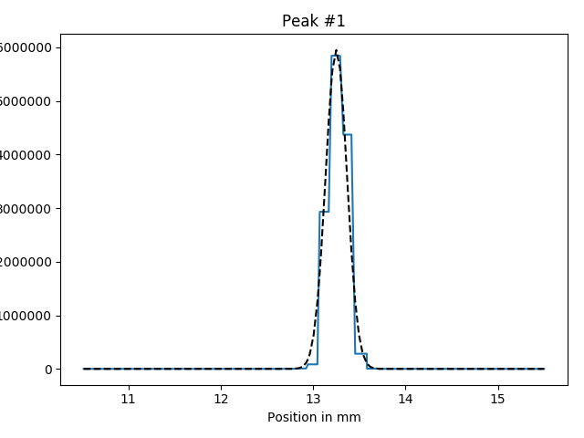
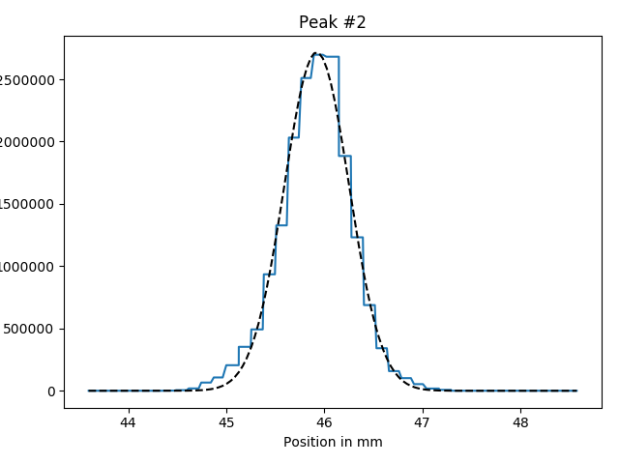
Beam Width - Wire Scanner
$$×{10}^{6}$$
Horizontal wire
$$×{10}^{6}$$
45°-wire
6
2.5
5
2
4
Count rate in events/s
1.5
3
2
1
1
0.5
0
0
11
12
13
14
15
44
45
46
47
48
Position in mm
Position in mm
Vertical beam width $σ_{y}$ in mm (measured) | Beam width $σ_{45°}$ in mm (measured) | Horizontal beam width $σ_{x}$ in mm (calculated)
$$0.10±0.01$$ | $$0.38±0.04$$ | $$0.37±0.05$$
Manuel Dutine

Slide 10
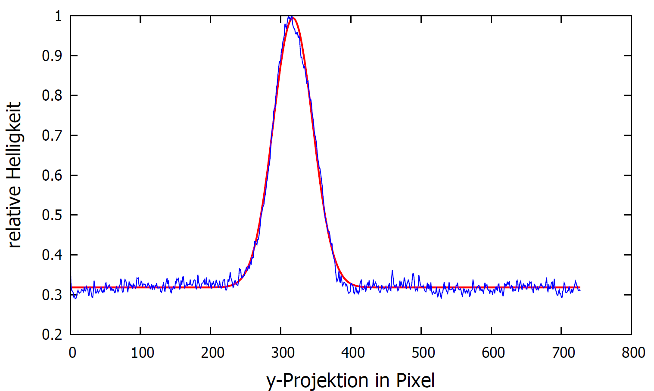
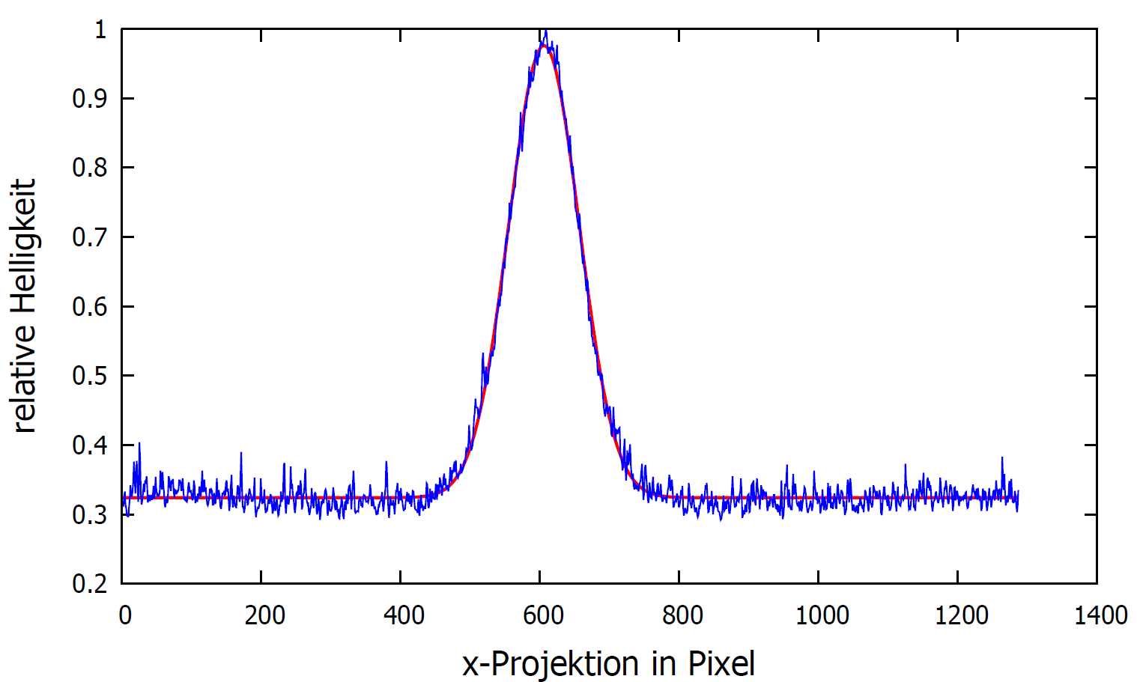
Beam Width – OTR Target
Vertical beam width: $σ_{y}=(0.192±0.005)$ mm
Horizontal beam width: $σ_{x}=(0.356±0.005$) mm
Statistical uncertainties one order of magnitude smaller than wire scanner:
$σ_{y}=(0.10±0.01$) mm
$σ_{x}=(0.37±0.05$) mm
1 mm
1 mm
Manuel Dutine

Slide 11
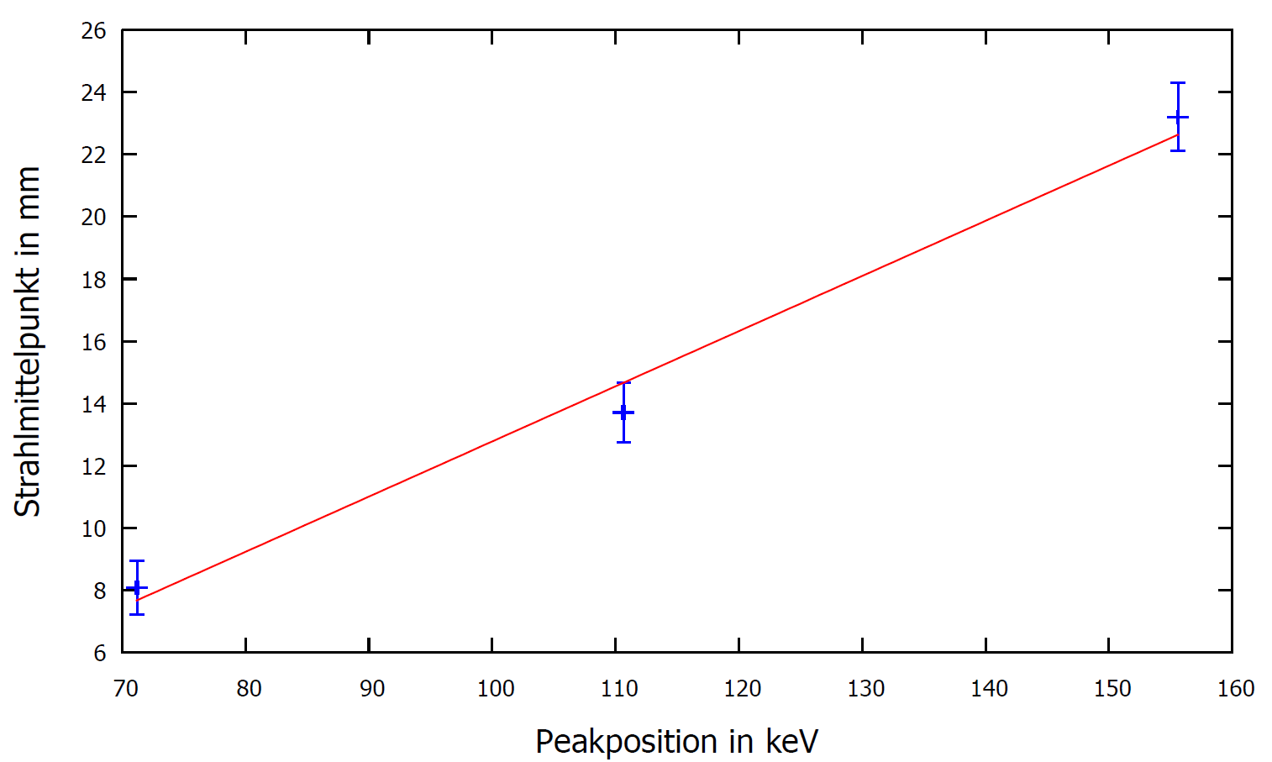
Measurement of Dispersion
BeO Target
5 mm
Dispersion: ($40±5)\frac{mm}{\%}$
Large uncertainties due to cross-fade and brigth scale
Future: Higher precision with OTR-measurement-system
Manuel Dutine

Slide 12
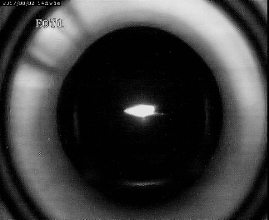
Milestones Since August 2017
August 17
Very good setting
24.11.2017: ~98 % transmission to extraction at design current for recirculating operation (20 µA) → first reach of design value
Beam losses very small
October / November 17
BeO target
10 mm

Slide 13
Milestones Since August 2017
August 17
Beam based alignment injector linac
October / November 17
5 m
December 17
Injector
Thermionic Gun
BeO target
5-cell cavity
F. Hug et al., IPAC 2018, in press

Slide 14
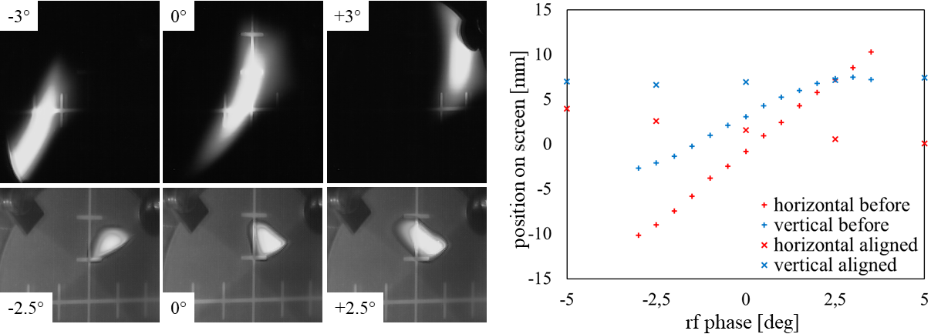
Beam Based Alignment
Before alignment
After alignment
 |  | ε_{nx,rms} [π µm] | ε_{ny,rms} [π µm]
Before alignment | simulated | 0.54 | 0.31
 | measured | 1.3 ± 0.1 | 0.4± 0.02
After alignment | simulated | 0.43 | 0.24
 | measured | 0.84± 0.05 | 0.15± 0.05
Much less steering effect of 5-cell cavity
Better focus at optimum rf phase
Total change of rf phase of more than 20° possible without losing beam on screen
F. Hug et al., IPAC 2018, in press

Slide 15
Milestones Since August 2017
August 17
Upgrade path length adjustment systems of first and third recirculation
Work on vacuumsystem (e.g. pumps, new elements)
Repair of power supplies, rf-amplifiers
Interlock system (personell and machine safety): small corrections (not relevant to safety), upgrades to increase user-friendliness
Alignment: cooperation contract with Franfurt UAS in preparation
…
Refurbishment of He-refrigerator, work on SRF-modules
October / November 17
December 17
Shut Down

Slide 16
Simplified Scheme
Sauer compressor
(up to 200 bar)
Kaeser compressor (in operation approx. 9-11.5 bar)
Buffer
(50 m³, 10 bar)
„Lade“-valve
„Ablade“-valve
Balloon
HP-bottles
(2.55 m³, 200 bar)
Bypass-
valve
Plant
Residual gas
analyzer
Low pressure
High pressure
Machine circuit
Dirty circuit
Leybold pumping stages
(35 mbar to 1050 mbar)
Exchange buffer
HX 1
Turbine 1
HX 7
HX 2
Turbine 2
HX 8
HX 3
HX 4
HX 9
HX 6
Cryostat
HX 5

Slide 17
Simplified Scheme
Bauer
(Year of construction: ~1984)
Kaeser
(Year of construction: 2003)
Sauer compressor
(up to 200 bar)
Kaeser compressor (in operation approx. 9-11.5 bar)
Buffer
(50 m³, 10 bar)
„Lade“-valve
„Ablade“-valve
Balloon
HP-bottles
(2.55 m³, 200 bar)
Leybold
(Year of construction: 2004)
Bypass-
valve
Plant
Residual gas
analyzer
Low pressure
High pressure
Machine circuit
Dirty circuit
Leybold pumping stages
(35 mbar to 1050 mbar)
Linde
Exchange buffer
HX 1
Turbine 1
Sulzer cryo plant
(Year of construction: 1982)
HX 7
HX 2
Turbine 2
HX 8
HX 3
HX 4
HX 9
HX 6
Cryostat
HX 5

Slide 18
Costs for Refurbishment
Investment of IKP to prepare for an operation of the cryo plant in the next years:
Turbines, residual gas analyzer
RAK, spare parts cryo plant
Kaeser compressor, motor fan
Leybold pumping stages
Sauer compressor
Total
27.0 k€
64.2 k€
54.1 k€
70.9 k€
33.5 k€
249.7 k€
Experience up to now: No internal / unwanted bypass gas flows any more → high power of system is visible

Slide 19
Status He-Refrigerator
No problems in cooldown after complete disassembly and reassembly of nearly every element! All degraded parts replaced.
Comparison of cooling parameters before (operational setting) and after refurbishment (cooldown setting)
 | HP in bar | Position Bypass in % | Cooling Power in W | Differential pressure increase in bar per week
Before Refurbishment | 11.5 | ~ 15 | ~ 80 | ~ 0
After Refurbishment | 10.0 | ~ 53 | ~ 55 | ~ 0.04
Important: Refrigerator will be performance-checked and further pushed for cooling power in the next days → no problems for beam time expected

Slide 20
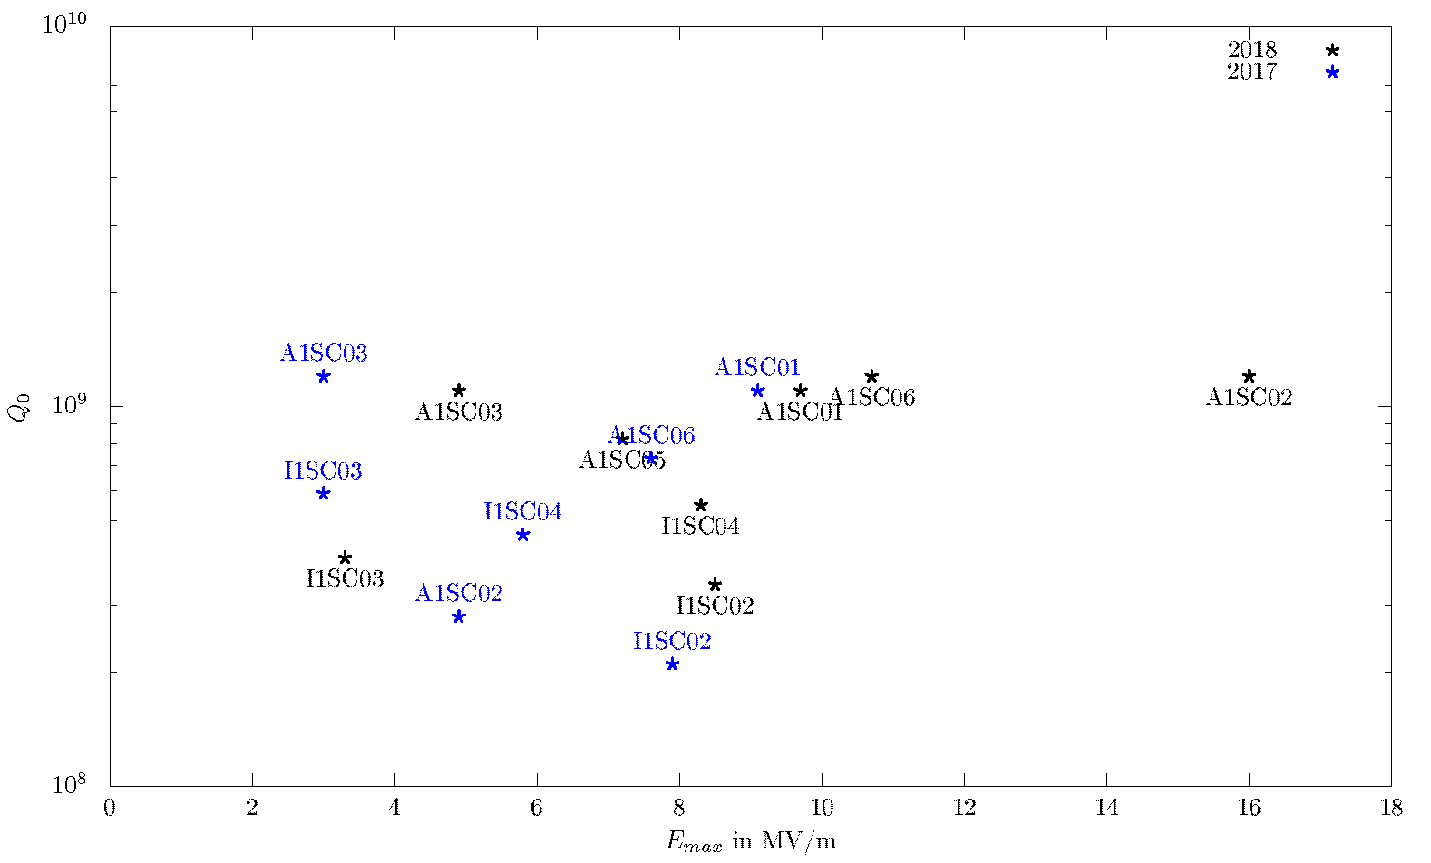
Status Cavities – Measurement ongoing Average Q₀ vs max. Gradient
Uncertainties in range ~1% to ~40% due to measurement
Ruben Grewe
A1SC01 and A1SC02: field flatness tuning @ IKP,
ultrasonic cleaning with ultrapure water @ DESY)

Slide 21
Beam Time Schedule 2018
70 MeV non-isochronous
Cooldown, tests cavities and He-refrigerator
Beam tuning, machine experiments, KW 37 installation of He-target
Q-CLAM 180°
Q-CLAM 180° (35 MeV single pass)
Neptun Tagger
Q-CLAM
Twice recirculating ERL
Q-CLAM He-Target
Diamond detector tests

Slide 22
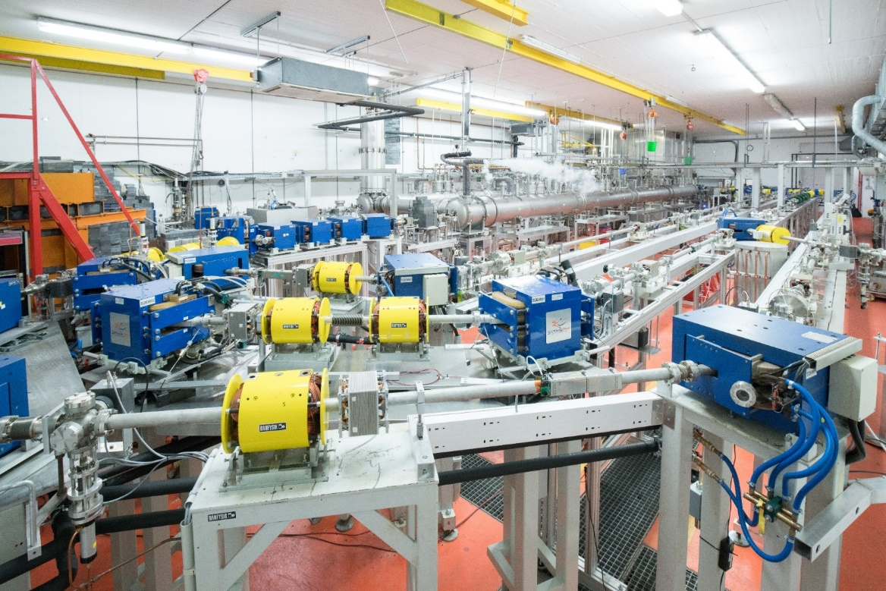
Thank you for your attention!
Picture: Jan-Christoph Hartung

