Slide 1
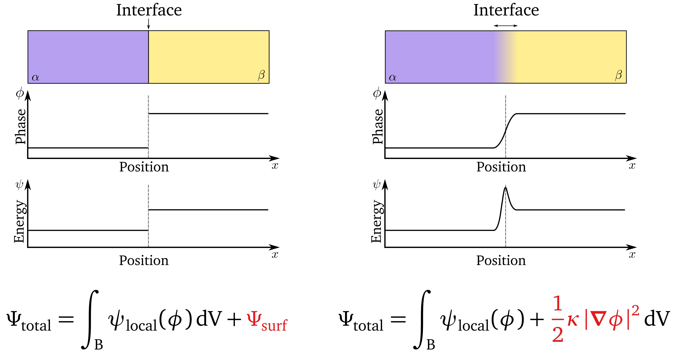

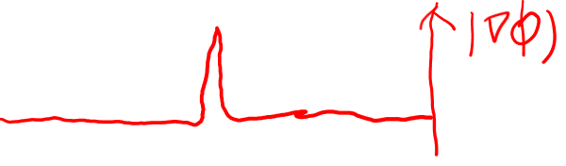
Diffusive interface description
sharp interface
diffuse interface
van der Walls (1894); Cahn & Hilliard (1958); Landau & Lifshitz (1955)

Slide 2
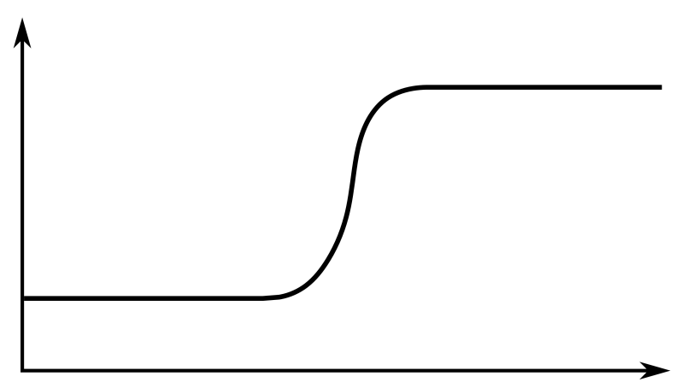
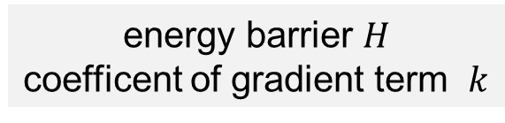




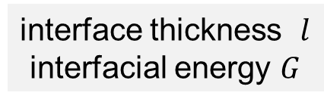



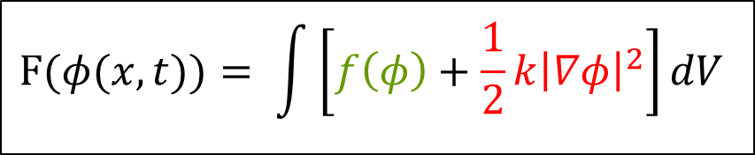
Free energy functional
Free energy consists of two parts: local and nonlocal ( or gradient)
$$F(φ(x,t))= \int{\left[f\left(φ\right)+\frac{1}{2}k{\left|∇φ\right|}^{2}\right]}dV$$
$$f\left(φ\right)$$
$$φ$$
1
$$φ_{α}$$
0
$$φ_{α}$$
$$φ_{α}$$
$$φ_{β}$$
$$x$$
energy barrier $H$
coefficent of gradient term $k$
interface thickness $l$
interfacial energy $G$

Slide 3
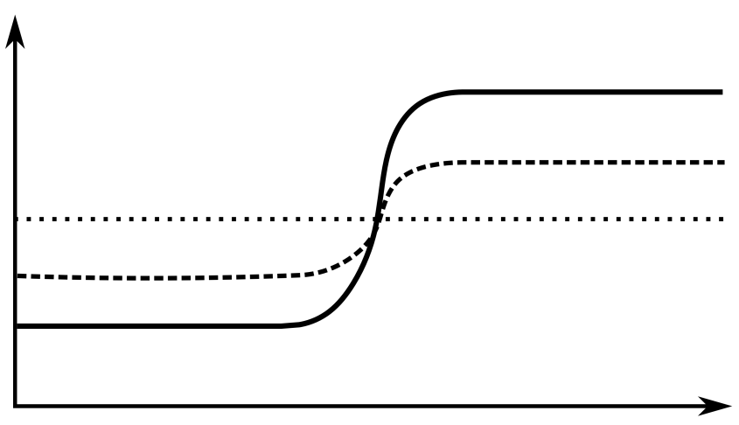
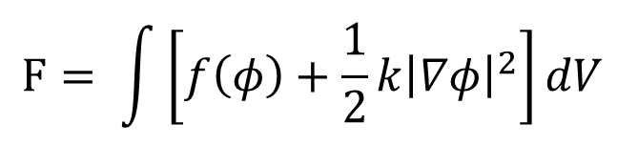
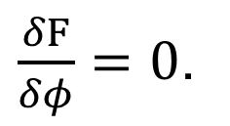
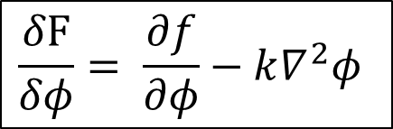


Variational derivative
Q1: How should the profile $φ\left(x\right)$ exactly be, in order to minimize $F$?
→ Equilibrium
Q2: How should $φ\left(x\right)$ evolve into the equilibrium?
→ Kinetics
$$F= \int{\left[f\left(φ\right)+\frac{1}{2}k{\left|∇φ\right|}^{2}\right]}dV$$
$$φ$$
$$\frac{δF}{δφ}= \frac{∂f}{∂φ}−k∇^{2}φ$$
$\frac{δF}{δφ}=0$.
$$x$$
The equilibrium is given by
The kinetics is also described by $\frac{δF}{δφ}$, depending on the field variable $φ$.

Slide 4
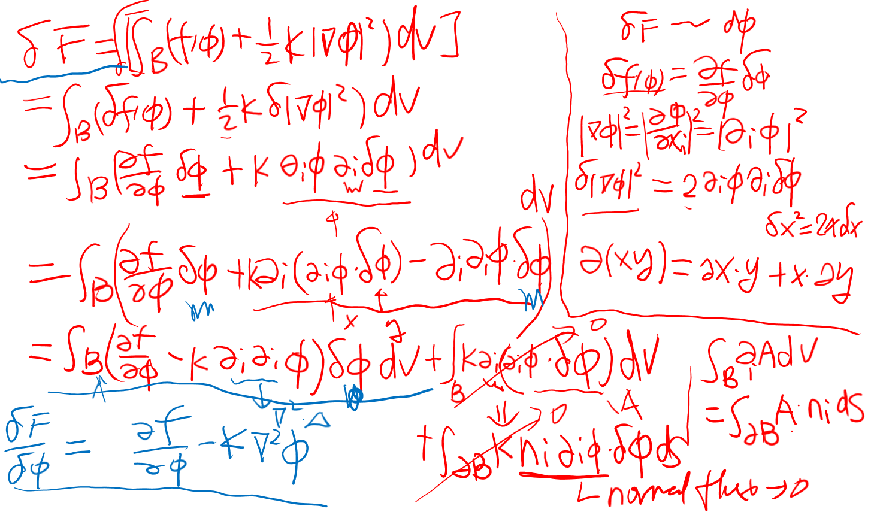
Variational derivative

Slide 5
Other advantages
There is no need for interface tracking, and topological evolution of the interfaces can be obtained by thermodynamics.
It is convenient to add new physics (e.g. mechanics, electrostatics, magnetostatics) through modification of the bulk free energy.
The phase field concept has such generality so that it can be applied to study of different microstructure resulted from different thermodynamic properties.
Thanks to the explicit formulation, phase field models are very convenient to be implemented and solved using most of the numerical methods.

Slide 6
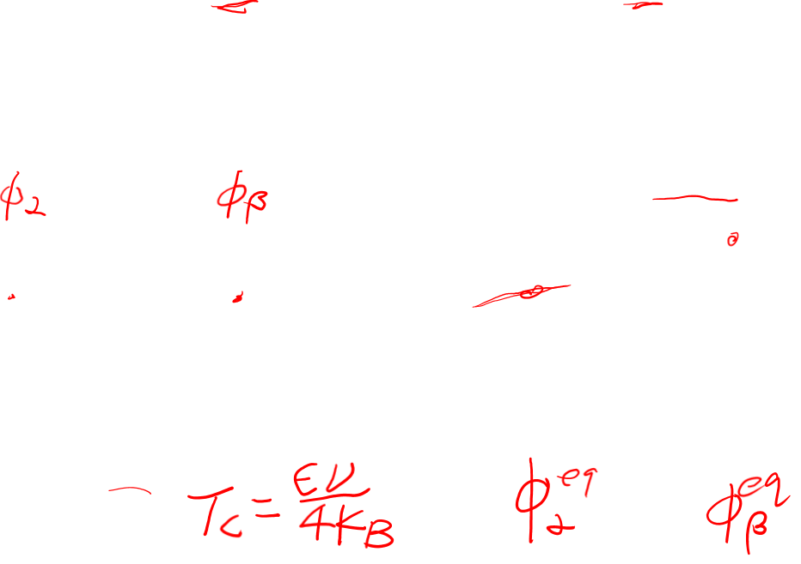
Bulk free energy density
Phase separation in a binary mixture

Slide 7
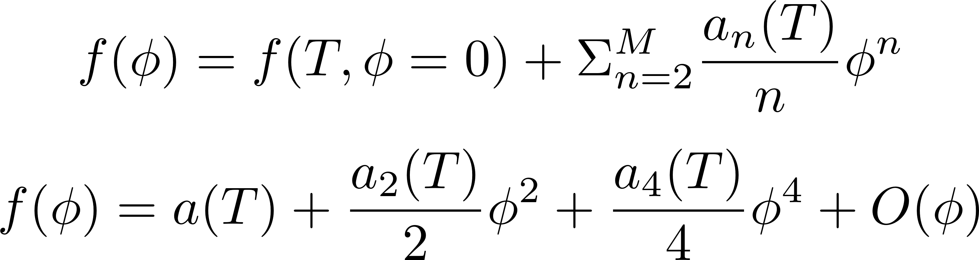
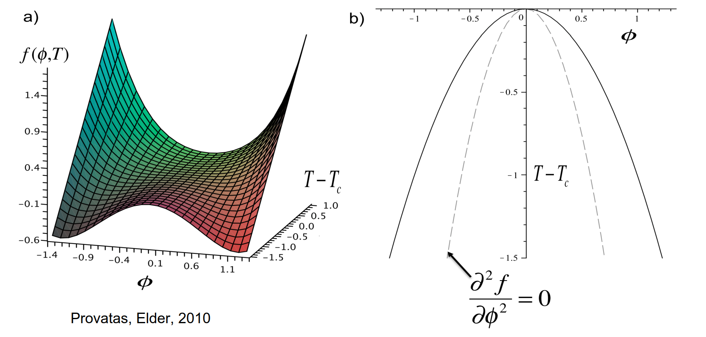
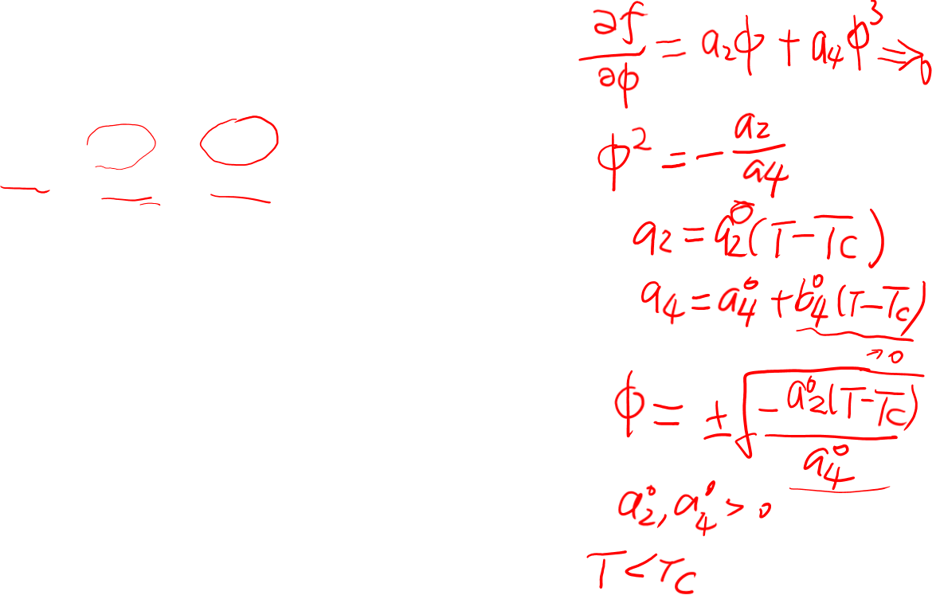
Bulk free energy density
Landau free energy functional for phase transformation

Slide 8
Bulk free energy density
Solidification

Slide 9
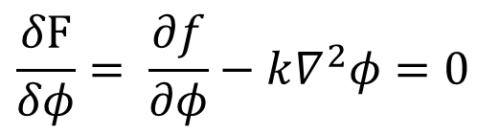
Equilibrium
Equilibrium $φ(x)$ is thus the solution of the equation
$$\frac{δF}{δφ}= \frac{∂f}{∂φ}−k∇^{2}φ=0$$
for the given boundary conditions.

Slide 10
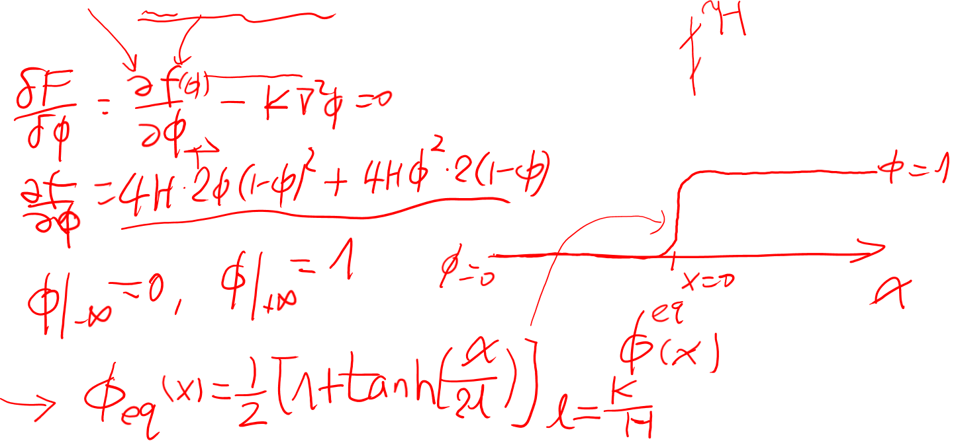
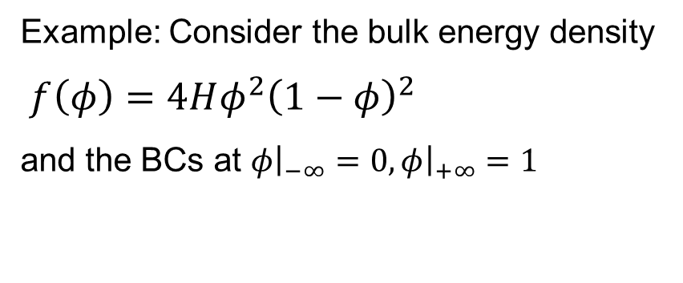
Equilibrium
Example: Consider the bulk energy density
$f\left(φ\right)=4Hφ^{2}{\left(1−φ\right)}^{2}$
and the BCs at $φ{\left.​\right|}_{−∞}=0,φ{\left.​\right|}_{+∞}=1$

Slide 11
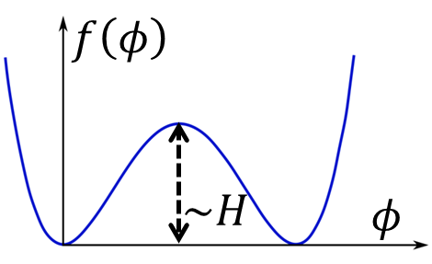
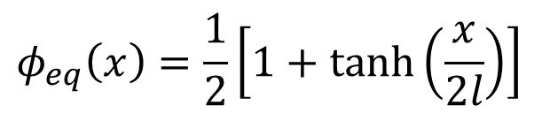

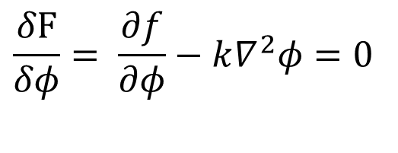
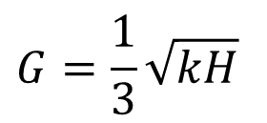

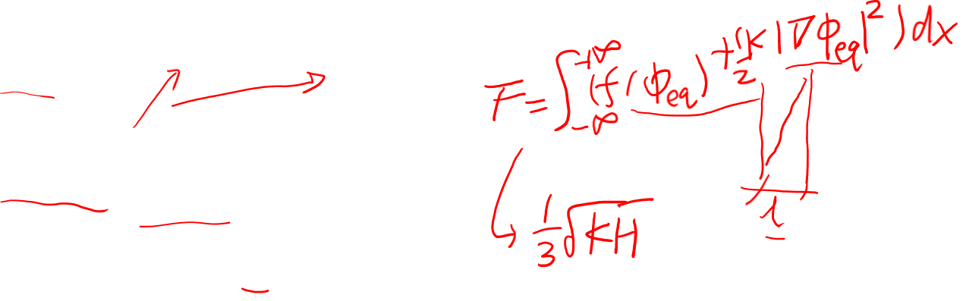
Equilibrium
Equilibrium $φ(x)$ is thus the solution of the equation
$$\frac{δF}{δφ}= \frac{∂f}{∂φ}−k∇^{2}φ=0$$
For $f\left(φ\right)=4Hφ^{2}{\left(1−φ\right)}^{2}$, one has
$$φ_{eq}\left(x\right)=\frac{1}{2}\left[1+\tanh\left(\frac{x}{2l}\right)\right]$$
Interface thickness
$$l=\sqrt{k/H}$$
$$G=\frac{1}{3}\sqrt{kH}$$
Interfacial energy

Slide 12
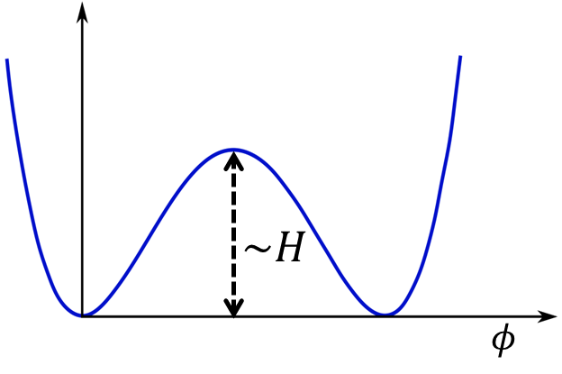
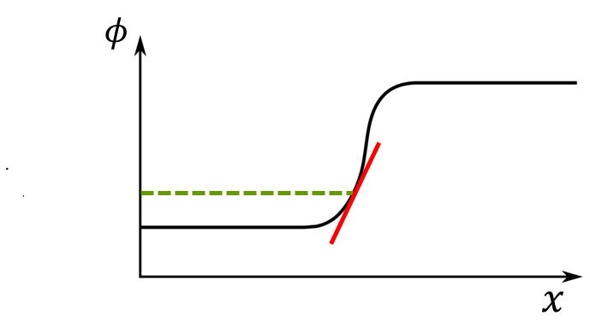
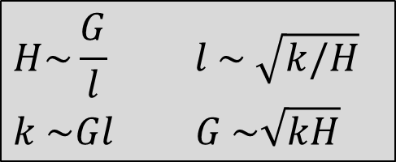
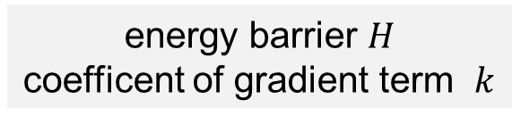
Equilibrium
Free energy consists of two parts: local and nonlocal ( or gradient)
$$F(φ(x,t))= \int{\left[f\left(φ\right)+\frac{1}{2}k{\left|∇φ\right|}^{2}\right]}dV$$
$$H\sim \frac{G}{l} l \sim \sqrt{k/H}$$
$$k \sim Gl G \sim \sqrt{kH}$$
energy barrier $H$
coefficent of gradient term $k$
interface thickness $l$
interfacial energy $G$

Slide 13
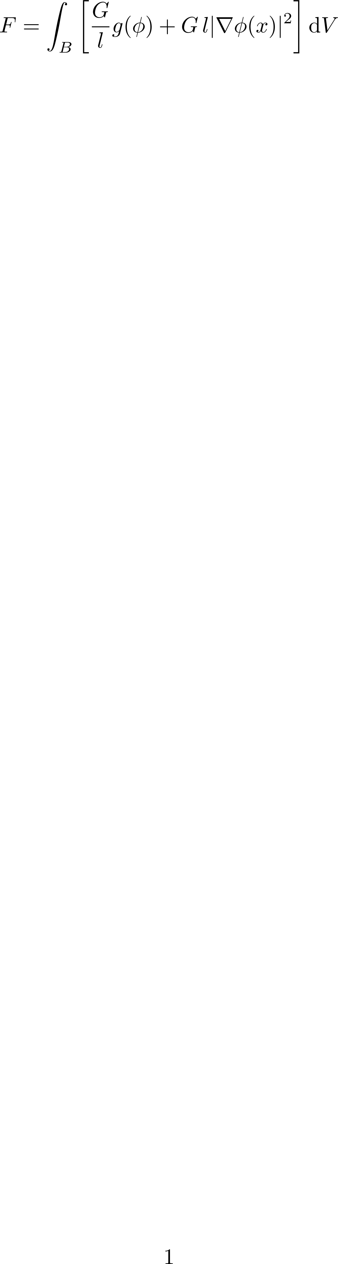
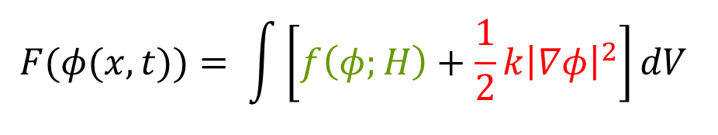

Equilibrium
Both the barrier height $H$ and the gradient coefficient $κ$ effect the interface thickness $l$ and interface energy $G$ .
Instead, one also use the interface features as model parameters
Considre multiphysics problem by combining multiple phase field parameters and adding other energy contributions like elastic and electrostatic energy.
$$F(φ(x,t))= \int{\left[f\left(φ;H\right)+\frac{1}{2}k{\left|∇φ\right|}^{2}\right]}dV$$

Slide 14
Questions?

