Slide 1
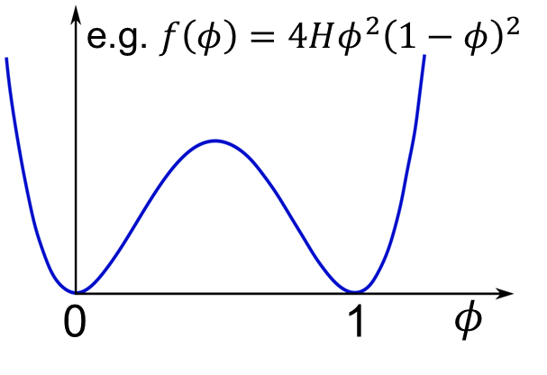

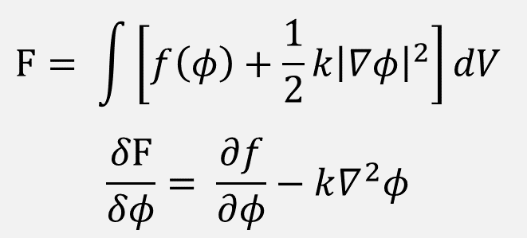
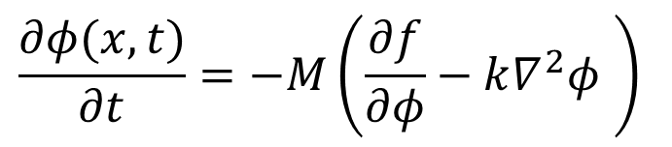
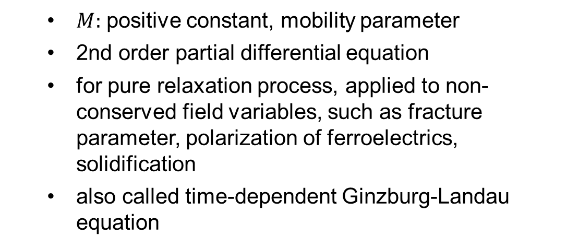
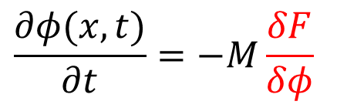
Kinetics: Allen-Cahn equation 1977
$$\frac{∂φ(x,t)}{∂t}=−M\frac{δF}{δφ}$$
$$F= \int{\left[f\left(φ\right)+\frac{1}{2}k{\left|∇φ\right|}^{2}\right]}dV$$
$$\frac{δF}{δφ}= \frac{∂f}{∂φ}−k∇^{2}φ$$
$$\frac{∂φ(x,t)}{∂t}=−M\left(\frac{∂f}{∂φ}−k∇^{2}φ \right)$$
  $M:$ positive constant, mobility parameter
  2nd order partial differential equation
  for pure relaxation process, applied to non-conserved field variables, such as fracture parameter, polarization of ferroelectrics, solidification
  also called time-dependent Ginzburg-Landau equation
Notes:
Last lecture, F, first derivative, equilibrium interface energy and thickness
Langevin-type physics, the according to the steepest decreasing path on the free energy landscape w.r.t the phase-field parameter.
Variational derivative

Slide 2
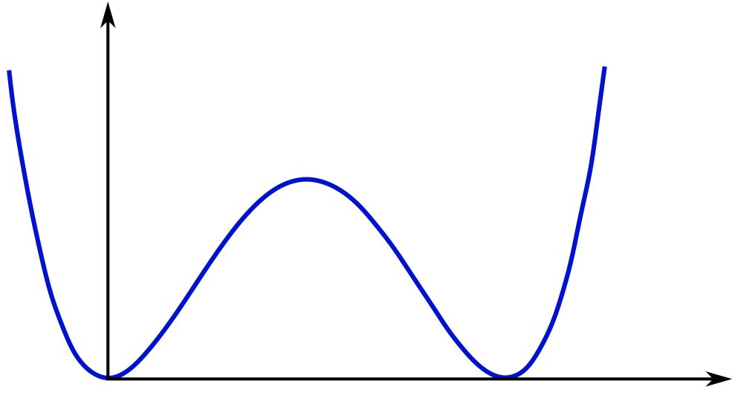
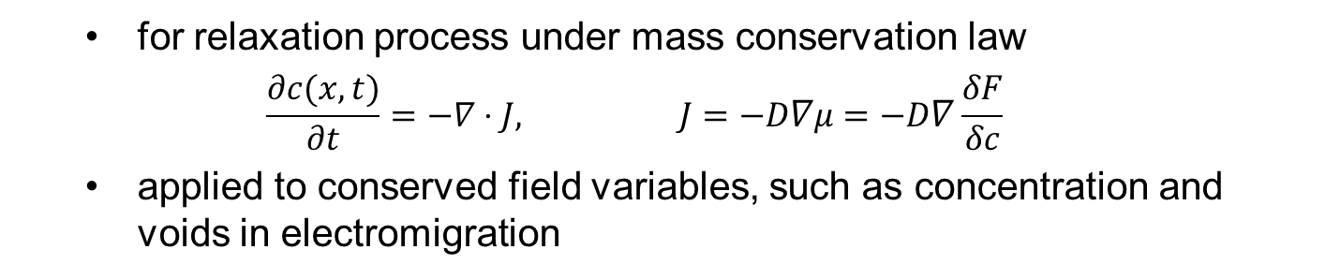
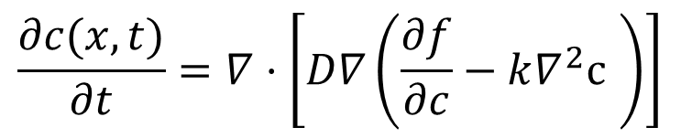
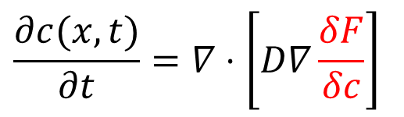

Kinetics: Cahn-Hilliard equation 1958
$$\frac{∂c(x,t)}{∂t}=∇⋅\left[D∇\frac{δF}{δc}\right]$$
Spinodal decomposition
$$\frac{∂c(x,t)}{∂t}=∇⋅\left[D∇\left(\frac{∂f}{∂c}−k∇^{2}\text{c} \right)\right]$$
0
1
$$φ$$
  for relaxation process under mass conservation law
  $$\frac{∂c(x,t)}{∂t}=−∇⋅J, J=−D∇μ=−D∇\frac{δF}{δc}$$
  applied to conserved field variables, such as concentration and voids in electromigration
Notes:
In fact, the just mentioned A-C model can be understood as a linear kinetic model, because it assumes that the rate of microstructure evolution is linearly proportional to the driven force which is defined as the tendency of the energy decrease.
It is very simple but does not apply to all microstructures. For instance, in the case of spinodal decomposition, during the phase separation pattern evolution, the energy of the system should decrease but under an additional condition. This condition is the mass conservation of the chemical species. For this case, we have the Cahn-Hilliard model. We start with the flux-conservation law. Here j is the flux and mu is the chemical potential. This is the driven force for the microstructure evolution and therefore in the phase-field modeling this term is assumed to be the first variational derivative of the total free energy. By substituting the specific form of the first derivative into here and the result further into here, we obtain a fourth-order partial differential equation. This is called the Cahn-Hilliard model. It is typically applied to conserved phase-field parameters such as concentration.

Slide 3
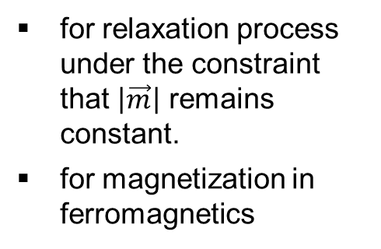
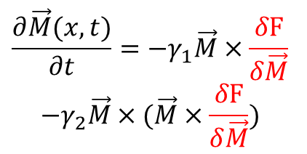
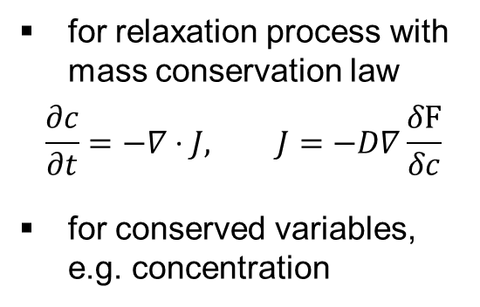
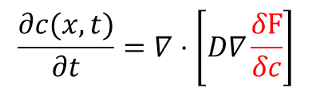
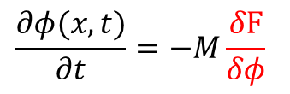
Summary on basic kinetic models
Landau–Lifshitz–Gilbert (1955)
Allen-Cahn (1977)
Cahn-Hilliard (1958)
$$\frac{∂φ(x,t)}{∂t}=−M\frac{δF}{δφ}$$
$$\frac{∂c(x,t)}{∂t}=∇⋅\left[D∇\frac{δF}{δc}\right]$$
$$\frac{∂\vec{M}(x,t)}{∂t}=−γ_{1}\vec{M}×\frac{δF}{δ\vec{M}}$$
$$−γ_{2}\vec{M}×(\vec{M}×\frac{δF}{δ\vec{M}})$$
pure relaxation process
for non-conserved field variables, e.g. fracture, polarization of ferroelectrics
for relaxation process with mass conservation law
$$\frac{∂c}{∂t}=−∇⋅J, J=−D∇\frac{δF}{δc}$$
for conserved variables, e.g. concentration
for relaxation process under the constraint that $\left|\vec{m}\right|$ remains constant.
for magnetization in ferromagnetics

Slide 4
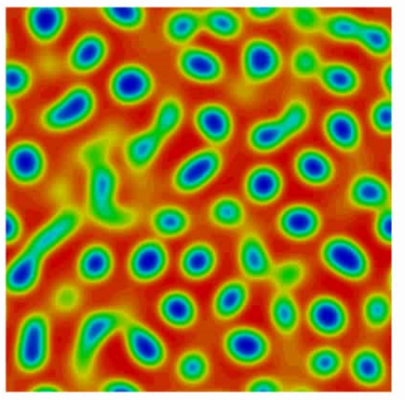
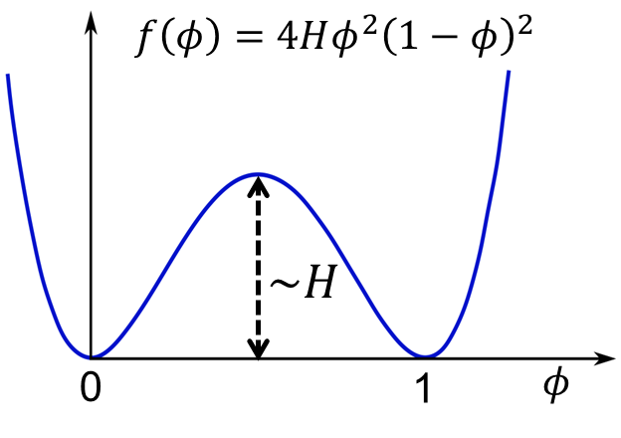
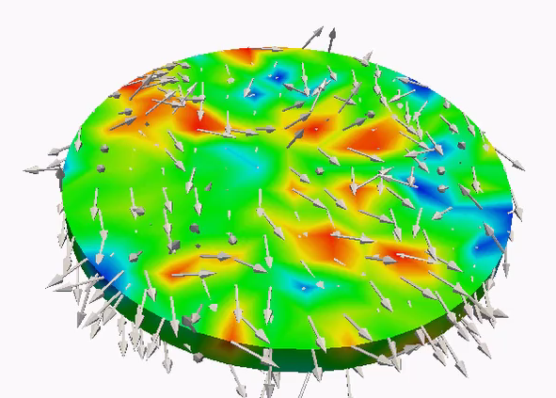
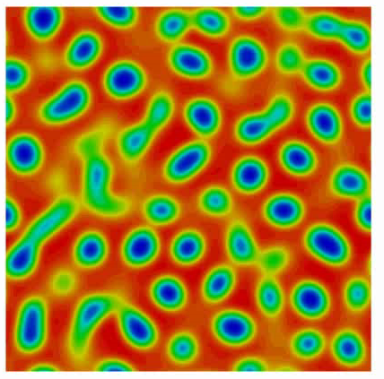
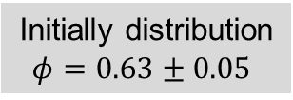

Comparison among kinetic models
Initially distribution
$φ=0.63±0.05$
Landau–Lifshitz–Gilbert:
magnetization
Allen-Cahn: Equ. at$φ=1.0$
Cahn-Hilliard: Phase sep.

Slide 5
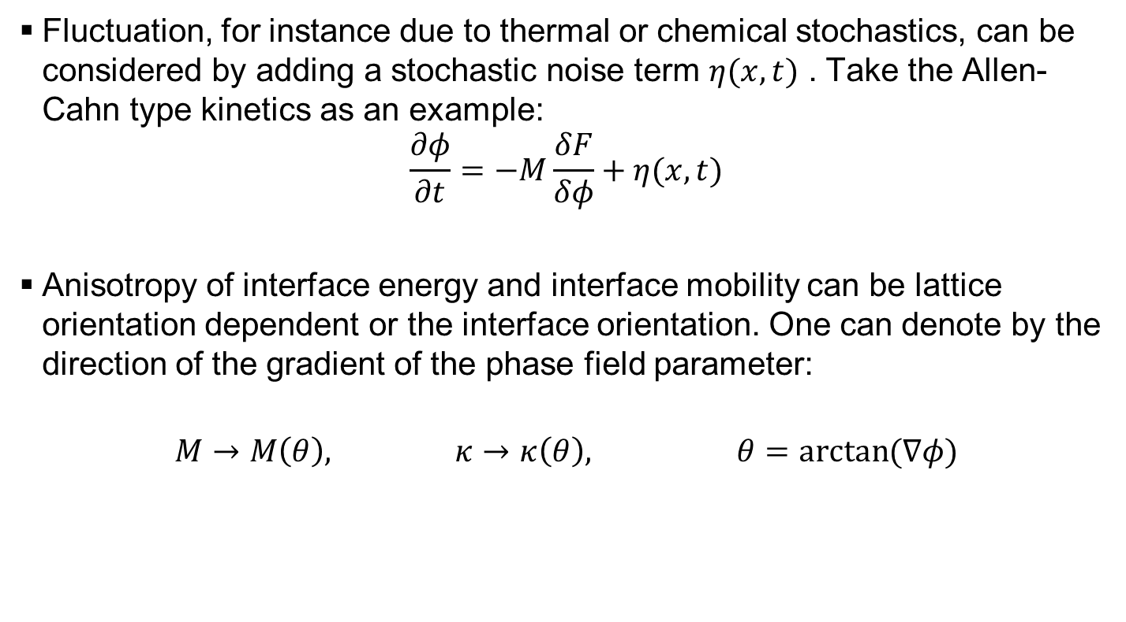
General comments on the kinetic models
Fluctuation, for instance due to thermal or chemical stochastics, can be considered by adding a stochastic noise term $η(x,t)$ . Take the Allen-Cahn type kinetics as an example:
$$\frac{∂φ}{∂t}=−M\frac{δF}{δφ}+η(x,t)$$
Anisotropy of interface energy and interface mobility can be lattice orientation dependent or the interface orientation. One can denote by the direction of the gradient of the phase field parameter:
$$M→M\left(θ\right), κ→κ\left(θ\right), θ=\arctan{(∇φ)}$$

Slide 6
Prons
Advantages of phase-field modeling include
no need for explicit tracking of interface
topological evolution of interface obtained naturally
generality of the concept
easy to add new physics
adapted by different numerical methods

Slide 7
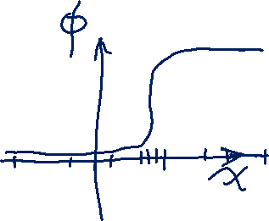

Cons
Parameter determination
  First-Principle and atomistic calculations
  CALPHAD for multicomponent alloys
  Sharp/thin interface asymptoic expansion
  Experimental data input
Computation cost
  Adaptive mesh
  Macro-Micro two scale modeling
Quantitative validation

Slide 8
Literature
Review articles
L.Q. Chen, Phase-Field Models for Microstructure Evolution, Annu. Rev. Mat. Res. 2002, 32, 113-140.
W. J. Boettinger, J. A. Warren, C. Beckermann, A. Karma, Phase-Field Simulation of Solidification, Annu. Rev. Mat. Res. 2002, 32, 163-194.
I. Steinbach, Phase-field models in materials science, Modelling Simul. Mater. Sci. Eng. 17, 073001, 2009
Book
Provata and Elder, Phase-Field Methods in Material Science and Engineering, Wiley-VCH

Slide 9
Basics of phase-field brittle fracture model
Reference
A Karma, DA Kessler, H Levine. Phase-field model of mode III dynamic fracture. Physical Review Letters 87 (4), 45501. 2001
B Bourdin, GA Francfort, JJ Marigo. The variational approach to fracture. Journal of elasticity 91 (1-3), 5-148. 2008
C Miehe, M Hofacker, F Welschinger. A phase field model for rate-independent crack propagation: Robust algorithmic implementation based on operator splits. Computer Methods in Applied Mechanics and Engineering 199 (45-48), 2765-2778. 2010
MJ Borden, CV Verhoosel, MA Scott, TJR Hughes, CM Landis. A phase-field description of dynamic brittle fracture. Computer Methods in Applied Mechanics and Engineering 217, 77-95. 2011

Slide 10
Basics of phase-field brittle fracture model

Slide 11
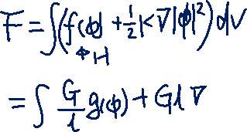
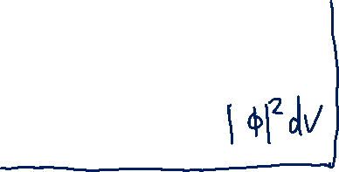
Basics of phase-field brittle fracture model

Slide 12
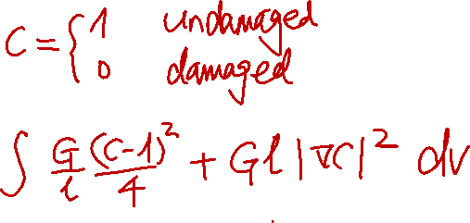
Basics of phase-field brittle fracture model

Slide 13
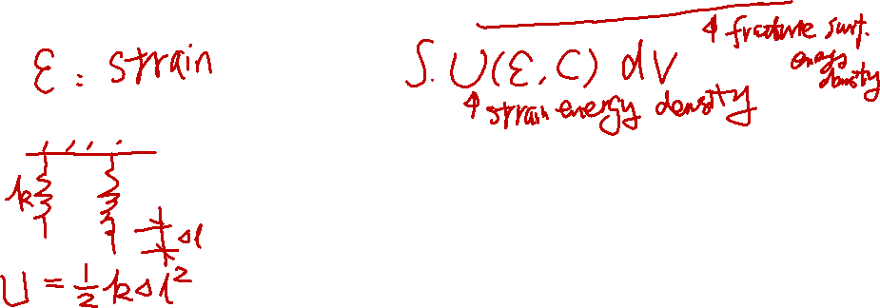
Basics of phase-field brittle fracture model

Slide 14

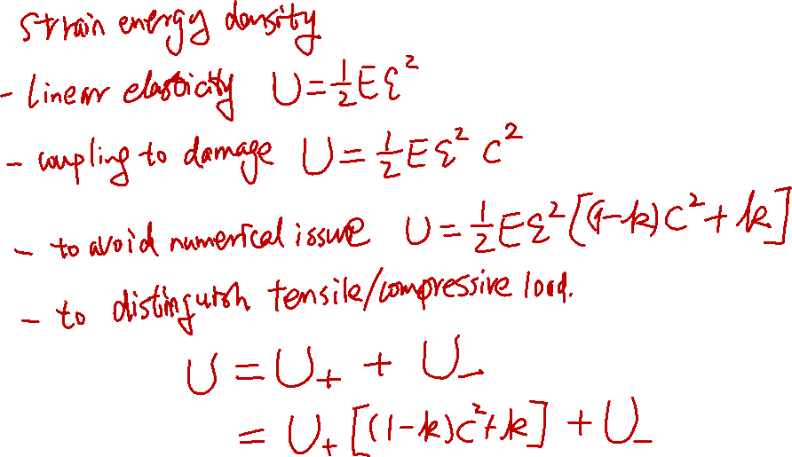
Basics of phase-field brittle fracture model

Slide 15
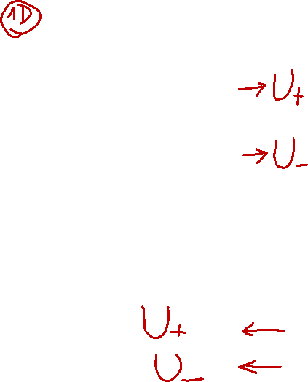
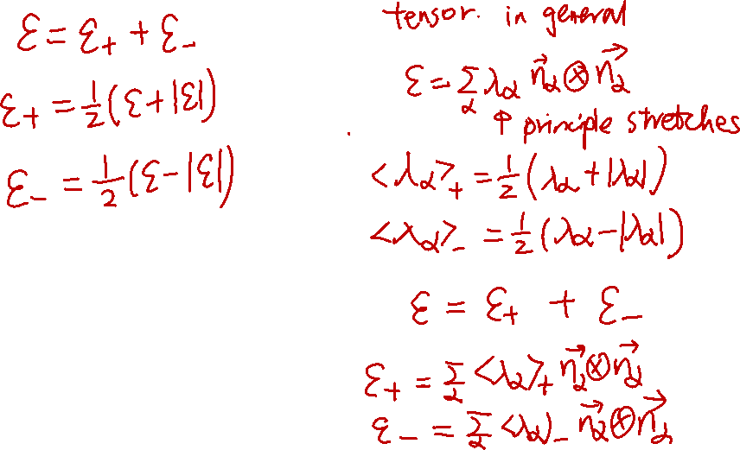
Basics of phase-field brittle fracture model

Slide 16
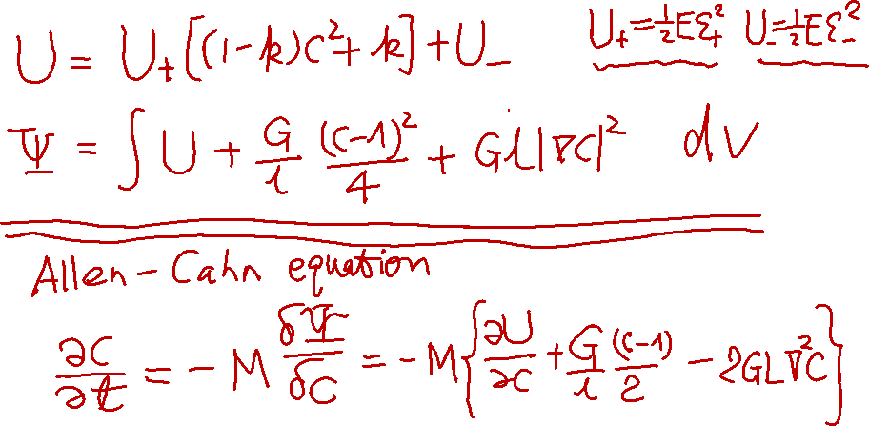
Basics of phase-field brittle fracture model

Slide 17
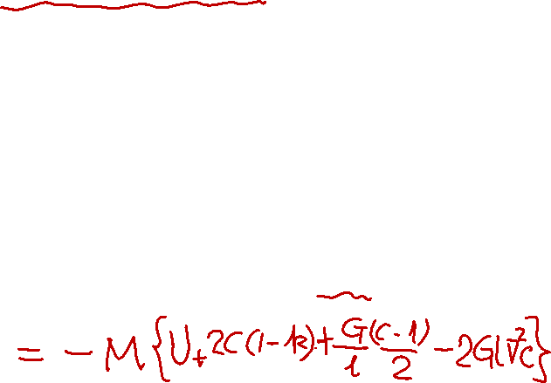
Basics of phase-field brittle fracture model

Slide 18
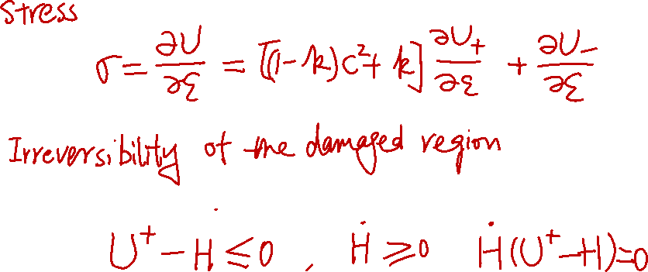
Basics of phase-field brittle fracture model

