Slide 1


Slide 2
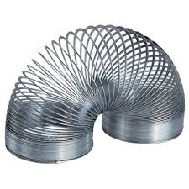
Overall strain:
P
Q
Displacement field
P’
Q’
Local strain:

Slide 10
volume force
traction

Slide 11
or

