Slide 1
Intuitive Information Management in Collaborative Authoring Environments with the Help of Language Technologies
Iryna Gurevych
This is joint work with Dr. Torsten Zesch, Johannes Hoffart, Daniel Bär, Nico Erbs and others from UKP Lab

Slide 2
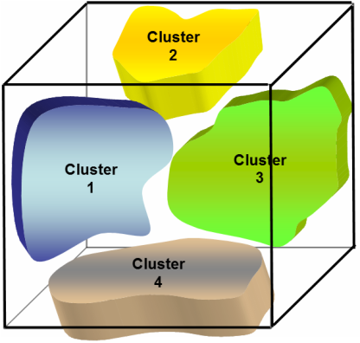
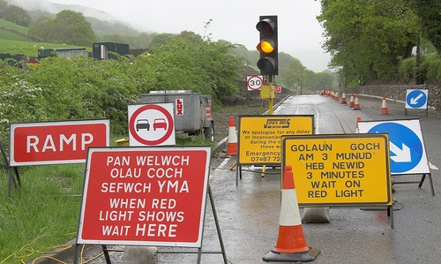
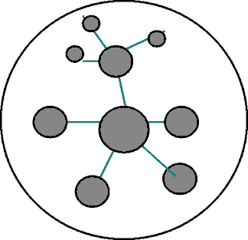
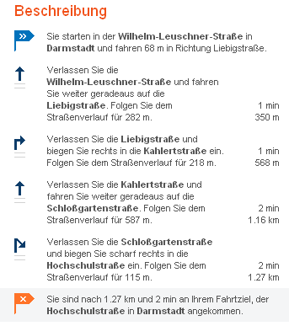
Vision of UKP Lab
Information
Knowledge
Focus on intelligent information processing
NLP – Natural Language Processing
Notes:
2
2

Slide 3
eLearning Related Projects
  DFG Emmy-Noether Group „Mining Lexical-Semantic Knowledge from Dynamic and Linguistic Sources and Integration into Question Answering for Discourse-Based Knowledge Acquisition in eLearning“
  Lichtenberg Chair project „Educational Natural Language Processing“ (Volkswagen Foundation)
  Wikulu: Self-Organization in Wikis (Klaus-Tschira Foundation)

Slide 4
Goals of This Talk
Introduce current developments in language technology
Discuss their use for information search, information management and information authoring tasks
Take a closer look at the Wikulu project
  Requirements analysis and language technologies
  A sample technology – link detection
  A sample tool for information navigation – Wiki Sniffer (demo)
Initiate discussions on using this technology for eLearning

Slide 5
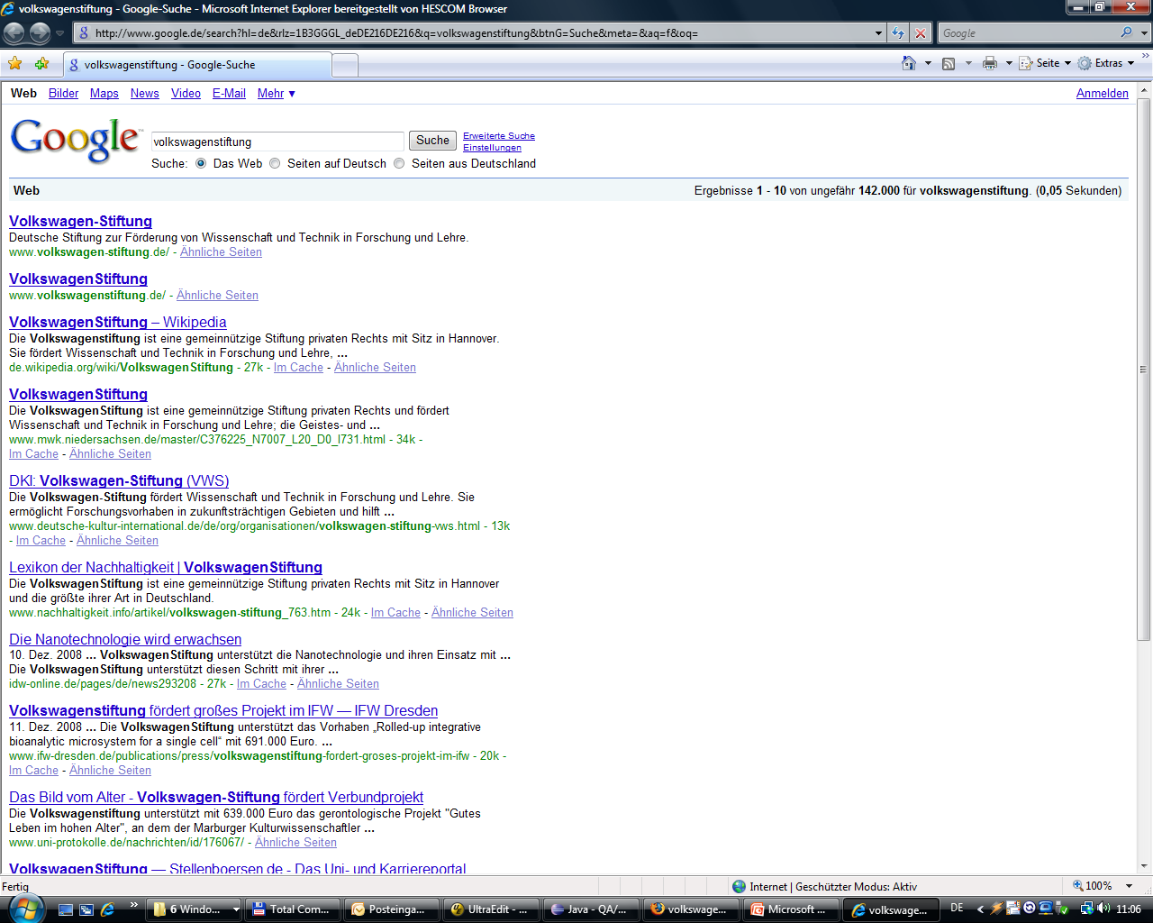

Motivation
WWW-Recherche – Heute
Was ist die Volkswagen-Stiftung?

Slide 6
Motivation
WWW-Recherche – Vision
Was ist die Volkswagen-Stiftung?
2.0
Was ist die VolkswagenStiftung?
Die Volkswagenstiftung ist eine gemeinnützige Stiftung privaten Rechts mit Sitz in Hannover. Sie fördert Wissenschaft und Technik in Forschung und Lehre, die Geistes- und Gesellschaftswissenschaften ebenso wie die Natur- und Ingenieurwissenschaften und die Medizin. Sie ermöglicht Forschungsvorhaben in zukunftsträchtigen Gebieten und hilft wissen-schaftlichen Institutionen bei der Verbesserung der strukturellen Voraussetzungen für ihre Arbeit. Besondere Aufmerksamkeit widmet sie dem wissen-schaftlichen Nachwuchs sowie der Zusammenarbeit von Forschern über disziplinäre und staatliche Grenzen hinweg.

Slide 7






Motivation
Systemübersicht
?
Natürlichsprachliche
Frage
Datenquellen
Combining Answers from heterogeneous Web Documents for Question Answering
Natürlichsprachliche
Antwort
Programmbibliotheken, Korpora,
Wissensdatenbanken,…
!

Slide 8
Methodik
1. Vorverarbeitung
  Segmentierung: Absätze, Sätze, Worte
  Wortarten bestimmen
  Wortbedeutungen finden
  Allgemeine, spezifische, unwichtige Worte unterscheiden
2. Relevante Abschnitte
  Duplikate entfernen
  Irrelevante Absätze filtern
  Relevante Sätze ermitteln
  Optimieren der Grenze zwischen relevanten und irrelevanten Passagen
3. Themen finden
  Hierarchisch (HAC-Algorithmus)
  Iterativ (k-means Clustering)
  Vernetzt (Newman‘s Modularity)
  Kombiniert
4. Zusammenfassen
  Fehlerhafte Sätze entfernen
  Themenüberschriften
  Sätze nach Wichtigkeit ordnen
  Ergebnis darstellen

Slide 10
eLearning Related Projects
  DFG Emmy-Noether Group „Mining Lexical-Semantic Knowledge from Dynamic and Linguistic Sources and Integration into Question Answering for Discourse-Based Knowledge Acquisition in eLearning“
  Lichtenberg Chair project „Educational Natural Language Processing“ (Volkswagen Foundation)
  Wikulu: Self-Organization in Wikis (Klaus-Tschira Foundation)

Slide 11
Goals of Educational NLP
Use Natural Language Processing for analyzing educational documents and automatically providing keywords and other metadata
Build tools that assist educators in easy content creation and management as well as collaborative authoring of their materials
Explore new algorithms in NLP which bear great potential to simplify tedious, recurring tasks, e.g. creation of questions, exercises and tests

Slide 12
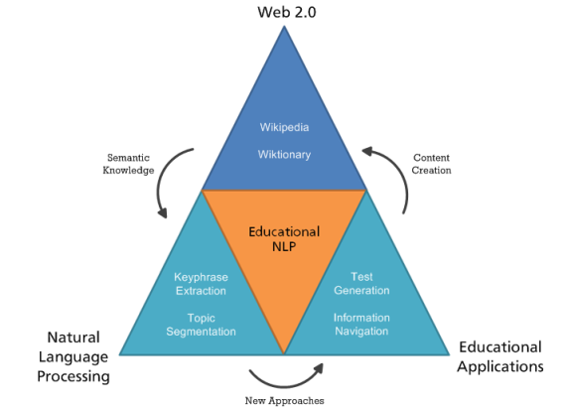
NLP Technologies

Slide 13
Research Questions
Leveraging semantic knowledge from Web 2.0, i.e. Wikipedia and Wiktionary providing high quality background knowledge in NLP
Developing new approaches in Test Item Generation to enrich test authoring tools, also games-with-a-purpose
Creating new algorithms for the discovery and classification of educational documents in heterogeneous web-based resources
Building easily accessible, teacher-centered tools for collaboratively creating educational materials

Slide 14
What is this text about?
CHICAGO, Oct 29 - Kraft Foods Inc and Kellogg Co posted better-than-expected third-quarter profits on Wednesday as price increases and new products helped lift sales in a weak economy. Kraft also stood by its forecasts for 2008 earnings before one-time items as well as for 2009 net income, while Kellogg said its profit this year should hit the high end of its previous targeted range. Both Kraft, the largest North American food maker, and Kellogg, the world's largest cereal company, have taken steps to cut costs and put more money into advertising. Both have also bolstered new product development to attract consumers even as rising commodity costs pushed them to raise prices. Commodities like wheat and energy have become less expensive in recent months, but food companies may not see a big benefit until next year, in part because they lock in their costs months ahead. Kraft, which makes Oreo cookies, Tang breakfast drink and Oscar Mayer hot dogs, reported a profit of 45 cents a share before one-time items, a penny above what analysts polled by Reuters Estimates had expected. The company hiked prices on products, leading to a 0.9 percent drop in volume. However, that key result was still better than the company had expected. Analysts are watching to see how much consumers cut back on buying branded products in the face of rising food prices and a slumping economy. Kraft sales rose 19.4 percent to $10.46 billion. Organic sales, which exclude the impact of currency, acquisitions and divestitures, rose 7.1 percent due to higher pricing. Over the past several years, Kraft has closed factories, cut jobs and divested brands to focus on areas like cookies and crackers, pizza and healthier foods. Shares of Kraft rose 1.8 percent to $29.39 in premarket trading from Tuesday's closing price of $28.88 on the New York Stock Exchange, while Kellogg stock was not active. Kellogg, the maker of Rice Krispies and Eggo waffles, said net income rose to 89 cents a share from 76 cents a year earlier. The results were far better than the 80 cents analysts had forecast.
Notes:
12. Mai 2008
|
| 14

Slide 15
Keyphrase Extraction
CHICAGO, Oct 29 - Kraft Foods Inc and Kellogg Co posted better-than-expected third-quarter profits on Wednesday as price increases and new products helped lift sales in a weak economy. Kraft also stood by its forecasts for 2008 earnings before one-time items as well as for 2009 net income, while Kellogg said its profit this year should hit the high end of its previous targeted range. Both Kraft, the largest North American food maker, and Kellogg, the world's largest cereal company, have taken steps to cut costs and put more money into advertising. Both have also bolstered new product development to attract consumers even as rising commodity costs pushed them to raise prices. Commodities like wheat and energy have become less expensive in recent months, but food companies may not see a big benefit until next year, in part because they lock in their costs months ahead. Kraft, which makes Oreo cookies, Tang breakfast drink and Oscar Mayer hot dogs, reported a profit of 45 cents a share before one-time items, a penny above what analysts polled by Reuters Estimates had expected. The company hiked prices on products, leading to a 0.9 percent drop in volume. However, that key result was still better than the company had expected. Analysts are watching to see how much consumers cut back on buying branded products in the face of rising food prices and a slumping economy. Kraft sales rose 19.4 percent to $10.46 billion. Organic sales, which exclude the impact of currency, acquisitions and divestitures, rose 7.1 percent due to higher pricing. Over the past several years, Kraft has closed factories, cut jobs and divested brands to focus on areas like cookies and crackers, pizza and healthier foods. Shares of Kraft rose 1.8 percent to $29.39 in premarket trading from Tuesday's closing price of $28.88 on the New York Stock Exchange, while Kellogg stock was not active. Kellogg, the maker of Rice Krispies and Eggo waffles, said net income rose to 89 cents a share from 76 cents a year earlier. The results were far better than the 80 cents analysts had forecast.
Notes:
12. Mai 2008
|
| 15

Slide 16

Keyphrase Extraction for “Zentralblatt Math”
Zentrallblatt Math
Provides online reviews and abstracts for articles in pure and applied mathematics
Large database
Keyphrase extraction could improve search

Slide 17
Example
Domination-related parameters. (In Section 14.3) we discuss a generalization (of dominating sets and the domination number of a graph) which is (...) a generalization of (...) the concepts of minimality and maximality. (...) The related inequality chains are discussed, and the values of these parameters are given for paths and cycles. We (...) explain how this generalization leads to a generalization of the theory of T. Gallai [Über extreme Punkt- und Kantenmengen, Ann. Univ. Sci. Budapest, Rolando Eötvös, Sect. Math. 2, 133-138 (1959; Zbl 0094.36105)] which relates maximal independent sets and minimal vertex covers of a graph. Section 14.4 is devoted to Nordhaus-Gaddum results, that is, results concerning the sum or product of a given parameter for a graph and its complement. Lower Ramsey numbers (which involve the independent domination number , as well as generalized maximal independent numbers) are discussed in Section 14.5. For the sake of completeness, a brief survey of irredundant Ramsey numbers is given in Section 14.6 (...). We conclude with some open problems and directions for further research in Section 14.7.

Slide 18
Manually Annotated Keyphrases
Domination-related parameters. (In Section 14.3) we discuss a generalization (of dominating sets and the domination number of a graph) which is (...) a generalization of (...) the concepts of minimality and maximality. (...) The related inequality chains are discussed, and the values of these parameters are given for paths and cycles. We (...) explain how this generalization leads to a generalization of the theory of T. Gallai [Über extreme Punkt- und Kantenmengen, Ann. Univ. Sci. Budapest, Rolando Eötvös, Sect. Math. 2, 133-138 (1959; Zbl 0094.36105)] which relates maximal independent sets and minimal vertex covers of a graph. Section 14.4 is devoted to Nordhaus-Gaddum results, that is, results concerning the sum or product of a given parameter for a graph and its complement. Lower Ramsey numbers (which involve the independent domination number , as well as generalized maximal independent numbers) are discussed in Section 14.5. For the sake of completeness, a brief survey of irredundant Ramsey numbers is given in Section 14.6 (...). We conclude with some open problems and directions for further research in Section 14.7.

Slide 19
Automatically annotated keyphrases
Domination-related parameters. (In Section 14.3) we discuss a generalization (of dominating sets and the domination number of a graph) which is (...) a generalization of (...) the concepts of minimality and maximality. (...) The related inequality chains are discussed, and the values of these parameters are given for paths and cycles. We (...) explain how this generalization leads to a generalization of the theory of T. Gallai [Über extreme Punkt- und Kantenmengen, Ann. Univ. Sci. Budapest, Rolando Eötvös, Sect. Math. 2, 133-138 (1959; Zbl 0094.36105)] which relates maximal independent sets and minimal vertex covers of a graph. Section 14.4 is devoted to Nordhaus-Gaddum results, that is, results concerning the sum or product of a given parameter for a graph and its complement. Lower Ramsey numbers (which involve the independent domination number , as well as generalized maximal independent numbers) are discussed in Section 14.5. For the sake of completeness, a brief survey of irredundant Ramsey numbers is given in Section 14.6 (...). We conclude with some open problems and directions for further research in Section 14.7.

Slide 20
Quality of the Automatic Annotation
Domination-related parameters. (In Section 14.3) we discuss a generalization (of dominating sets and the domination number of a graph) which is (...) a generalization of (...) the concepts of minimality and maximality. (...) The related inequality chains are discussed, and the values of these parameters are given for paths and cycles. We (...) explain how this generalization leads to a generalization of the theory of T. Gallai [Über extreme Punkt- und Kantenmengen, Ann. Univ. Sci. Budapest, Rolando Eötvös, Sect. Math. 2, 133-138 (1959; Zbl 0094.36105)] which relates maximal independent sets and minimal vertex covers of a graph. Section 14.4 is devoted to Nordhaus-Gaddum results, that is, results concerning the sum or product of a given parameter for a graph and its complement. Lower Ramsey numbers (which involve the independent domination number , as well as generalized maximal independent numbers) are discussed in Section 14.5. For the sake of completeness, a brief survey of irredundant Ramsey numbers is given in Section 14.6 (...). We conclude with some open problems and directions for further research in Section 14.7.

Slide 21
Can we watch a document growing?
Dr Zoidberg
Dr Zoidburg is a lobster in the series of Futurama. He works as the doctor for Planet Express. He's very poor and always hungry.

Slide 22
Can we watch a document growing?
Dr Zoidberg
Dr Zoidberg is a lobster in the series of Futurama. He works as the doctor for Planet Express. He's very poor and always hungry.

Slide 23
Can we watch a document growing?
Dr Zoidberg
Dr Zoidberg is a lobster in the series of Futurama. He works as the doctor for Planet Express. He's very poor and always hungry.

Slide 24
Can we watch a document growing?
Dr Zoidberg
Dr Zoidberg is a lobster in the series of Futurama. He works as the doctor for Planet Express. He's very poor and always hungry.
Links
Dr. Zoidberg fan page

Slide 25
Can we watch a document growing?
Dr Zoidberg
Dr 'John' Zoidberg is a lobster-like alien in the series of Futurama. He works as the doctor for Planet Express. He's very poor and always hungry. Zoidberg is voiced by Billy West.
Links
Dr. Zoidberg fan page

Slide 26
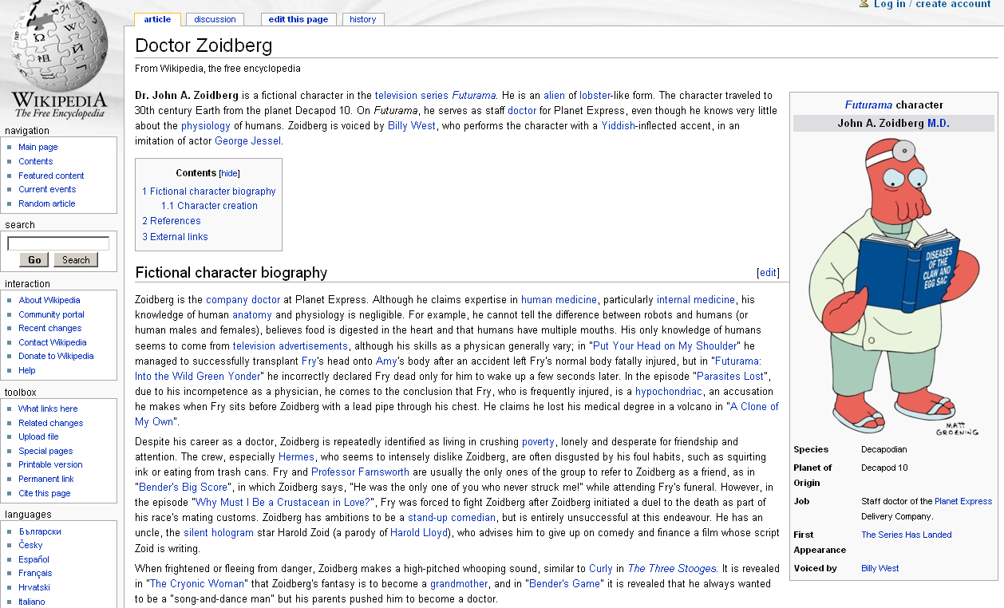
Can we watch a document growing?

Slide 27
Things to Learn from Revisions
How people cooperate when writing documents collaboratively
Detect spelling errors and grammatical errors
Recognize paraphrases
Learn sentence compression models
Learn text summarization models

Slide 28
eLearning Related Projects
  DFG Emmy-Noether Group „Mining Lexical-Semantic Knowledge from Dynamic and Linguistic Sources and Integration into Question Answering for Discourse-Based Knowledge Acquisition in eLearning“
  Lichtenberg Chair project „Educational Natural Language Processing“ (Volkswagen Foundation)
  Wikulu: Self-Organization in Wikis (Klaus-Tschira Foundation)

Slide 29
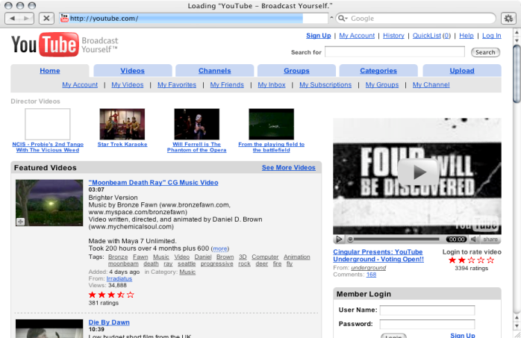
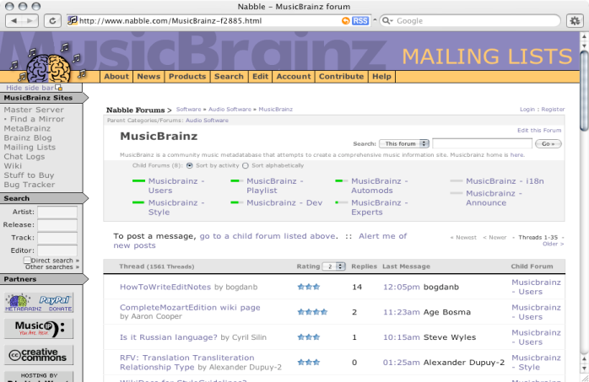
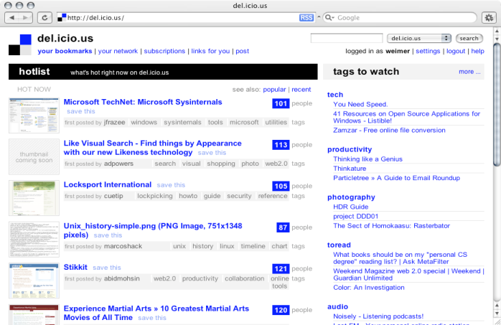
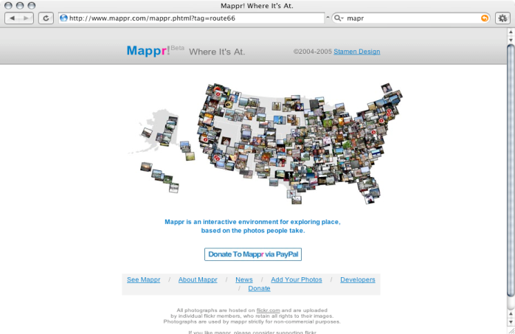
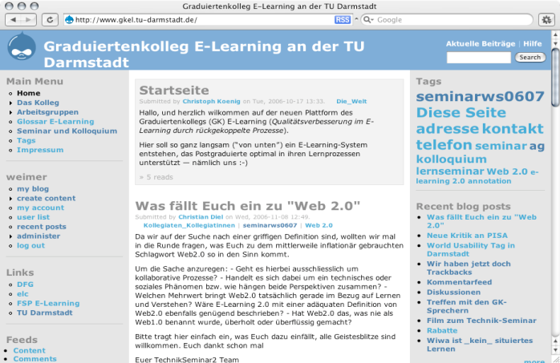
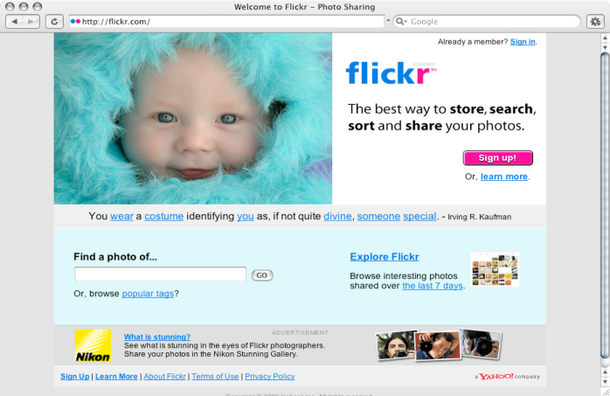
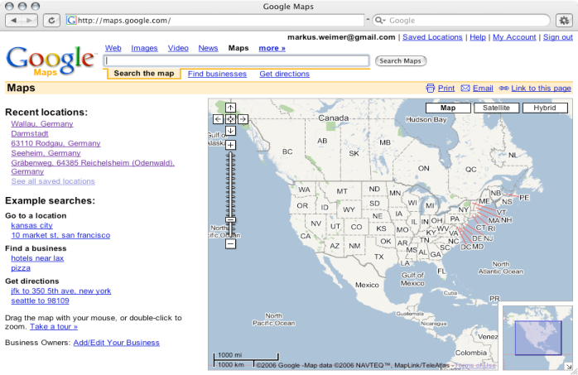
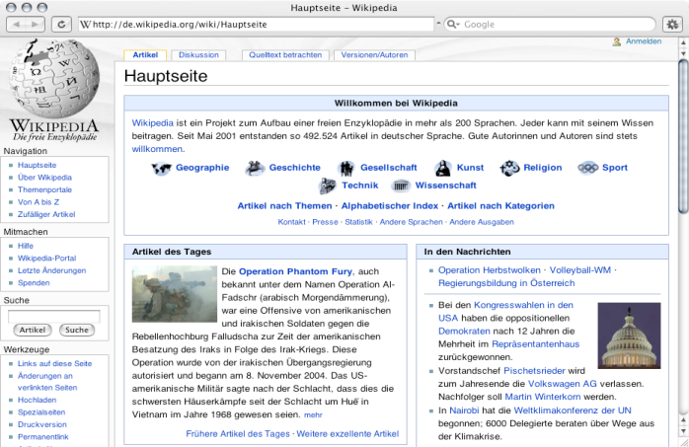
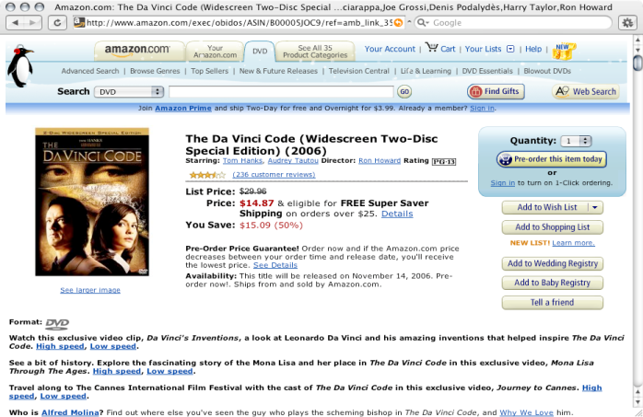
Related Research Topics
Web-based Knowledge Processes
Authoring Environments
Information Search
Information Management
Collaborative Writing
Notes:
29

Slide 30
Some Observations
  Information search, information management and content authoring skills of an individual are crucial to education
  Some technology-related changes:
    Individual authoring versus collaborative authoring
    Linking, merging, structuring of information
  Distributed information management in web-based environments requires additional skills not yet acquired as part of conventional education

Slide 31
Wikulu: Goals
  Create intuitive interface to support users with their day-to-day tasks in a wiki
  Adapt and integrate natural language processing methods to wikis
  Support multiple wiki platforms

Slide 32





Major Wiki Related Challenges
Searching
Organizing
    M. Buﬀa: Intranet Wikis
    Proceedings of the IntraWebs Workshop 2006 at the 15th International World Wide Web Conference.
Notes:
Two major complaints (by 15 computer scientists)

Slide 33
Wiki User Survey -
15 participants, Computer Scientists
Wiki refactoring capabilities (5 Votes)
Finding information (4 Votes)
Old content stays in the Wiki (3 Votes)
Bad editor (2 Votes)
Merging related pages is difficult (1 Vote)
Navigation is slow (1 Vote)
Barely readable notifications (1 Vote)
No templates (1 Vote)
Lack of import capabilities (1 Vote)

Slide 34
Wiki User Survey -
15 participants, Computer Scientists
Addressed by Wikulu
Wiki refactoring capabilities (5 Votes)
Finding information (4 Votes)
Old content stays in the Wiki (3 Votes)
Bad editor (2 Votes)
Merging related pages is difficult (1 Vote)
Navigation is slow (1 Vote)
Barely readable notifications (1 Vote)
No templates (1 Vote)
Lack of import capabilities (1 Vote)

Slide 35
Innovative Ideas
Send actions / content by email (6 Votes)
Wiki personalization / recommendations (3 Votes)
Better editor (2 Votes)
  Feature: formulation editor like Latex
  Page creation wizards, better templates
  Image map: to create overview maps (1 Vote)
Find pages similar to current page (1 Vote)
Better notifications / history (1 Vote)

Slide 36
Innovative Ideas
Addressed by Wikulu
Send actions / content by email (6 Votes)
Wiki personalization / recommendations (3 Votes)
Better editor (2 Votes)
  Feature: formulation editor like Latex
  Page creation wizards, better templates
  Image map: to create overview maps (1 Vote)
Find pages similar to current page (1 Vote)
Better notifications / history (1 Vote)

Slide 37
Innovative Ideas
Addressed by Wikulu
( Send actions / content by email ) (6 Votes)
Wiki personalization / recommendations (3 Votes)
Better editor (2 Votes)
  Feature: formulation editor like Latex
  Page creation wizards, better templates
  Image map: to create overview maps (1 Vote)
Find pages similar to current page (1 Vote)
Better notifications / history (1 Vote)

Slide 38
Types of User Interaction
  Adding Content
  Organizing Content
  Finding Content

Slide 39
ADDING CONTENT
User Interaction

Slide 40


Adding Content:
Detect Duplicate Content
!

Slide 41
Adding Content:
Suggest Points of Insertion

Slide 42
Adding Content:
NLP Algorithms
  Text similarity [Zesch et al., 2008]
    Highly similar documents might be duplicates
    ... or possible places for adding the new content
  Text segmentation [Choi et al., 2001]
    Find specific position for inserting new text by segmenting page into coherent topics

Slide 43
ORGANIZING CONTENT
User Interaction

Slide 44
Organizing Content:
Suggest Links

Slide 45

Organizing Content:
Suggest Tags
CHICAGO, Oct 29 - Kraft Foods Inc and Kellogg Co posted better-than-expected third-quarter profits on Wednesday as price increases and new products helped lift sales in a weak economy. Kraft also stood by its forecasts for 2008 earnings before one-time items as well as for 2009 net income, while Kellogg said its profit this year should hit the high end of its previous targeted range. Both Kraft, the largest North American food maker, and Kellogg, the world's largest cereal company, have taken steps to cut costs and put more money into advertising. Both have also bolstered new product development to attract consumers even as rising commodity costs pushed them to raise prices. Commodities like wheat and energy have become less expensive in recent months, but food companies may not see a big benefit until next year, in part because they lock in their costs months ahead. Kraft, which makes Oreo cookies, Tang breakfast drink and Oscar Mayer hot dogs, reported a profit of 45 cents a share before one-time items, a penny above what analysts polled by Reuters Estimates had expected.

Slide 46
Organizing Content:
Suggest Page Split/Merge

Slide 47
Organizing Content:
NLP Algorithms
  Link detection [Green, 1999]
    Suggest similar content as link target
  Keyphrase extraction [Mihalcea & Tarau, 2004]
    Propose important keyphrases as possible tags
  Text segmentation [Choi et al., 2001]
    Find coherent topics in a page to propose splits
  Text similarity [Zesch et al., 2008]
    Find scattered pages similar enough to merge

Slide 48
FINDING CONTENT
User Interaction

Slide 49
Finding Content:
Recall-Oriented Search
Wiki
„problem“
„issue“

Slide 50
Finding Content:
Show Related Pages While Browsing

Slide 51
Finding Content:
NLP Algorithms
  Text similarity [Zesch et al., 2008]
    Improve search recall by taking into account term similarity to find additional relevant pages
    Show related pages while browsing

Slide 52
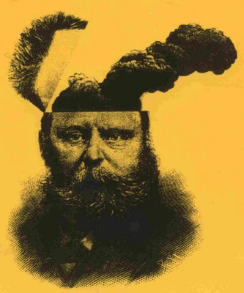
Example Use Case: Authoring Content
No Support
Search for the content
If available, do not add, or simply enhance
If not available, merge with a page where it fits or create new page
Link the new content
Add tags
Wikulu
Enter the content
Look at suggestions
  Check if similar pages already contain content
  Check suggestions for adding content to appropriate pages
  Check link suggestions
  Check tag suggestions
Mental Effort

Slide 53
  Now digging into the Link Discovery

Slide 54
The Need for Automatic Link Discovery
Growth
Everything is known, finding targets is easy
?
Where to link to?
Notes:
Adding links to documents is not trivial
Impossible to have a „grand view“ of large document collections
No knowledge of potential link targets
Especially problematic in large and dynamic collections, e.g. wikis

Slide 55
Automatic Link Discovery
Semantic Relatedness

Slide 56
Examples of Wiki Content
Wikipedia
  General knowledge encyclopedia
  Dense link structure
  5000 orphans out of ~2.7 million documents
Te Ara
  Encyclopedia about New Zealand
  No links
  438 articles (~3000 files)
    all articles should be linked
  Highly structured articles

Slide 57
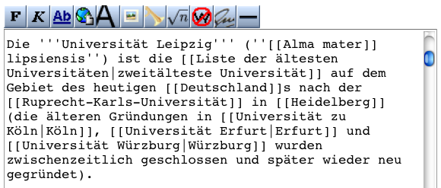
Link Ancors & Link Targets

Slide 58
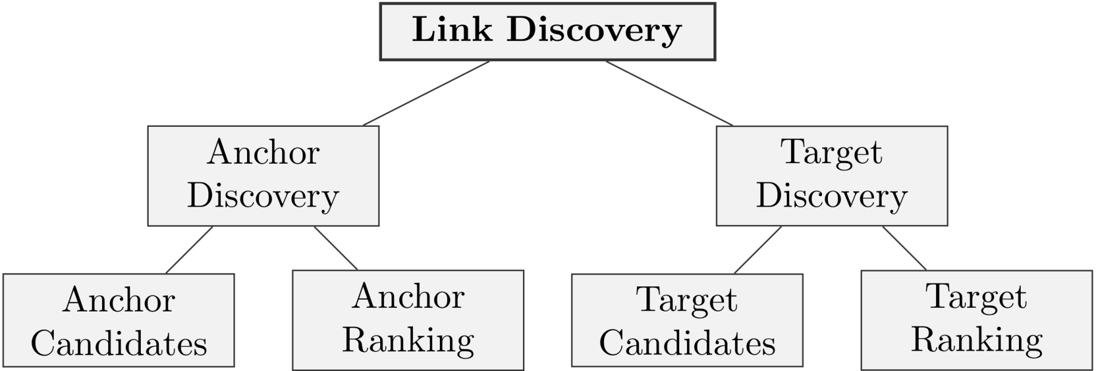
Methods of Link Discovery

Slide 59
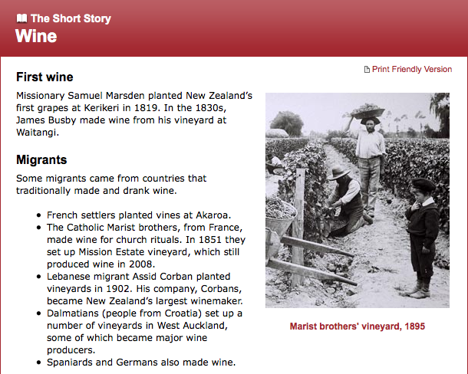
Identifying Anchor Candidates
No links
  Document title
  Section titles
  N-Grams
  Noun phrases
Existing links
  Anchor phrases

Slide 60
Identifying Anchor Candidates
No links
  Document title
  Section titles
  N-Grams
  Noun phrases
Existing links
  Anchor phrases

Slide 61
Identifying Anchor Candidates
No links
  Document title
  Section titles
  N-Grams
  Noun phrases
Existing links
  Anchor phrases

Slide 62
Identifying Anchor Candidates
No links
  Document title
  Section titles
  N-Grams
  Noun phrases
Existing links
  Anchor phrases

Slide 63
Identifying Anchor Candidates
No links
  Document title
  Section titles
  N-Grams
  Noun phrases
Existing links
  Anchor phrases

Slide 64
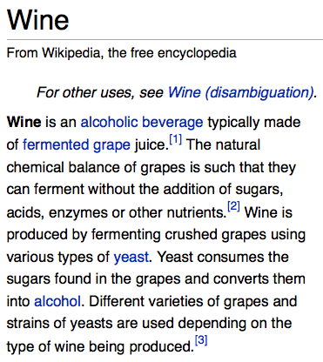
Identifying Anchor Candidates
No links
  Document title
  Section titles
  N-Grams
  Noun phrases
Existing links
  Anchor phrases

Slide 65
Anchor Candidate Ranking
Without links
  Term frequency and specificity measure, e.g. TF.IDF
Using links
  Keyphraseness (Mihalcea & Csomai, 2007)
  Maximum Association Strength

Slide 66
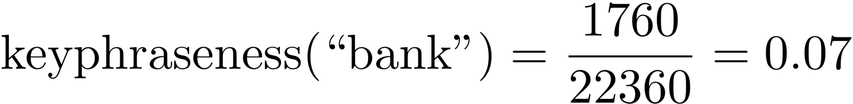
Keyphraseness Example: “bank”
“bank” used as anchor in 1780 documents
“bank” occurs in 22360 documents

Slide 67

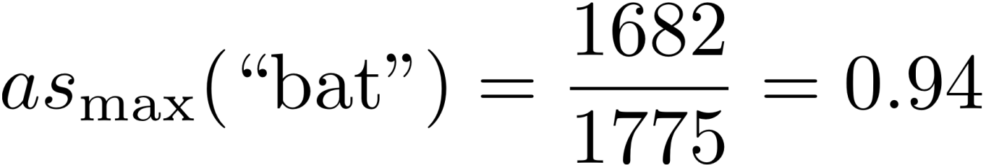
Example : “bat”
“bat” used in 1775 documents
targets
  Bat (1682)
  Baseball bat (34)
  Cricket bat (33)
  ...

Slide 68
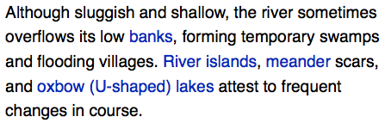
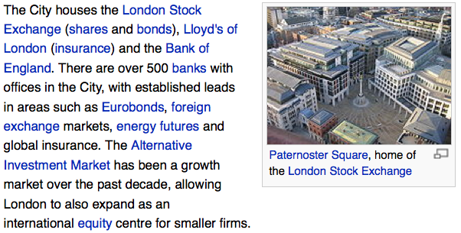
Link Target Candidates
Existing Link Targets
Geography of Paraguay
City of London
Bank_(geography)
Bank

Slide 69
Identifying Good Target Candidates
Using previous knowledge of links in the system
  Targets of existing link anchors
Using information retrieval
  Full-text search for the anchor to find targets
  Semantic information retrieval, taking into account the semantic relatedness between words
  Search in the complete document collection or only in parts of it (e.g. document titles, section titles, ...)

Slide 70
Preliminary Results:
Wikipedia Outgoing File-to-File Links
TF.IDF/Most Frequent: 16.3%

Slide 71
Wikulu Demonstration

Slide 72
Current Directions
Now that we have enhanced technology for wikis, investigate their usefulness and acceptance by users
Diploma Thesis by Fabian Tamin. Creating Wiki Page Overview Snippets. Diploma Thesis. Computer Science Department. Technische Universität Darmstadt. 2009
Cooperation with Prof. Dr. Nina Keith (Fachbereich 3, Psychology)
  Bachelor Thesis by Christopher Schwarz. Do overview snippets improve information search in the World Wide Web? Institut für Psychologie. Technische Universität Darmstadt.

Slide 73
Discussion
New technologies require new skills, e.g. link authoring as part of the collaborative writing process
Information search, information management, collaborative authoring are inherent parts of modern education
Training to acquire these new skills is part of education
Innovative language technologies yield novel learning environments
How to make them really useful in education?
Thank you very much for your attention!

